Slide 1
4: Uncertainty and Probability
“The scientist has a lot of experience with ignorance and doubt and uncertainty, and this experience is of very great importance, I think.
When a scientist does not know the answer to a problem, he is ignorant. When he has a hunch as to what the result is, he is uncertain. And when he is pretty damn sure of what the result is going to be, he is still in some doubt.
We have found it of paramount importance that in order to progress, we must recognize our ignorance and leave room for doubt.”
Richard Feynman, 1988

Slide 2
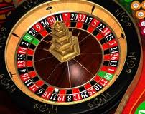
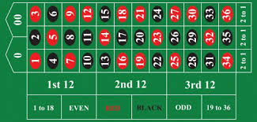

Slide 3
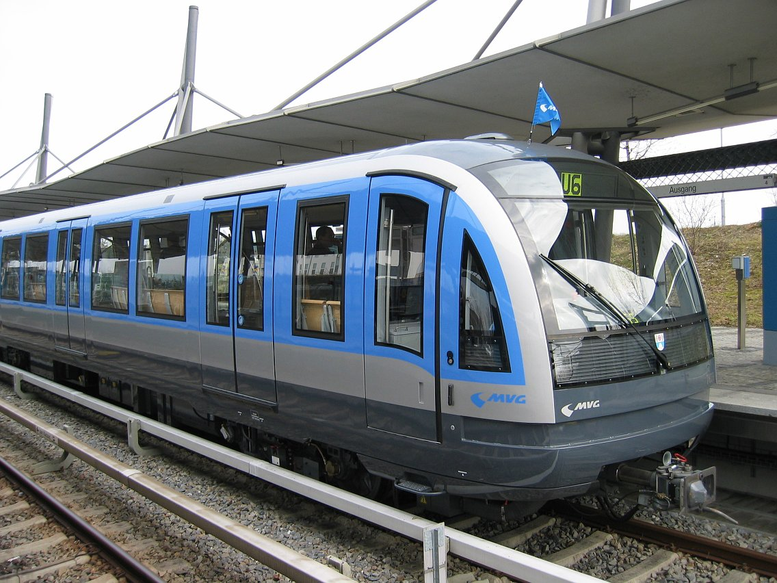
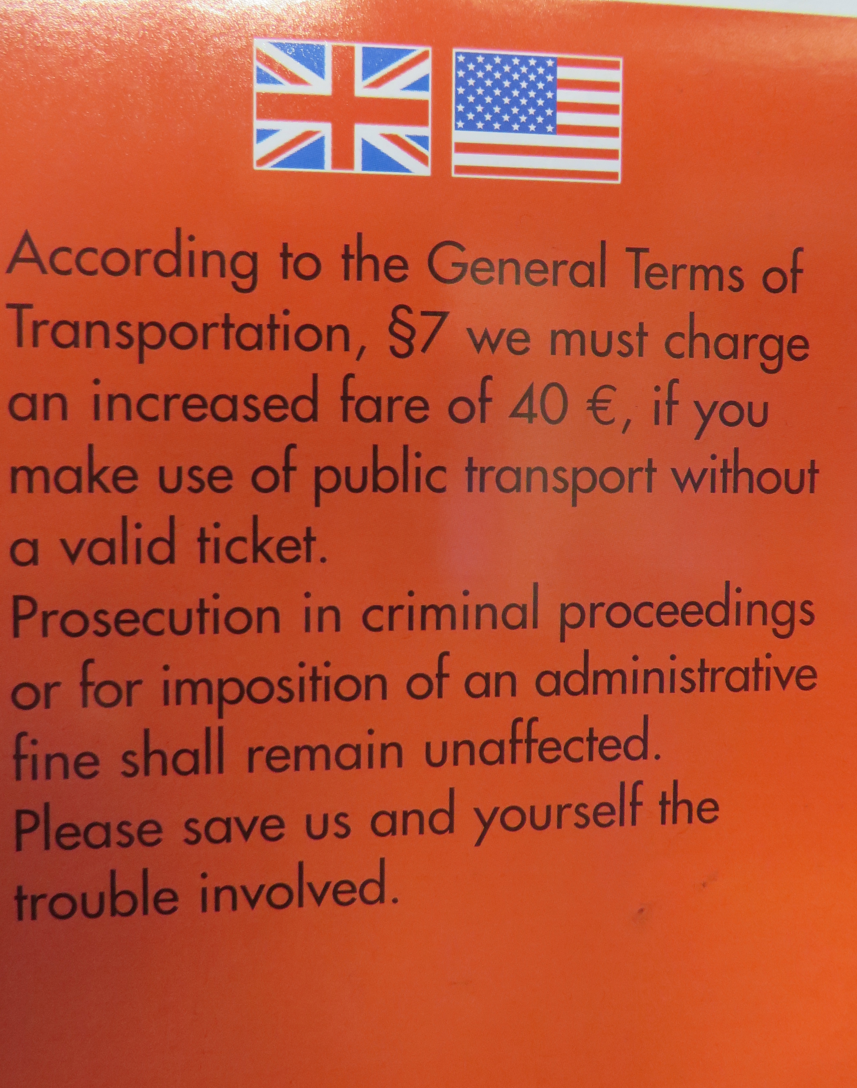
CQ: If you are caught riding the U-bahn without a ticket, you will be fined 40 Euros. What is the expected cost of getting caught? If a ticket costs 2 Euros, does it make sense to buy a ticket? Do you buy a ticket? Why or why not?

Slide 4
CQ:
Flip a coin twice and record the outcome – did you get at least one head?
Combine all of class’ tosses to see what fraction came up heads

Slide 5
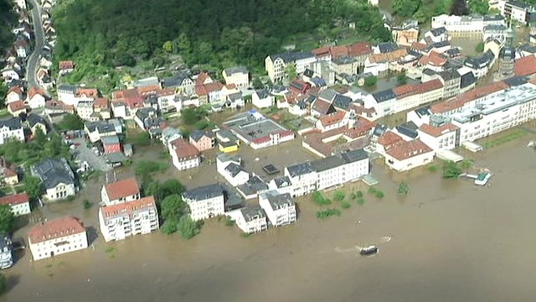
BBC 6 June 2013

Slide 6
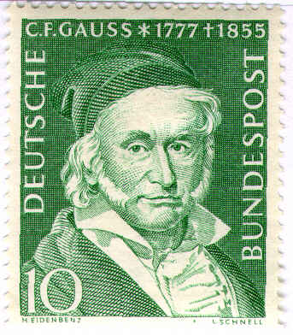
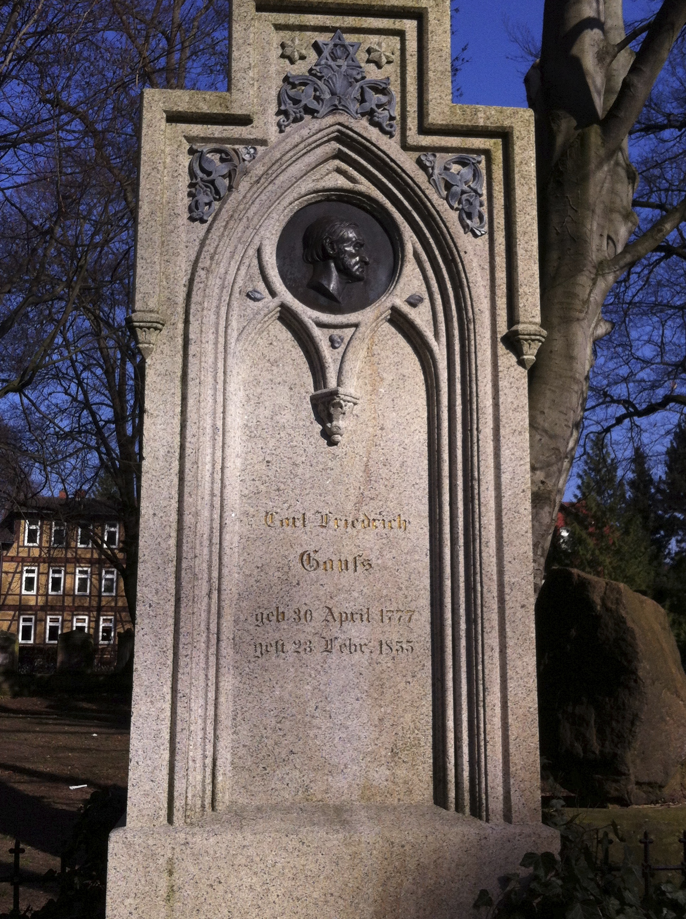
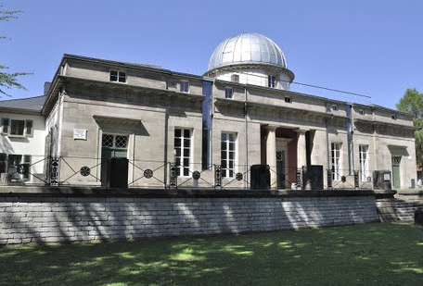

Slide 7
Gaussian distribution
PAN 4.1: Probability of observing specific values from a Gaussian parent distribution.

Slide 8
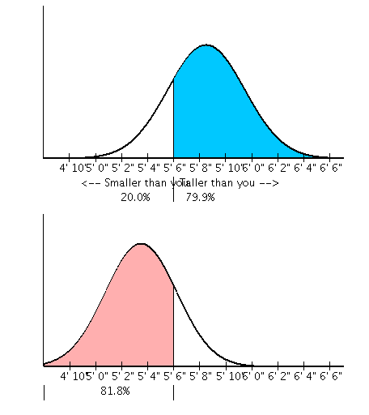
Distribution of heights: men vs women
Men
Women

Slide 9
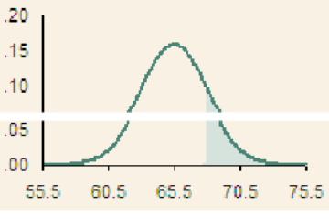
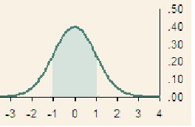
EXCEL: normal distribution

Slide 10
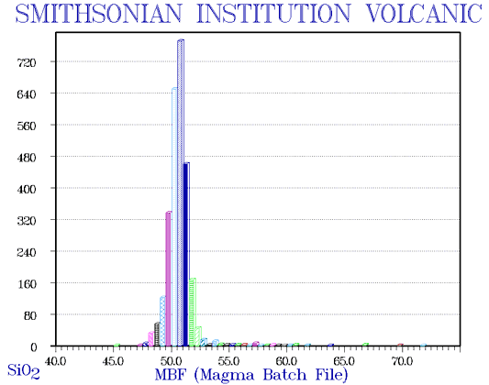
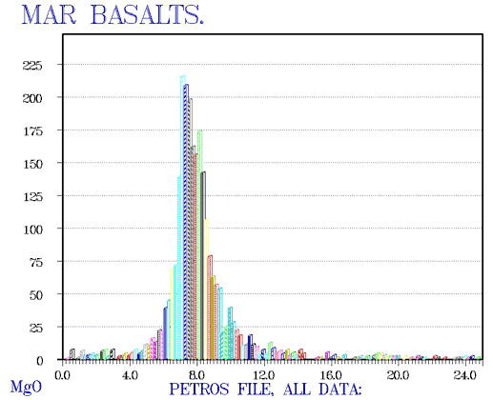
Oceanic crust variability
Basalt generally has a composition of 45-55 wt% SiO2, 2-6 wt% total alkalis, 0.5-2.0 wt% TiO2, 5-14 wt% FeO and 14 wt% or more Al2O3. Contents of CaO are commonly near 10 wt%, those of MgO commonly in the range 5 to 12 wt%.
http://www.geokem.com/earths_average_composition.html

Slide 11
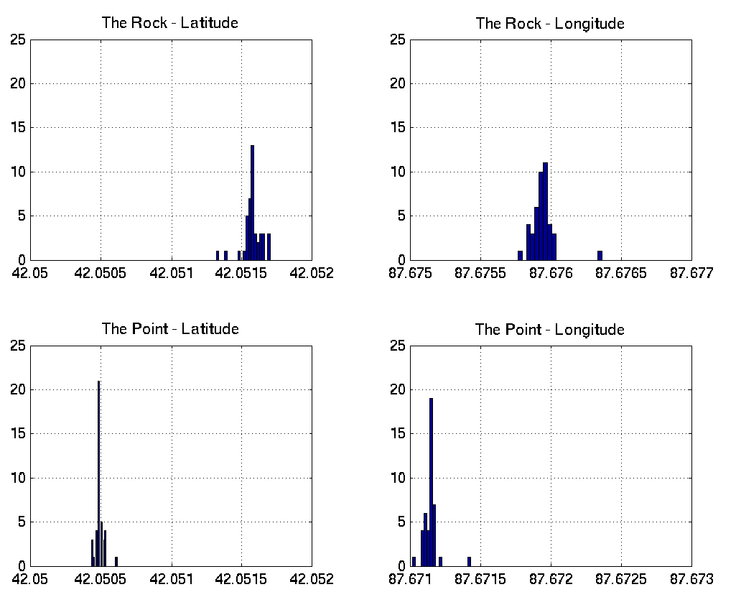
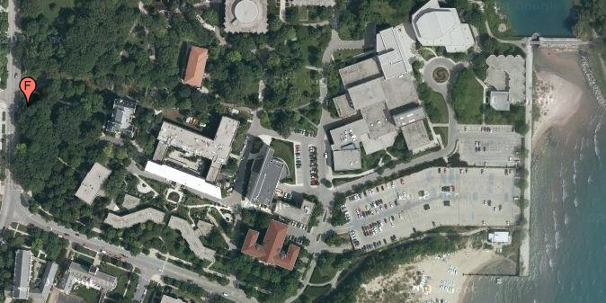

Slide 12
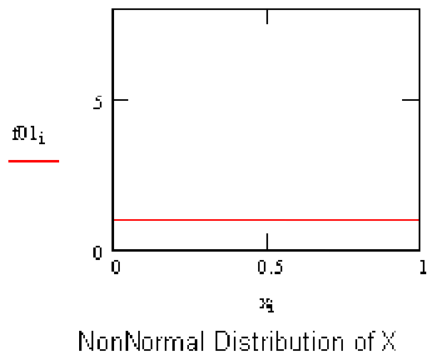
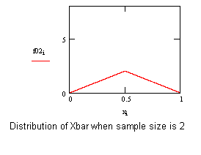
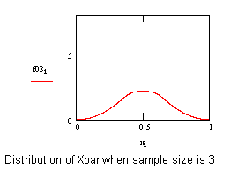
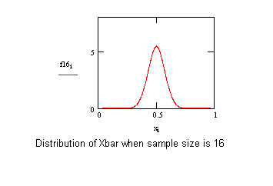
Numerical demonstration of Central Limit Theorem
Starting nonnormal distribution
Sum of two-point averages
Sum of 3-point averages
Sum of 16-point averages
http://www.statisticalengineering.com/central_limit_theorem.htm

Slide 13
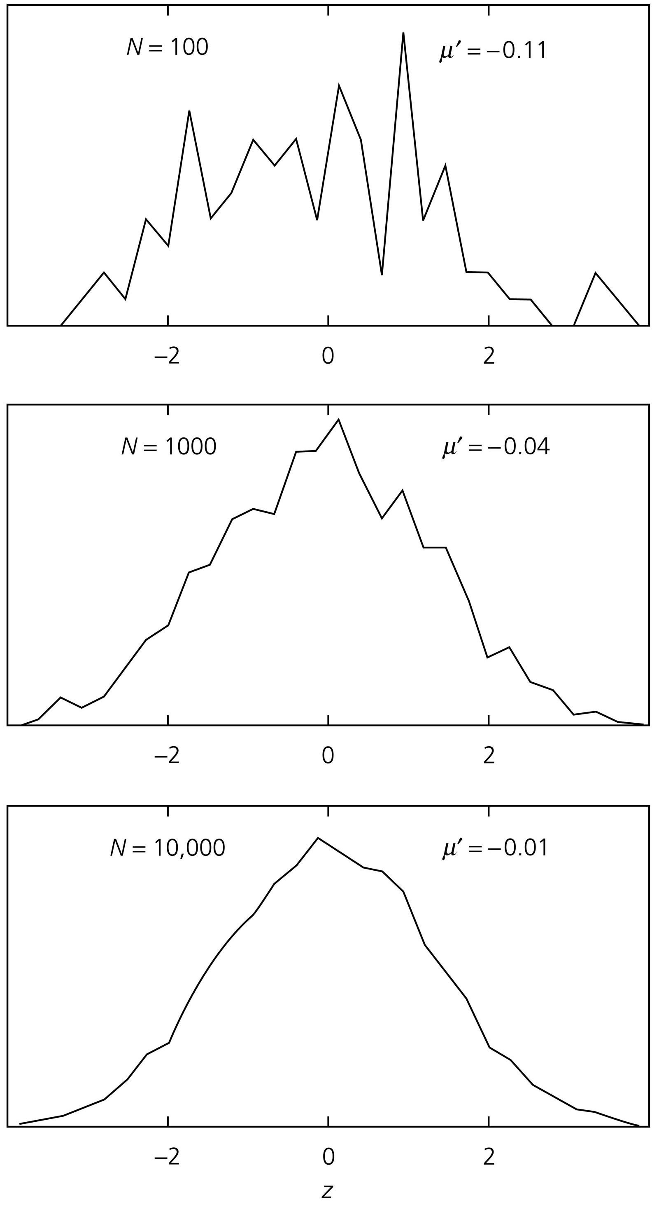
PAN 4.2: Histogram of the results of drawing N samples from a Gaussian parent distribution with mean zero and a unit standard deviation.
For small numbers of samples the observed distribution can look quite different from the parent distribution and the sample mean μ' differs from that of the parent distribution.
As the number of samples increases, the observed distribution looks increasingly like the parent distribution. (Stein and Wysession, 2003)

Slide 14
PAN 4.3: Maximum rate of motion in and across the New Madrid seismic zone shown by successively more precise GPS measurements. (Calais and Stein, 2009)

Slide 16
CQ: A challenge for medical researchers involves "cancer clusters," communities that have higher-than-expected cancer rates. Some clusters would be expected to occur purely from chance, because of 100 communities, 5% should have rates that are significantly higher at 95% confidence, etc. How could one try to identify which clusters result from factors other than chance?

Slide 17
Shallow uncertainty - we don’t know what will happen, but know the odds (pdf). The past is a good predictor of the future. We can make math models that work well.
Deep uncertainty - we don’t know the odds (pdf). The past is a poor predictor of the future. We can make math models, but they won’t work well.

Slide 18
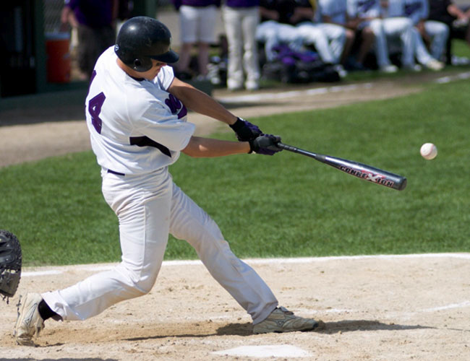
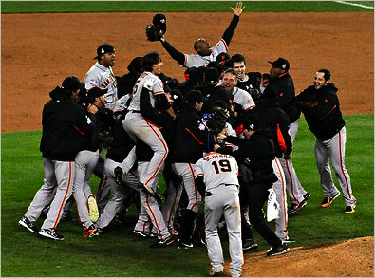
Shallow uncertainty is like estimating the chance that a batter will get a hit. His batting average is a good predictor.
Deep uncertainty is like trying to predict the winner of the World Series next baseball season. Teams' past performance give only limited insight into the future.

Slide 19
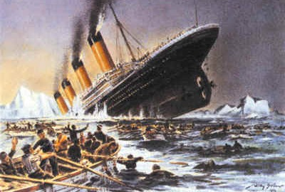
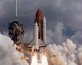
Due to deep uncertainty Predicted natural or other disaster probabilities are often very inaccurate The world is more complicated than we think or admit
Prob(sinking) = 0
Expected Prob(loss) = 1/100,000
Actual ~ 2/100 : 2000 x

Slide 20
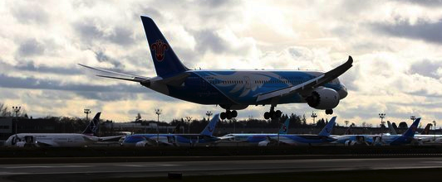
Boeing 787 Dreamliner batteries
Boeing “concluded that they were likely to emit smoke less than once in every 10 million flight hours.

Slide 21
Boeing 787 Dreamliner batteries
Boeing “concluded that they were likely to emit smoke less than once in every 10 million flight hours.
Once the planes were placed in service, the batteries overheated and emitted smoke twice, and caused one fire, after about 50,000 hours of commercial flights.” (NYT, 2/7/13)

Slide 22
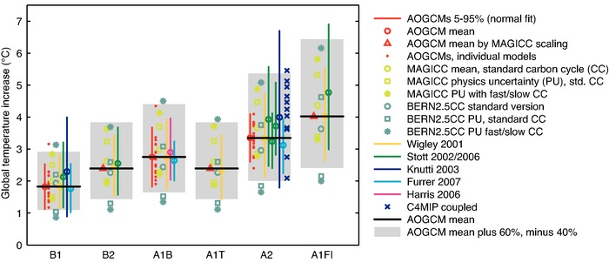
PAN 5.2: Comparison of the rise in global temperature by the year 2009 predicted by various climate models. For various scenarios of carbon emissions - B1, B2, , etc. - the vertical band shows the different predicted warming. (IPCC, 2007)

Slide 23
“Some of the most troubling risk management challenges of our time are characterized by deep uncertainties.
Well-validated, trustworthy risk models giving the probabilities of future consequences for alternative present decisions are not available
The relevance of past data for predicting future outcomes is in doubt; experts disagree about the probable consequences of alternative policies – or, worse, reach an unwarranted consensus that replaces acknowledgment of uncertainties and information gaps with groupthink
Policymakers (and probably various political constituencies) are divided about what actions to take to reduce risks
Passions run high and convictions of being right run deep in the absence of enough objective information to support rational decision analysis “
Cox (2012)

Slide 25
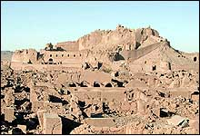
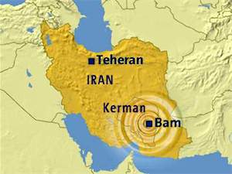
CQ: In 2003, a magnitude 6.6 earthquake destroyed much of the city of Bam, Iran. Much of the city, including its famous 2000-year-old citadel, was made of mud brick that is very vulnerable to earthquake shaking and thus was seriously damaged. What insights does the city's history give for how often on average such earthquakes happen? What can you say and not say?
M 6.6 27,000 deaths

Slide 26
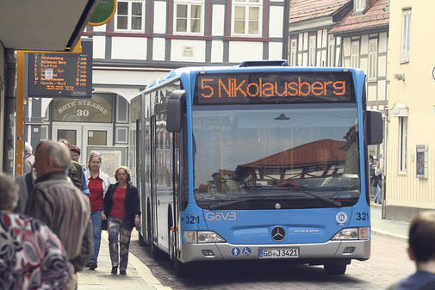
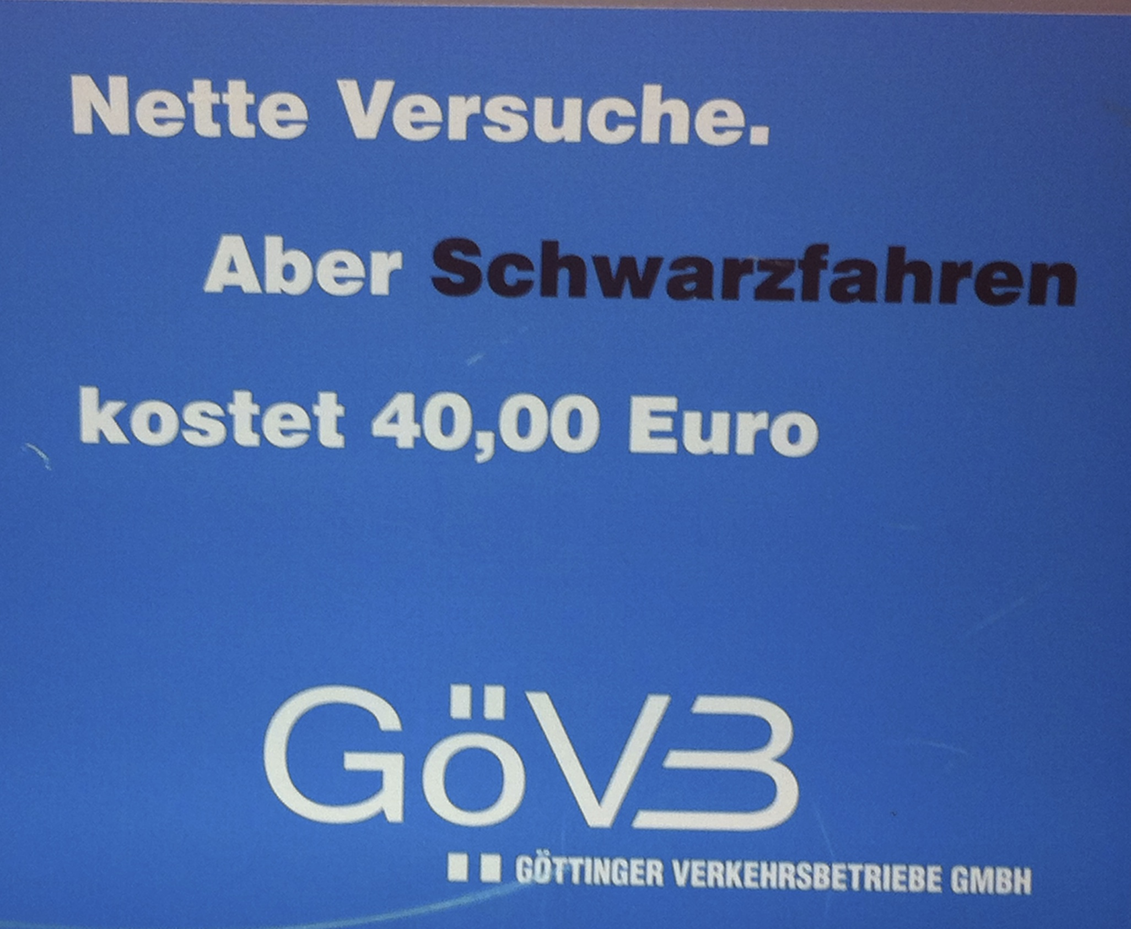
CQ: If you are caught riding the bus without a ticket, you will be fined 40 Euros. What is the expected cost of getting caught? If a ticket costs 2 Euros, does it make sense to buy a ticket? Do you buy a ticket? Why or why not?

