Slide 1
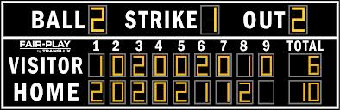
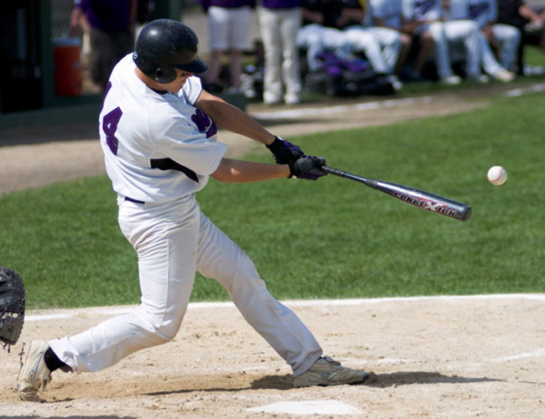
3: Nature Bats Last

Slide 2
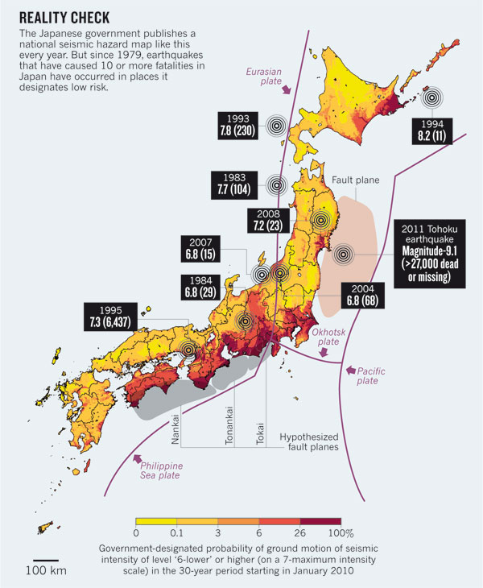
In Shakespeare's Henry IV,
Glendower says "I can call spirits from the vasty deep”
Hotspur replies "Why, so can I, or so can any man; but will they come when you do call for them?”
Similarly, we make detailed hazard assessments, but often nature acts differently
Geller 2011
Low
Hazard
predicted

Slide 3
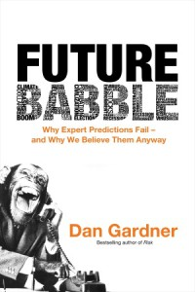
"They're wrong a lot, these experts.
History is littered with failed predictions.
Whole books can be filled with them. Many have."

Slide 4
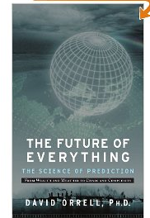
"While scientists have had great success in squinting through microscopes at the smallest forms of life, or smashing atoms together in giant particle accelerators, or using telescopes to look forward in space and backwards in time at the formation of distant galaxies,
their visions into the future have been blurred and murky. As a result, projections tend to go astray."

Slide 5
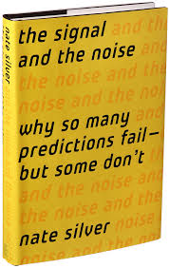
"The most calamitous failures of prediction usually have a lot in common. We focus on the signals that tell a story about the world as we would like it to be, not how it really is...
We make approximations and assumptions about the world that are much cruder than we realize. We abhor uncertainty, even when it is an irreducible part of the problem we are trying to solve."

Slide 6
"When you make a prediction that goes so badly, you have a choice of how to explain it. One path is to blame external circumstances - what we might think of as bad luck. Sometimes this is a reasonable choice or even the correct one.
When the National Weather Service says there is a 90% chance of clear skies, but it rains instead and spoils your golf outing, you can't really blame them. Decades of historical data shows that when the Weather Service says there is a 1 in ten chance of rain, it really does rain about 10% of the time.
This explanation becomes less credible when the forecaster does not have a history of successful predictions and when the magnitude of his error is larger. In these cases, it is more likely that the fault lies with the forecaster's model of the world and not with the world itself.”

Slide 7
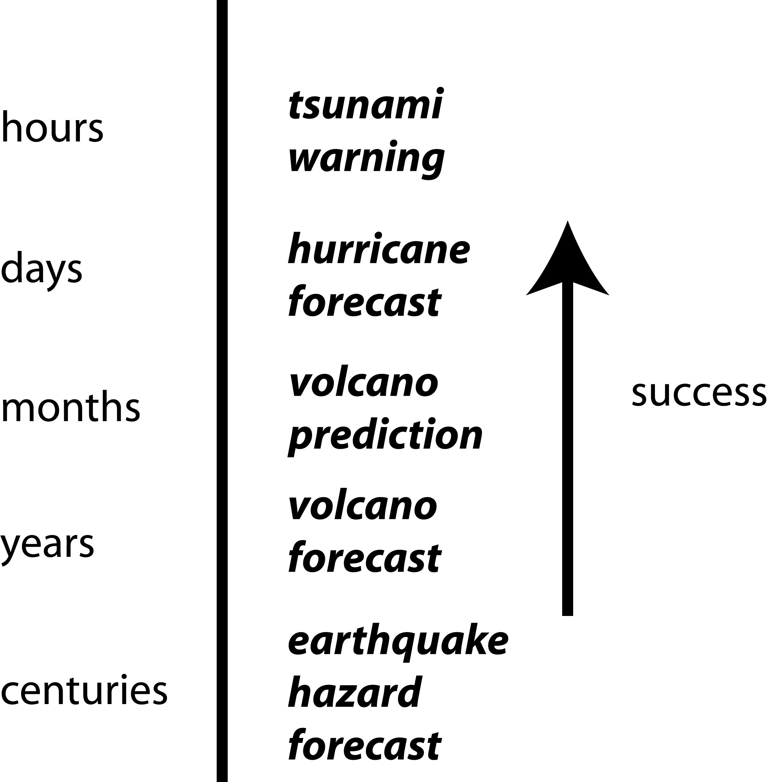
PAN 3.5

Slide 8
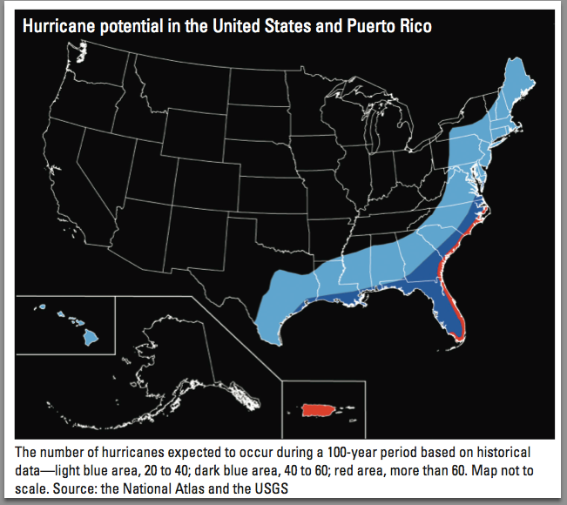
PAN 3.1

Slide 9
PAN 3.2: Volcanic hazard map for the Mount Rainier, Washington area. (USGS)
PAN 3.2

Slide 10
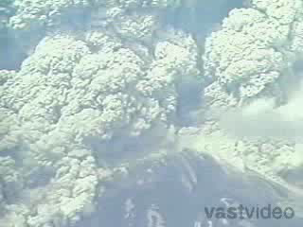
The area around Mt. St. Helens, Washington, was evacuated before the giant eruption of May 1980 (Figure 3.4), reducing the loss of life to only 60 people, including a geologist studying the volcano and citizens who refused to leave.

Slide 11
A false negative is an unpredicted or underpredicted hazard, which can cause loss of life and property. A false positive is an overpredicted hazard, which can waste resources spent on excessive mitigation and cause businesses to locate elsewhere.
PAN 3.3

Slide 12
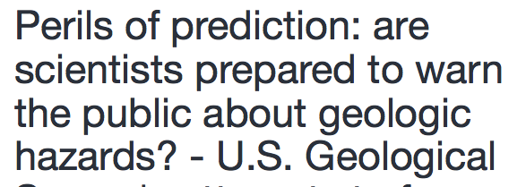
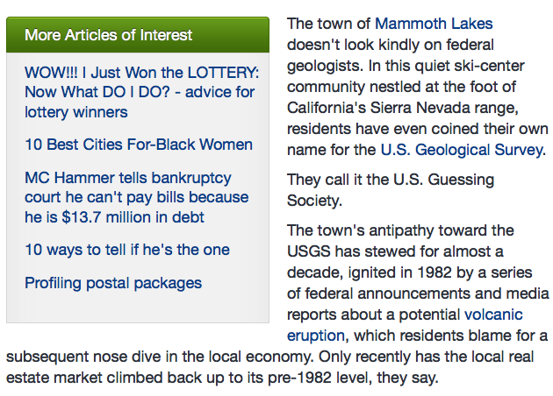
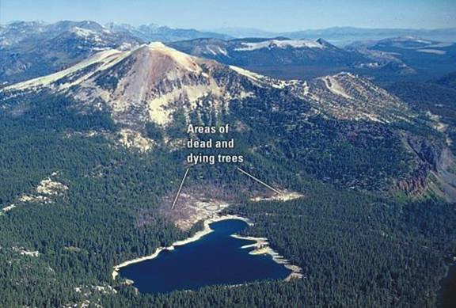
Science News
6/15/91
The local economy collapsed, said Glenn Thompson, Mammoth Lakes' town manager. Housing prices fell 40 percent overnight. In the next few years, dozens of businesses closed, new shopping centers stood empty and townspeople left to seek jobs elsewhere. (NYT 9/11/90)

Slide 13
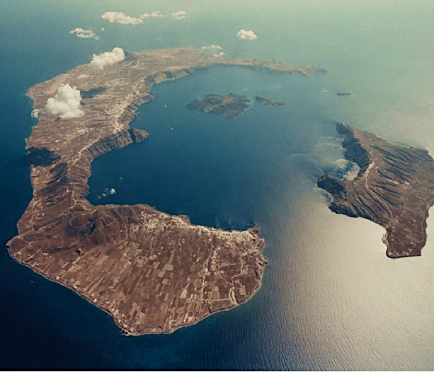
Santorini, Greece, Eruptions:
3 to 4 caldera eruptions in past 600 ka
Last caldera (Minoan) eruption
  ~1650 BC
  Likely from northern zone
Recent activity
  Over past 1000 yrs
  Small pyroclastic and phreatic eruptions dominated
  Forming Palea and Nea Kameni.
N
[Heiken and McCoy, 1984; Druitt et al., 1989 ], from A. Newman

Slide 14
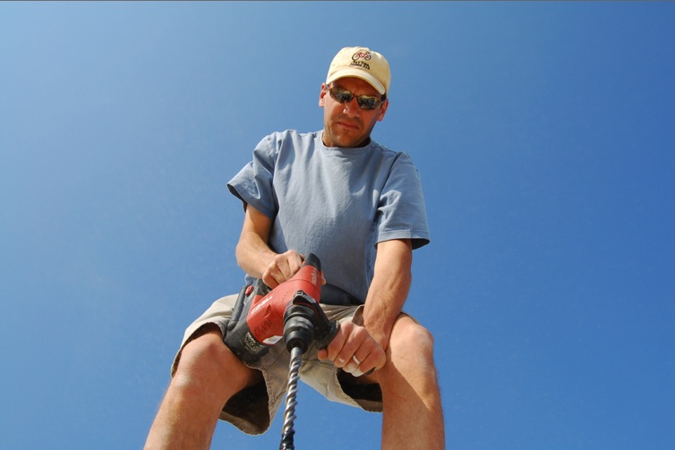
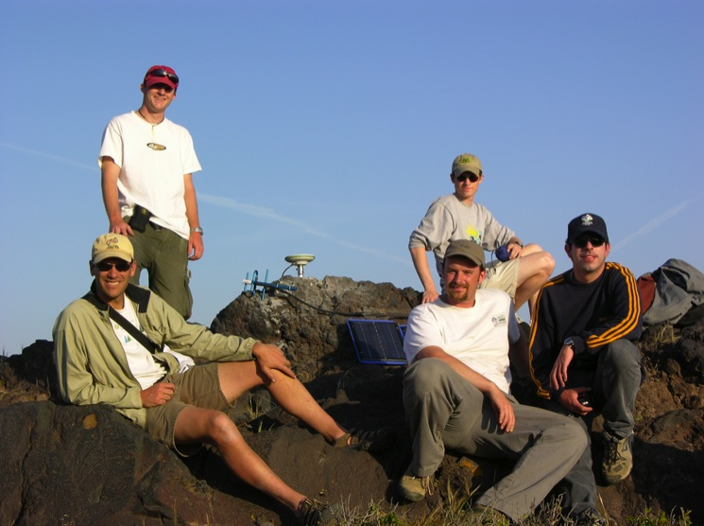
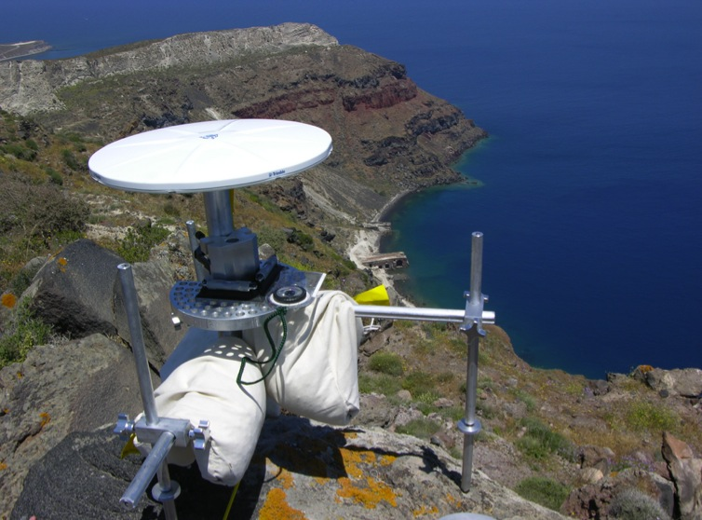
GPS surveys
2006, 2008, 2010
Photo from A. Newman, Georgia Tech

Slide 15
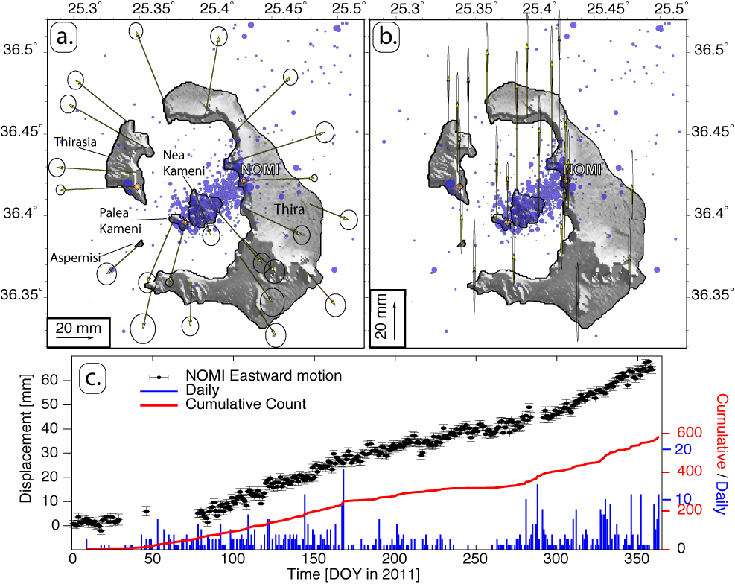
GPS & Seismicity show inflation
from A. Newman

Slide 16
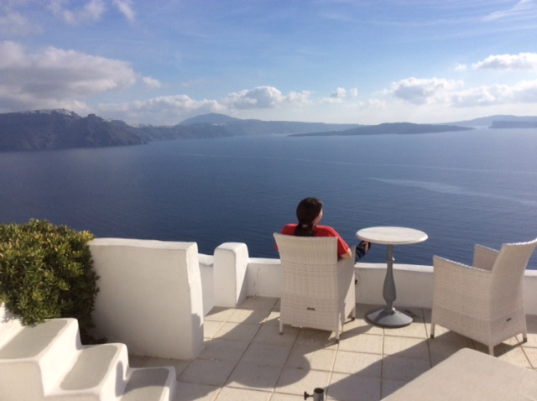
CQ: Imagine that the inflation continues, and a volcano alert issued, depressing vacation home prices by 50%
Some friends of yours are getting together to buy the house shown, at a huge discount.
Would you participate? Why or why not?

Slide 17
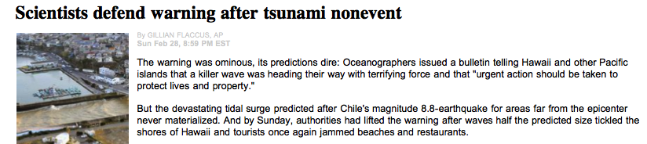
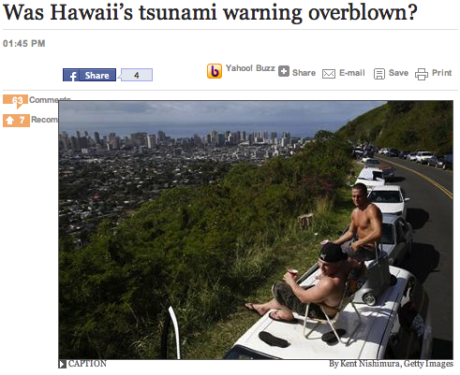

2/27/2010
Economic loss ?
What if weekday?

Slide 18
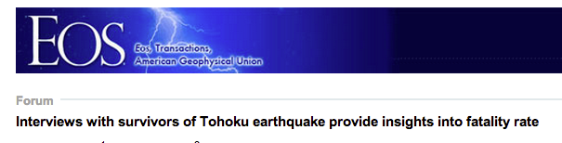
46, 411, 2011
Some coastal residents ignored the tsunami warning - which proved correct and actually underestimated the tsunami size - because of past false positives.
Researchers who interviewed residents noted that in the previous four years, sixteen warnings or alerts had issued for "small or even negligible tsunamis. These frequent warnings with overestimated tsunami height influenced the behavior of the residents."
As a result, new techniques are being introduced to give better real-time estimates of tsunami heights.

Slide 19
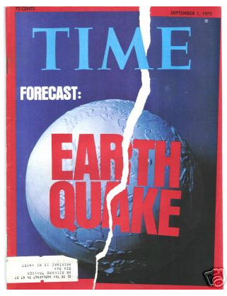
Traditional skepticism
“Only fools and charlatans predict earthquakes” Charles Richter (1900-1985)
1970’s optimism
Scientists will “be able to predict earthquakes in five years.”
Louis Pakiser , U.S. Geological Survey, 1971
“We have the technology to develop a
reliable prediction system already in hand.” Alan Cranston, U.S. senator, 1973
“The age of earthquake prediction is upon us” U.S. Geological Survey, 1975

Slide 20
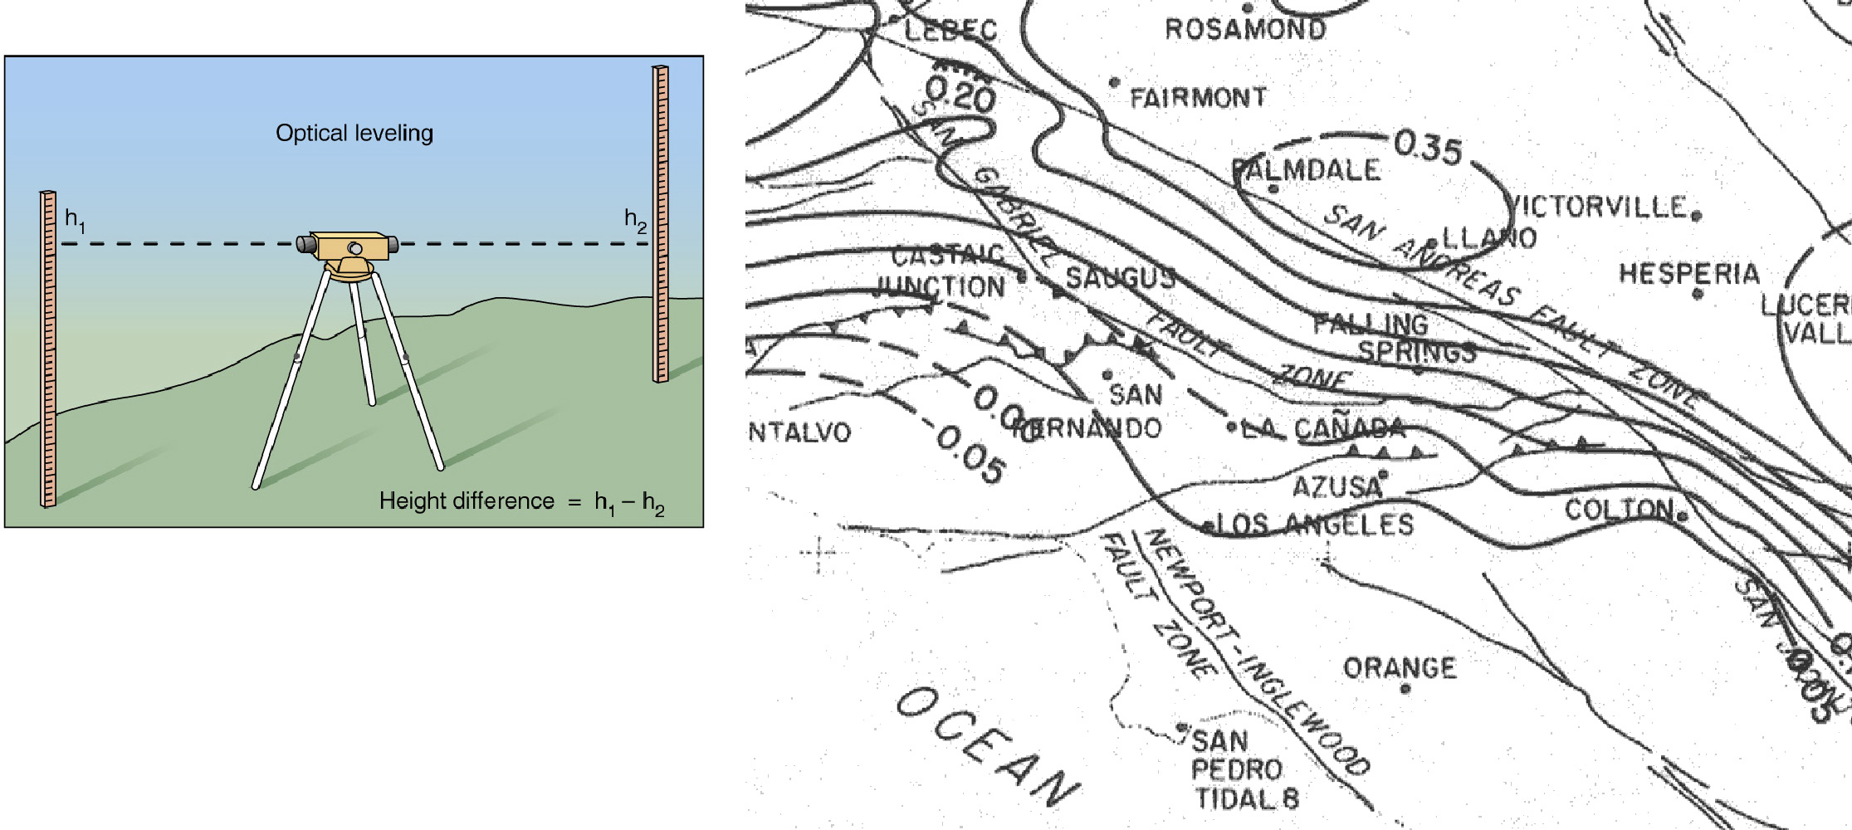
1975 PALMDALE BULGE – uplift reported
SAF
USGS director stated that “a great earthquake” would occur “in the area ... possibly within the next decade” that might cause up to 12,000 deaths, 48,000 serious injuries, 40,000 damaged buildings, and up to $25 billion in damage. California Seismic Safety Commission stated that “the uplift should be considered a possible threat to public safety” and urged immediate preparations…
39 years later, nothing yet..

Slide 21
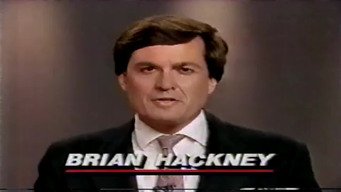

Slide 22
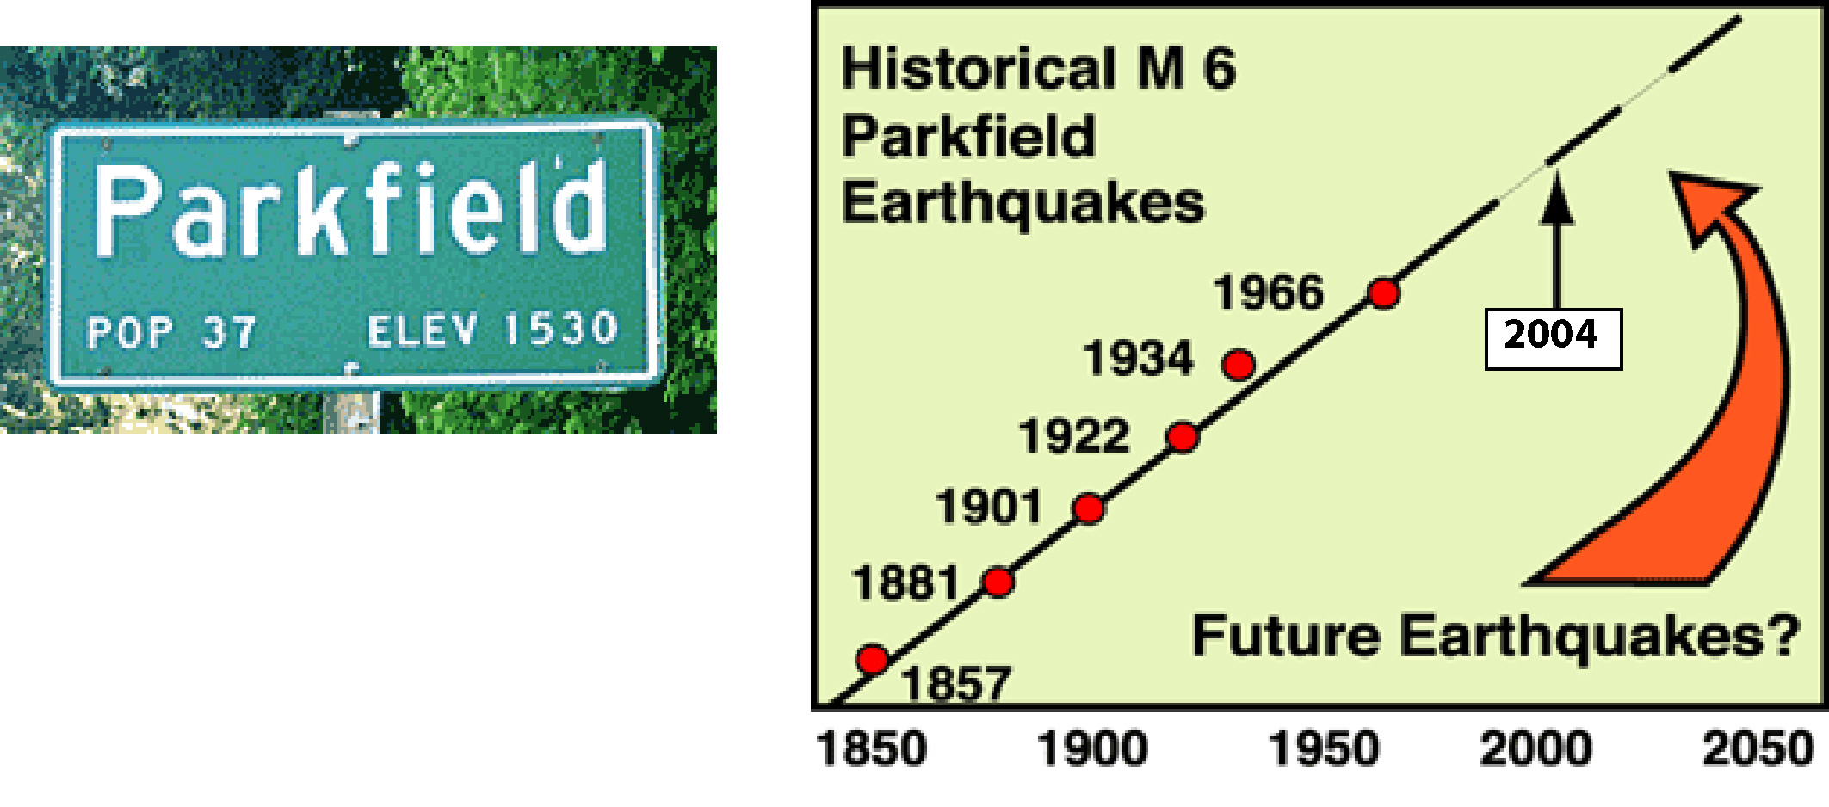
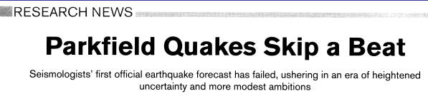
PARKFIELD, CALIFORNIA SEGMENT OF SAN ANDREAS
M 5-6 earthquakes about every 22 years: 1857, 1881, 1901, 1922, 1934, and 1966
In 1985, expected next in 1988; U.S. Geological Survey predicted 95% confidence by 1993
Occurred in 2004 (16 years late)
Discounting misfit of 1934 quake predicted higher confidence
Notes:
22

Slide 23
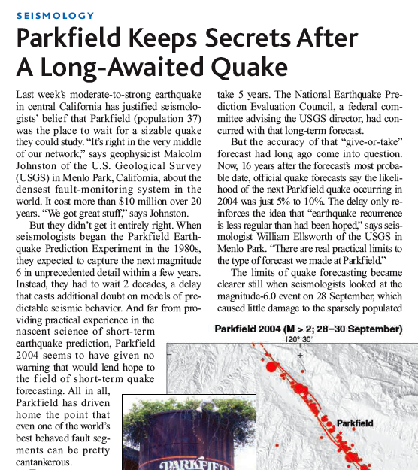
Science, 10/8//04
"Parkfield is geophysics' Waterloo. If the earthquake comes without warnings of any kind, earthquakes are unpredictable and science is defeated. " (The Economist)
No precursors in seismicity (foreshocks), strainmeters, magnetometers, GPS, creepmeter
$30 million spent on “Porkfield” project

Slide 24
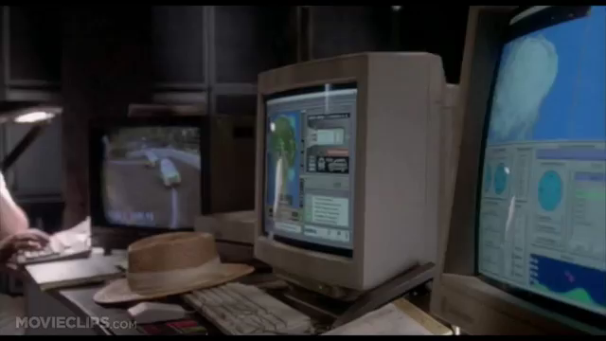
What’s going wrong?

Slide 25

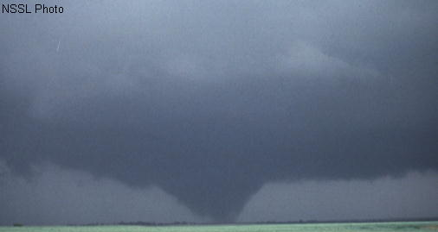
WHY CAN’T WE PREDICT EARTHQUAKES?
So far, no clear evidence for consistent changes in physical properties (precursors) before earthquakes.
Maybe lots of tiny earthquakes happen frequently, but only a few grow by random process to large earthquakes
In chaos theory, small perturbations can have unpredictable large effects - flap of a butterfly's wings in Brazil might set off a tornado in Texas
If there’s nothing special about the tiny earthquakes that happen to
grow into large ones, the time between large earthquakes is highly variable and nothing observable should occur before them.
If so, earthquake prediction is either impossible or nearly so.
Notes:
25

Slide 26
Starting values
Series 1: 0.750
Series 2: 0.749
PAN 3.8

Slide 27
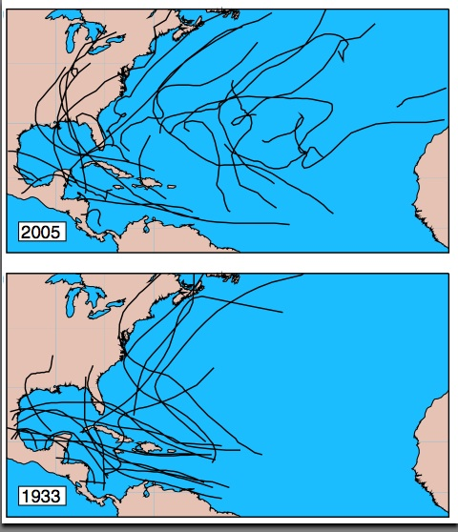
Insights from weather forecasting
Admit fundamental limits to how accurate forecasts can be.
If weather weren’t chaotic, every year storms would form on the same date & follow the same tracks
(Lorenz, 1995)
PAN 3.9

Slide 28
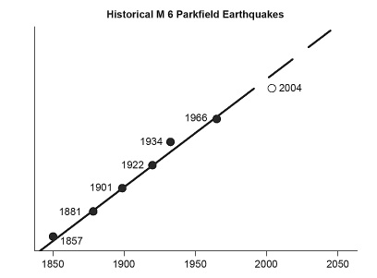
CQ: How might you try to determine whether the fact that earthquakes near Parkfield occurred for a while about 22 years apart reflects an important aspect of the physics of this particular part of the San Andreas, or just an apparent pattern that arose by chance?

