Slide 1
10: Assessing Hazards
"There are known knowns. These are things we know that we know. There are known unknowns. That is to say, there are things that we know we don't know. But there are also unknown unknowns. There are things we don't know we don't know."
U.S. Secretary of Defense Donald Rumsfeld

Slide 2
A natural hazard is not a physical quantity that can be measured. Instead it is a numerical metric chosen for use in mitigation planning and then estimated using a combination of data, the historical record, and models that are assumed to describe aspects of the process in question. As a result, how large a hazard is depends first on how it is defined.
Planning for floods, for example, is based on the water level expected on average at least once in a certain time period, typically 100 or 500 years, or equivalently at a certain probability in a given year. Depending on the application, different measures can be used. Following coastal flooding in 1953 that killed over 1,800 people, the Netherlands has installed systems to protect again the largest flood expected every 10,000 years. The same storm led to the construction of a moveable barrier in the Thames River, designed to protect London from flooding by the largest storm surge expected every 1,000 years.

Slide 3
http://www.youtube.com/watch?v=Dvg2asACsG0

Slide 4
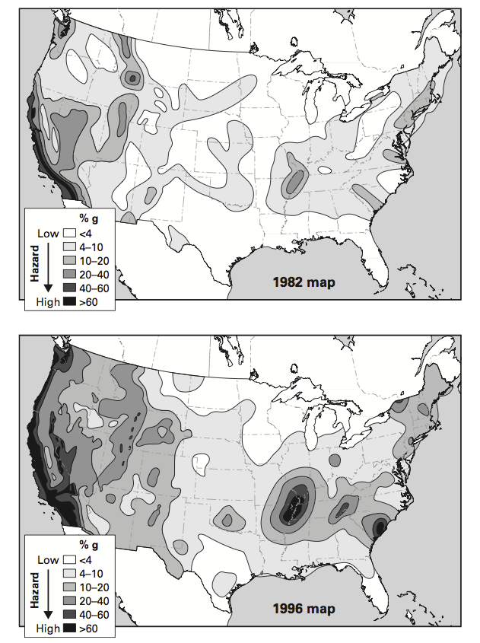
PAN 10.1: Comparison of the 1982 and 1996 U.S. Geological Survey earthquake hazard maps for the US. The predicted hazard is shown as a percentage of the acceleration of gravity. Redefining the hazard raised the predicted hazard in the Midwest from much less than in California to even greater than California's. (Stein, 2010)

Slide 5
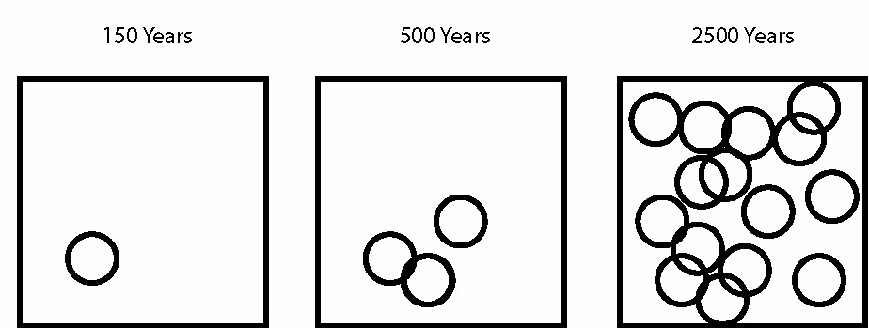
PAN 10.2: Schematic illustration showing how the predicted earthquake hazard increases for longer time window. The circles show areas within which shaking above a certain level will occur. (Stein, 2010)

Slide 6
Hazard maps are hard to get right: success depends on accuracy of four assumptions over 500-2500 years
Where will large earthquakes occur?
When will they occur?
How large will they be?
How strong will their shaking be?
Uncertainty & map failure result because these are often hard to assess

Slide 7
Hazard maps are hard to get right: success depends on accuracy of four assumptions over 500-2500 years
Where will large earthquakes occur?
When will they occur?
How large will they be?
How strong will their shaking be?

Slide 8
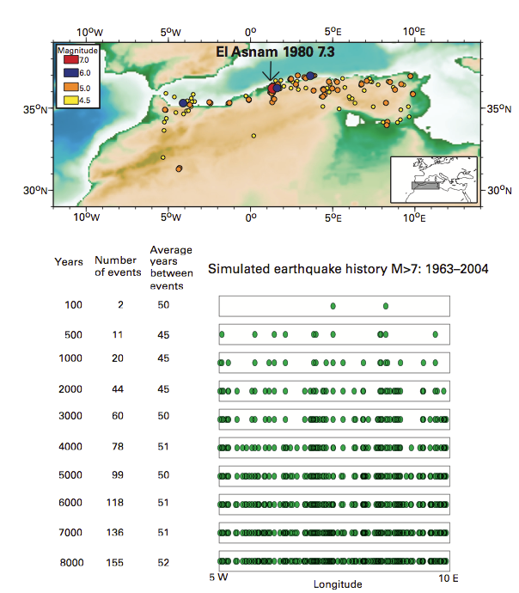
PAN 10.3: Seismicity along the North Africa plate boundary for 1963-2004.
Simulations using a frequency-magnitude relation derived from these data predict that if seismicity is uniform in the zone, about 8,000 years of record is needed to avoid apparent concentrations and gaps. (Swafford and Stein, 2007)

Slide 9
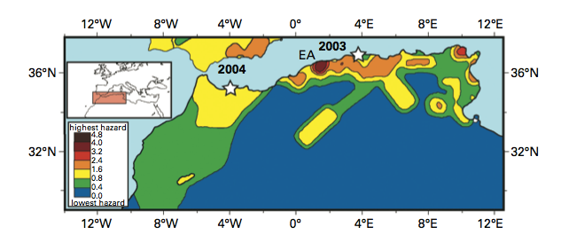
PAN 10.4: Global Seismic Hazard Map (1999) for North Africa, showing peak ground acceleration in m/s² expected at 10% probability in 50 years. Note "bull-eye" at site of the 1980 Ms 7.3 El Asnam (EA) earthquake. The largest subsequent earthquakes to date, the May 2003 M 6.8 Algeria and February 2004 M 6.4 Morocco events (stars) did not occur in the predicted high hazard regions. (Swafford and Stein, 2007)

Slide 10
CQ: Earthquake hazard maps typically show high-hazard bull's-eyes at the locations of past large earthquakes. Are such maps being made with time-independent or time-dependent probabilities?

Slide 11
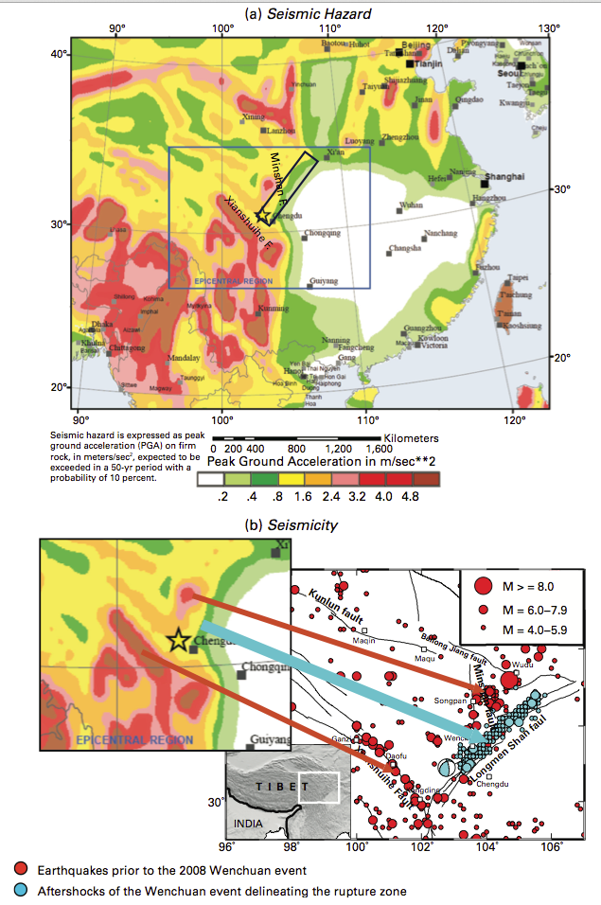
PAN10.5: (a) Seismic hazard map for China produced prior to the 2008 Wenchuan earthquake, which occurred on the Longmenshan Fault (black rectangle).
(b) Seismicity in the region. The hazard map showed low hazard on the Longmenshan fault, on which little instrumentally recorded seismicity had occurred before the Wenchuan earthquake, and higher hazard on faults nearby that showed more seismicity. (Stein et al., 2012)

Slide 12
PAN 10.6: In many continental fault systems, it appears that rather than one main fault staying active for a long time (top), many faults turn on and off (bottom). (McKenna et al., 2007)

Slide 13
Liu, Stein & Wang 2011
during the period
Earthquakes in North China
prior to the period
instrumental events
Beijing
Bohai Bay
Ordos
Plateau
Shanxi Graben
Weihi rift
1556 Huaxian
M 8.3
Large events often pop up where there was little seismicity!

Slide 14
Liu, Stein & Wang 2011
during the period
Earthquakes in North China
prior to the period
instrumental events
Beijing
Bohai Bay
Ordos
Plateau
Shanxi Graben
Weihi rift
1668 Tancheng
M 8.5
Large events often pop up where there was little seismicity!

Slide 15
Liu, Stein & Wang 2011
during the period
Earthquakes in North China
prior to the period
instrumental events
1679 Sanhe
M 8.0
Beijing
Bohai Bay
Ordos
Plateau
Shanxi Graben
Weihi rift
Large events often pop up where there was little seismicity!

Slide 16
Liu, Stein & Wang 2011
during the period
Earthquakes in North China
prior to the period
instrumental events
1975 Haicheng
M 7.3
Beijing
1976 Tangshan
M 7.8
Bohai Bay
Ordos
Plateau
Shanxi Graben
1966 Xingtai
M 7.2
Weihi rift
Large events often pop up where there was little seismicity!

Slide 17
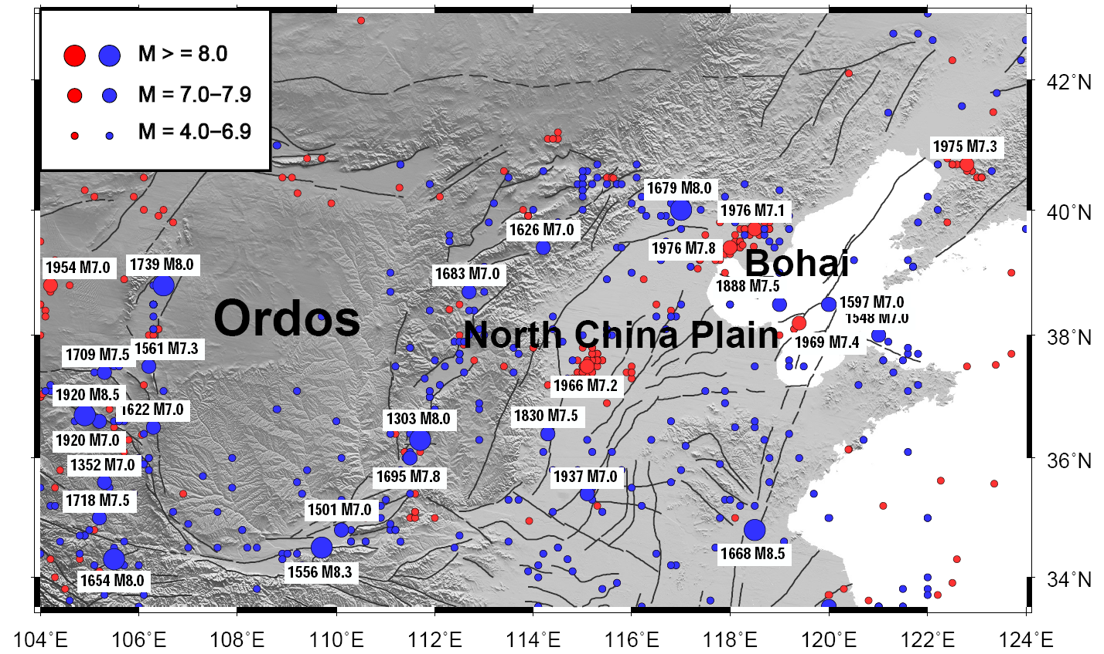
No large (M>7) events ruptured the same fault segment twice in past 2000 years
Historical
Instrumental
Shanxi Graben
Weihi rift
In past 200 years, quakes migrated from Shanxi Graben to N. China Plain

Slide 18
Maps are like ‘Whack-a-mole’ - you wait for the mole to come up where it went down, but it’s likely to pop up somewhere else.

Slide 19
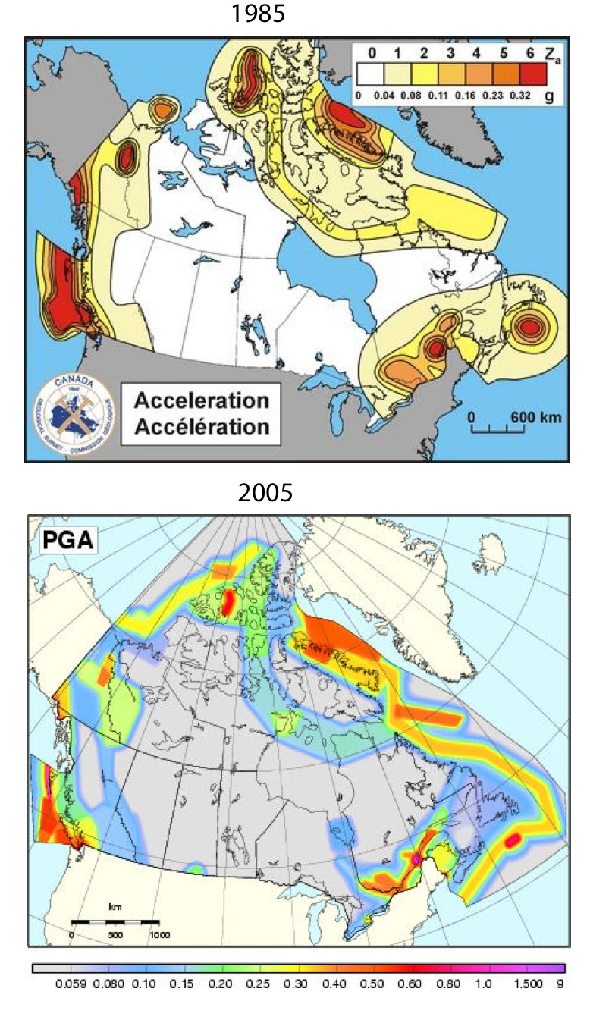
PAN 10.8: Comparison of the 1985 and 2005 Geological Survey of Canada earthquake hazard maps of Canada.
The older map shows concentrated high hazard bull's-eyes along the east coast at the sites of the 1929 Grand Banks and 1933 Baffin Bay earthquakes, whereas the new map assumes that similar earthquakes can occur anywhere along the margin. (Stein et al., 2012)

Slide 20
Hazard maps are hard to get right: success depends on accuracy of four assumptions over 500-2500 years
Where will large earthquakes occur?
When will they occur?
How large will they be?
How strong will their shaking be?

Slide 21
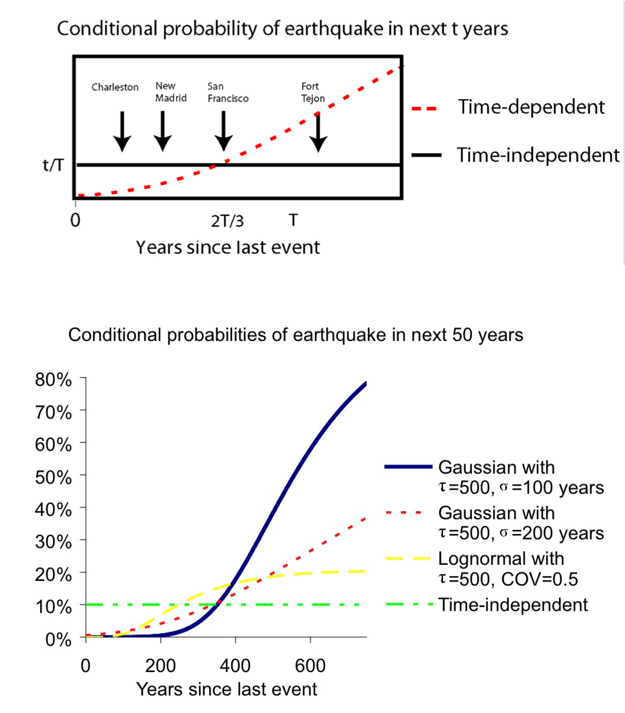
PAN 10.9: Top: Schematic comparison of time-independent and time-dependent models for different seismic zones.
Bottom: Comparison of the conditional probability of a large earthquake in the New Madrid zone in the next 50 years, assuming that the mean recurrence time is 500 years. (Hebden and Stein, 2009)

Slide 22
CQ: would you favor stronger and more expensive building standards near the "Fort Tejon" segment of the San Andreas fault than in San Francisco? Why or why not? Conversely, would you favor less stringent and less expensive standards after a large earthquake? Why or why not?

Slide 23
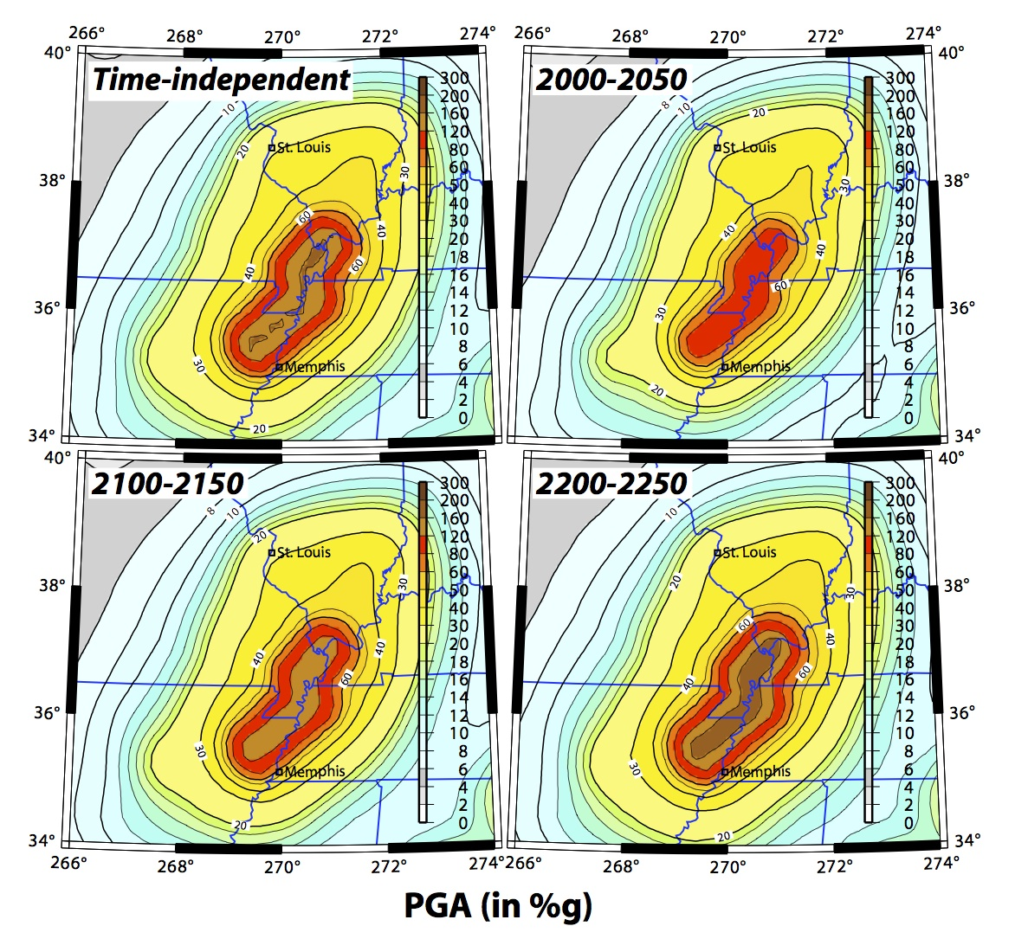
PAN 10.10: Comparison of hazard maps for the New Madrid zone.

Slide 24
Hazard maps are hard to get right: success depends on accuracy of four assumptions over 500-2500 years
Where will large earthquakes occur?
When will they occur?
How large will they be?
How strong will their shaking be?

Slide 25
Ms 5.4

Slide 26
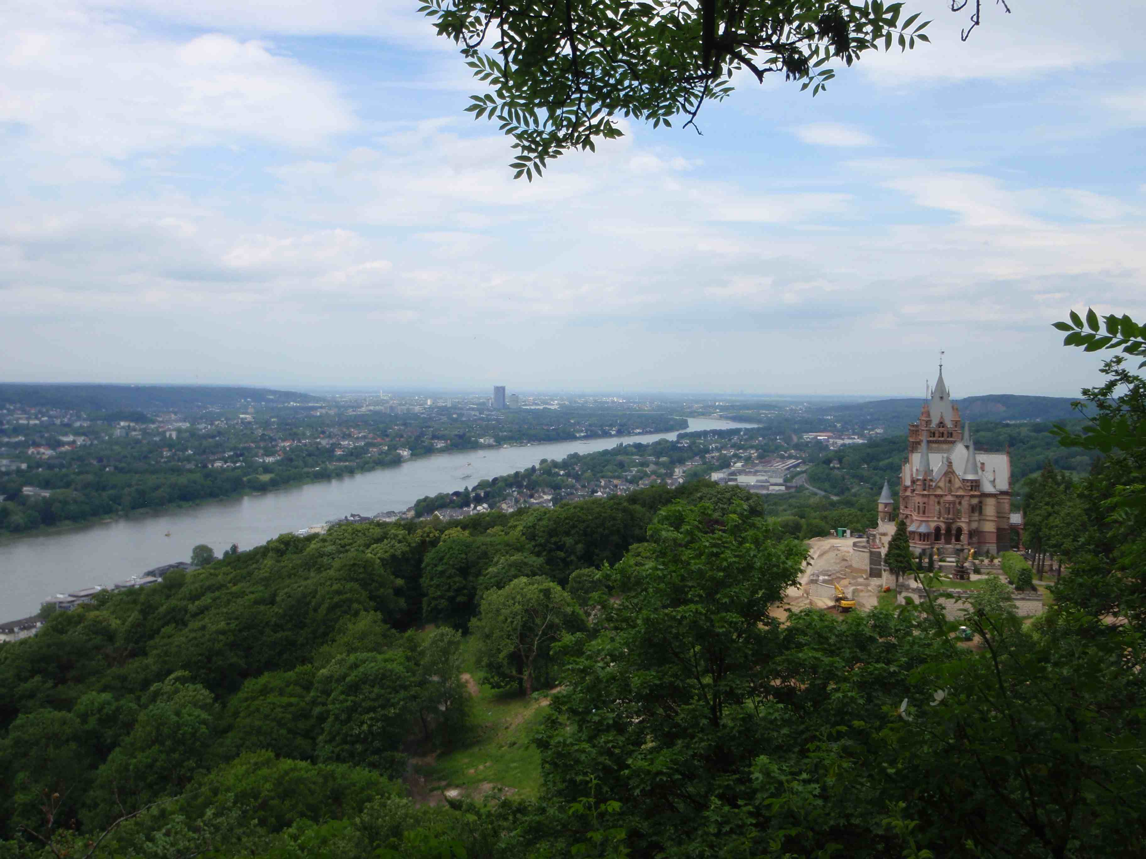
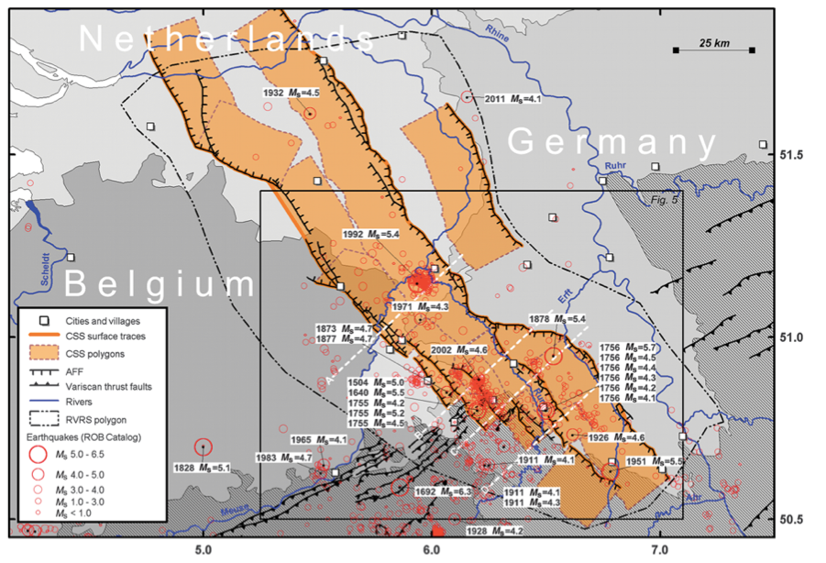

Slide 27
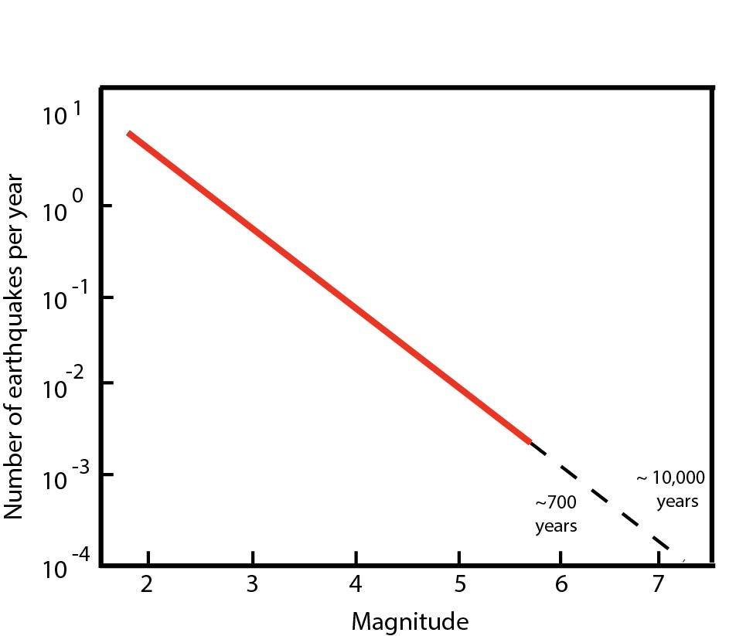
What’s the maximum magnitude to expect in the Lower Rhine Graben?
Nuclear plants designed for 1/10,000 yrs

Slide 28
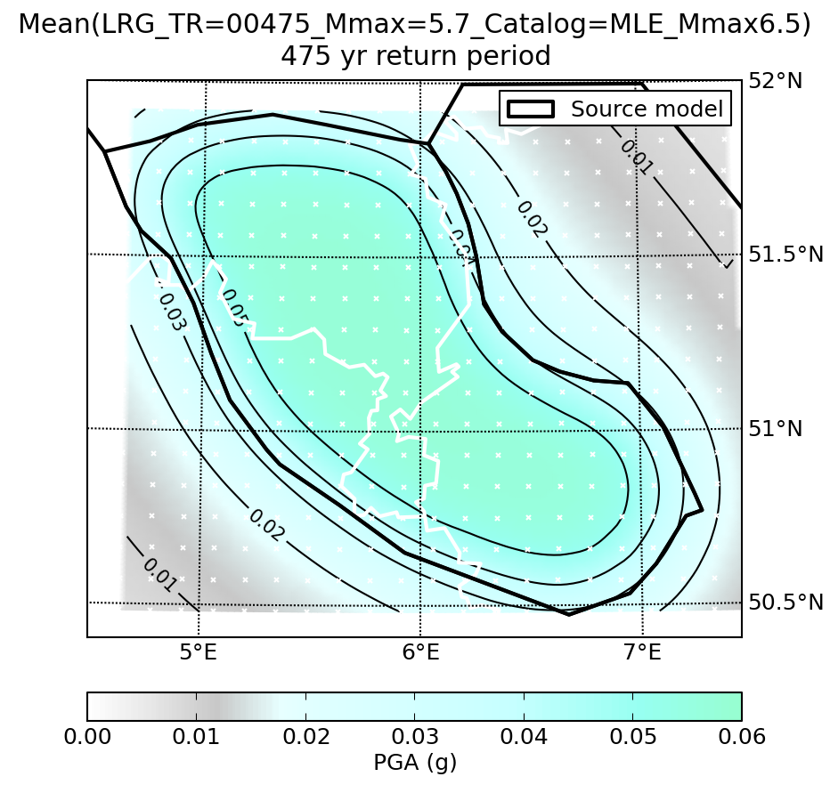
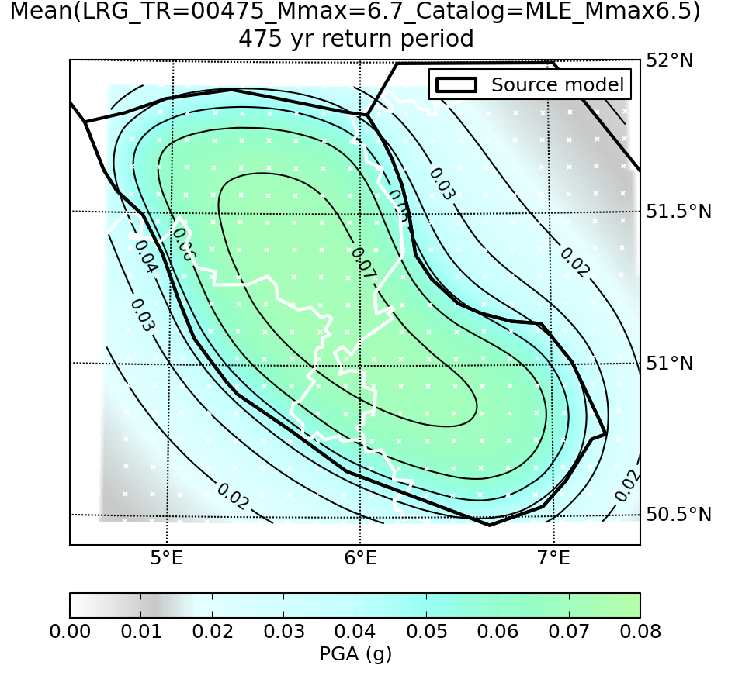
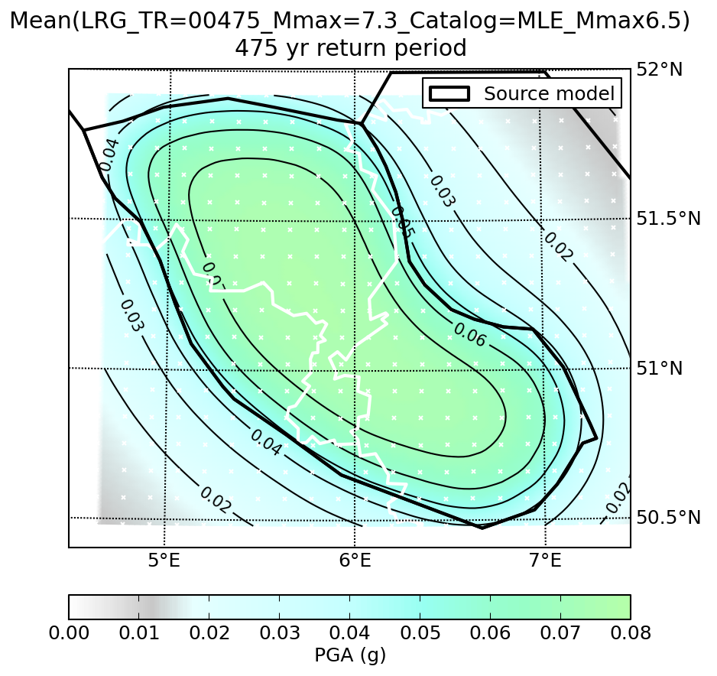
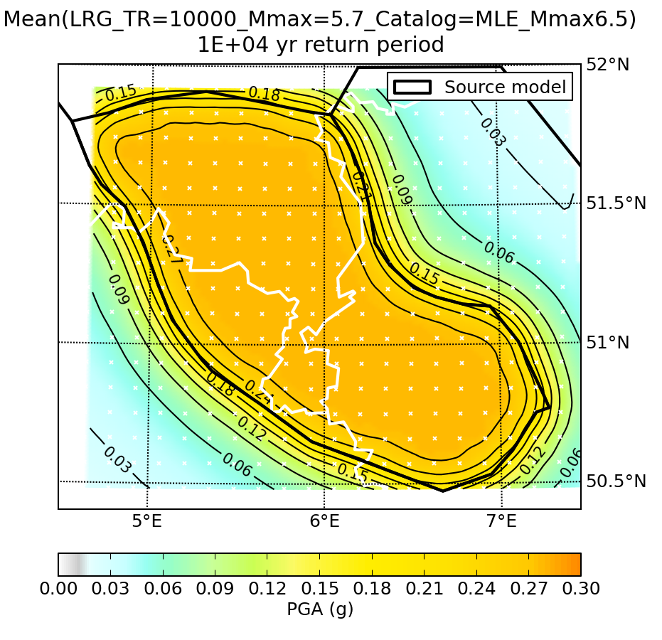
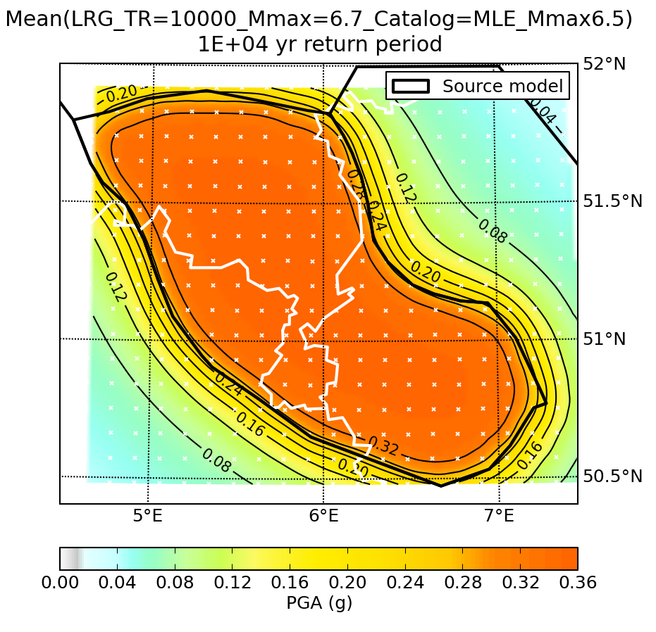
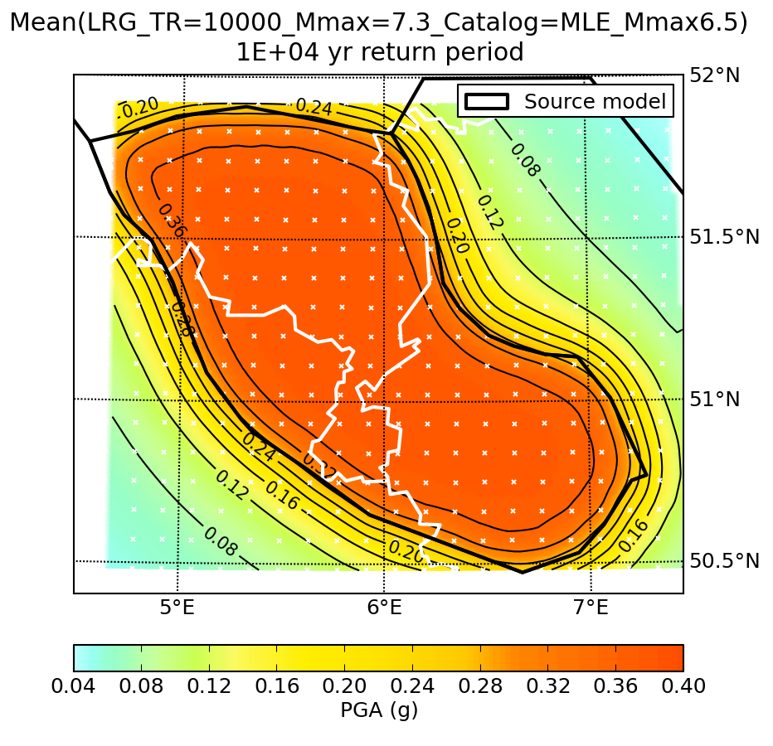
Hazard map – 475 year return period
Mmax 5.7
Mmax 6.2
Mmax 7.3
Hazard map – 10,000 year return period
Mmax 5.7
Mmax 6.2
Mmax 7.3
K. Vanneste ROB

Slide 29
Given 700 years of data, what Mmax would we observe if Mmax were really 6.2, 6.5, 6.8, 7.1?
Synthetic seismicity experiment – 10,000 catalogs
We generally miss the largest events and so underestimate Mmax
Most likely to observe Mmax ~6 with recurrence time ~ sample length
M. Merino, PhD thesis, 2014

Slide 30
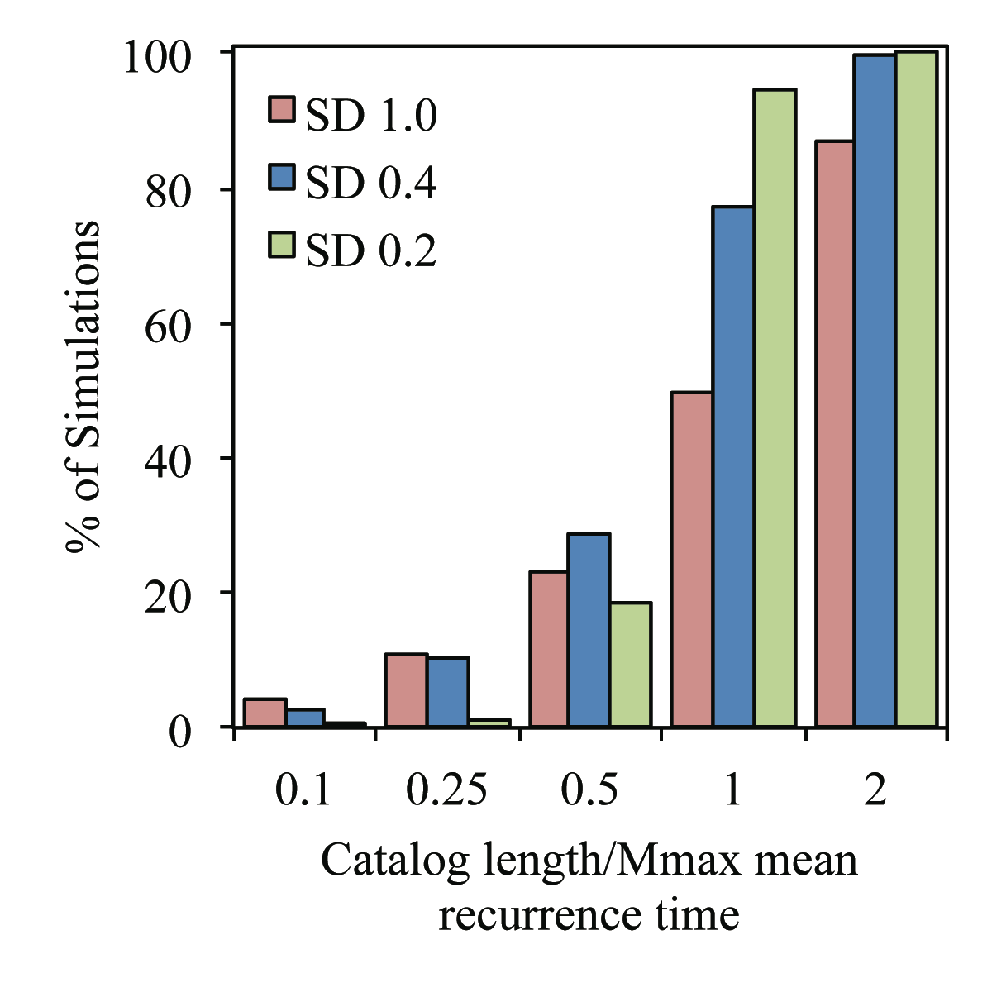
A catalog shorter than an earthquake’s mean recurrence time is likely to not contain an event of that size.
The largest earthquake observed likely reflects the length of the earthquake history used, even if larger earthquakes occur.
Merino, Stein, Adams, 2013

Slide 31
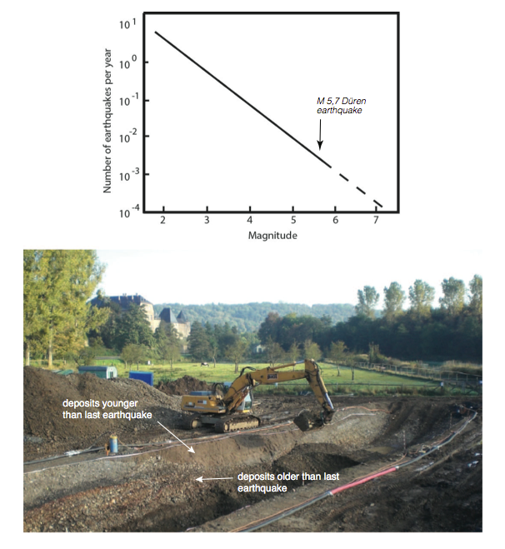
Kübler, Friedrich &
Strecker, 2014

Slide 32
Hazard maps are hard to get right: success depends on accuracy of four assumptions over 500-2500 years
Where will large earthquakes occur?
When will they occur?
How large will they be?
How strong will their shaking be?

Slide 33
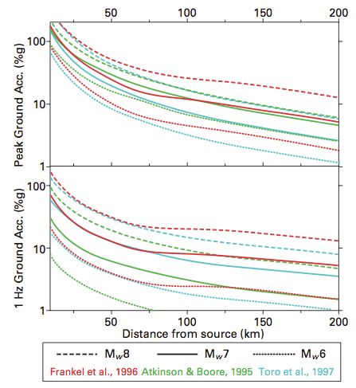
PAN 10.12: Comparison of ground motion (peak ground acceleration and 1 Hz) as a function of distance for different earthquake magnitudes predicted by three models for the central U.S.
For Mw 8, the Frankel et al. (1996) relation predicts significantly higher values than the others. (Newman et al., 2001)

Slide 34
CQ: On physical grounds, why would you expect the shaking from an earthquake to decrease so rapidly with distance from the earthquake?

Slide 35
PAN 10.13: Comparison of ground motion (peak ground acceleration and 1 Hz) as a function of distance for different earthquake magnitudes predicted by three models for the central U.S.
For M 8, the Frankel et al. (1996) relation predicts significantly higher values than the others. (Newman et al., 2001)

Slide 36
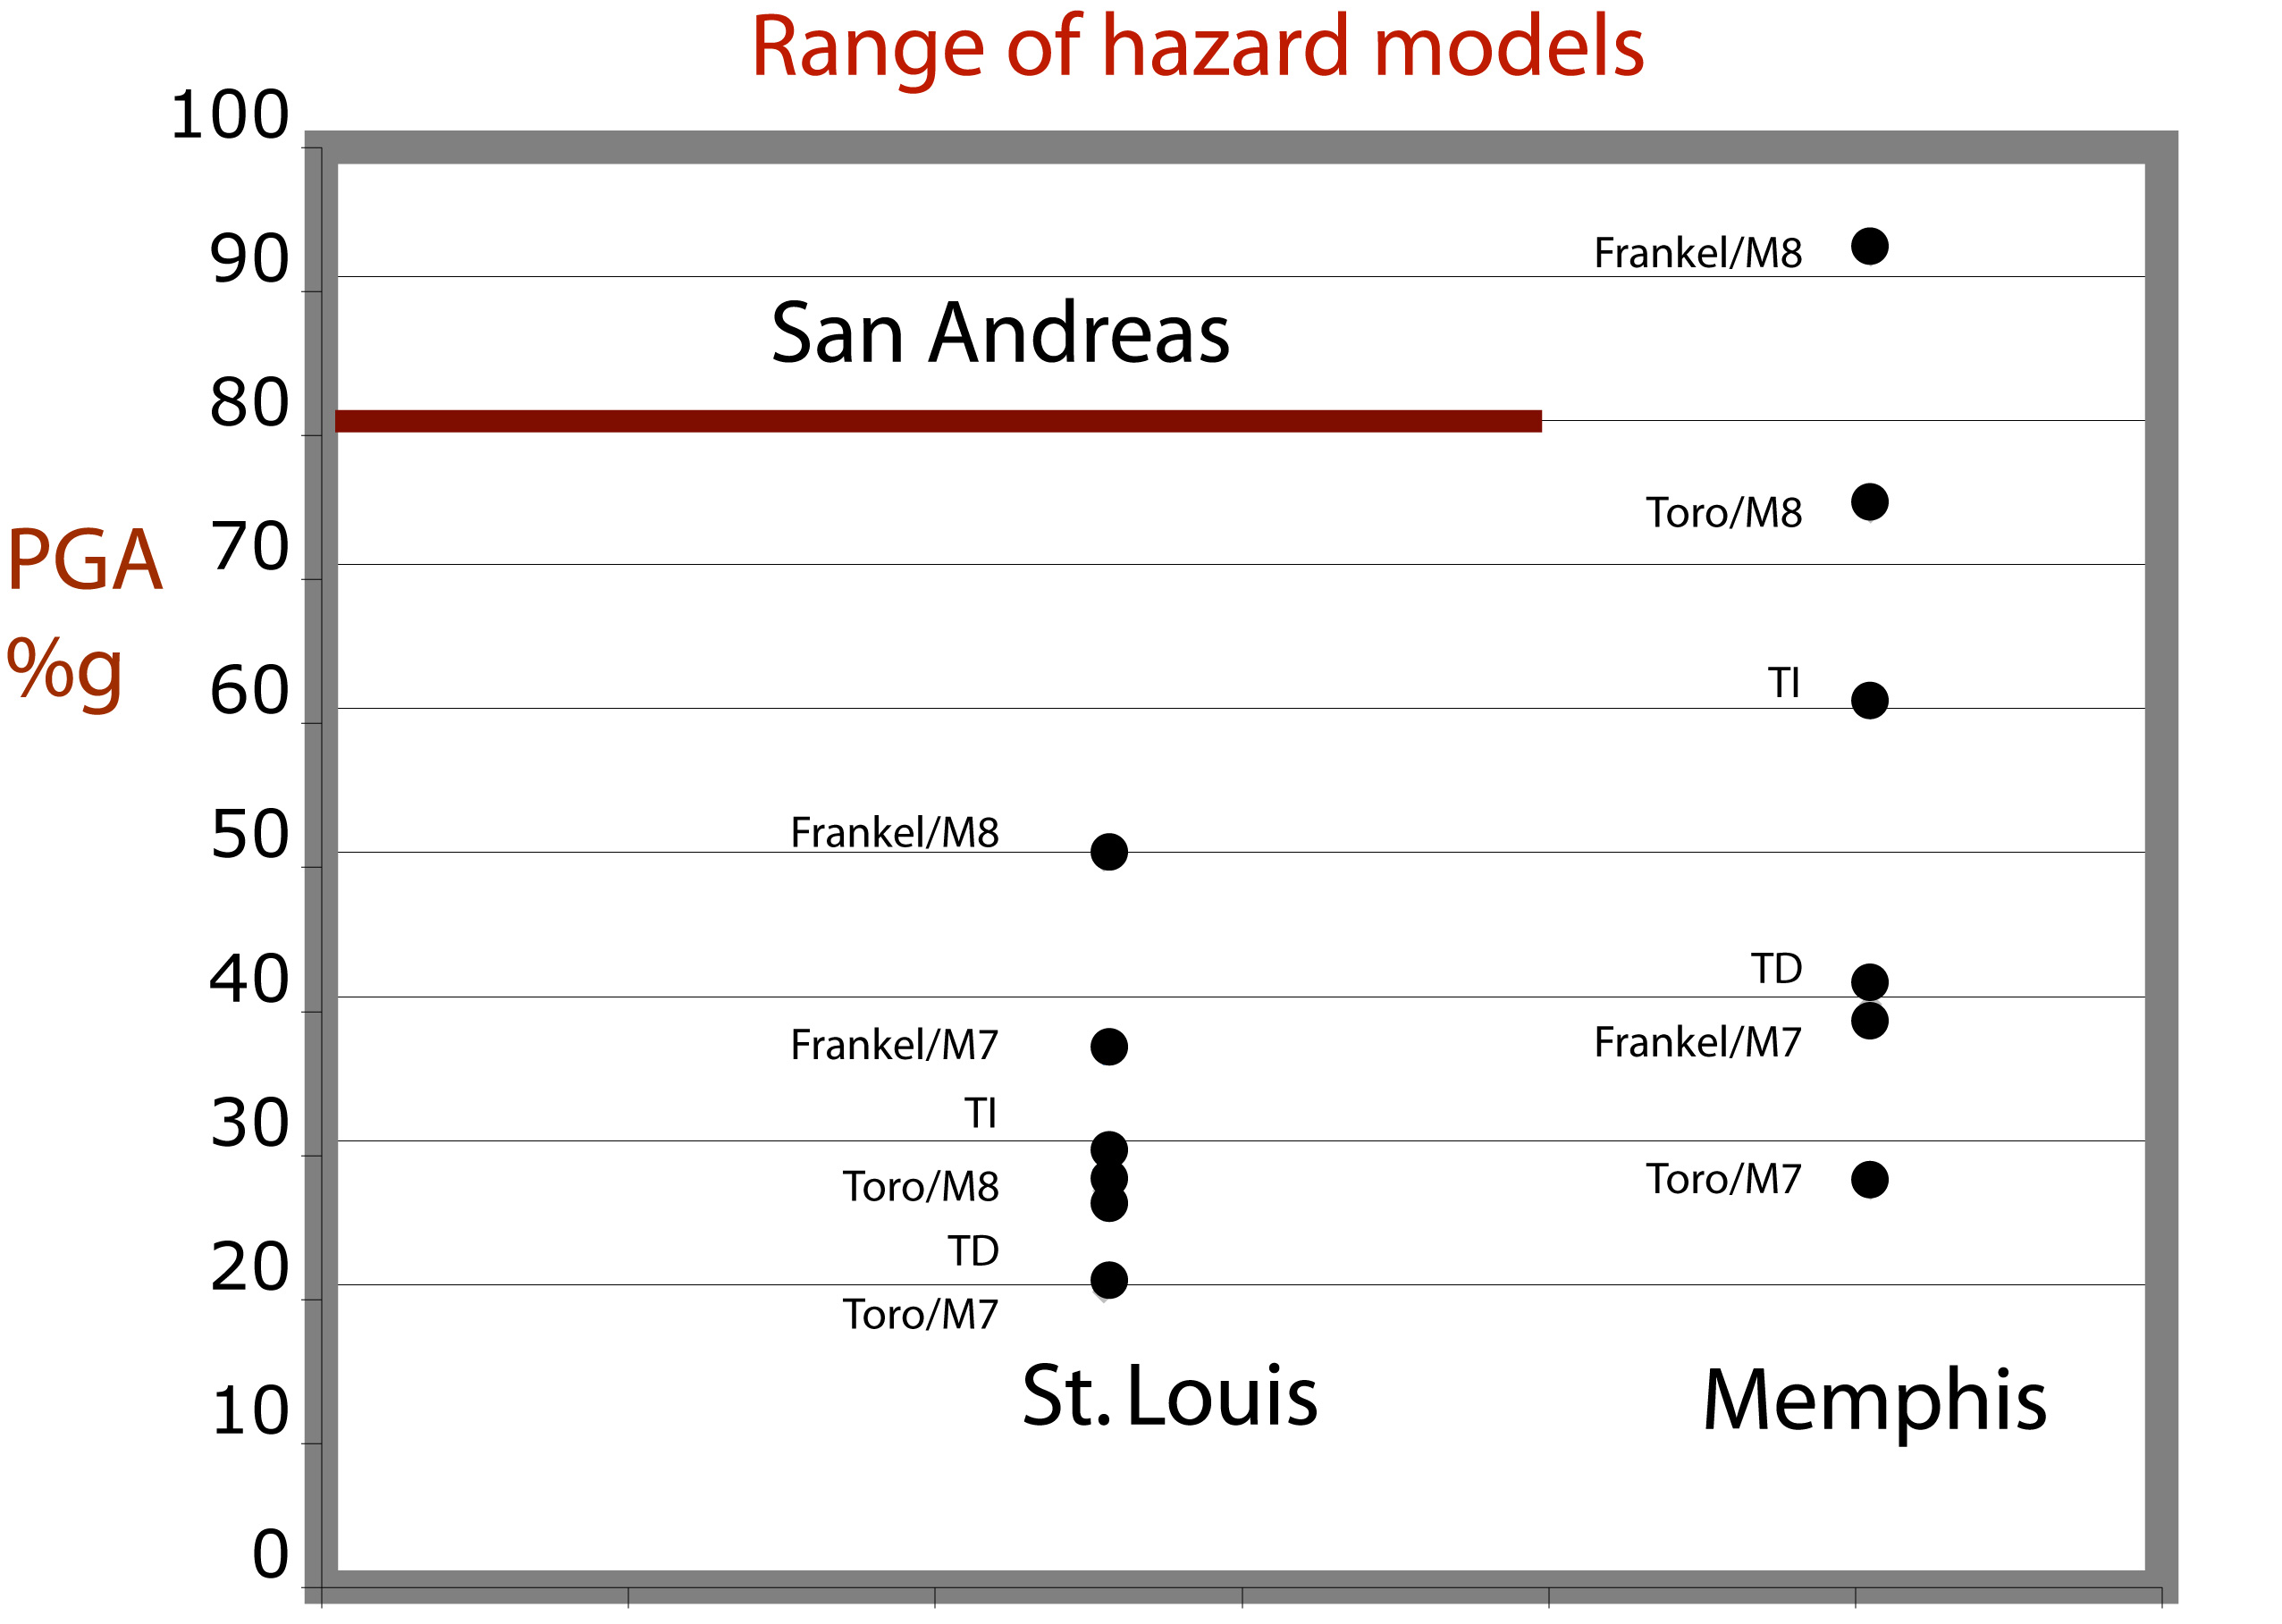
PAN 10.14: Comparison of the hazard at St Louis and Memphis predicted by the different hazard maps of the New Madrid zone.

Slide 37
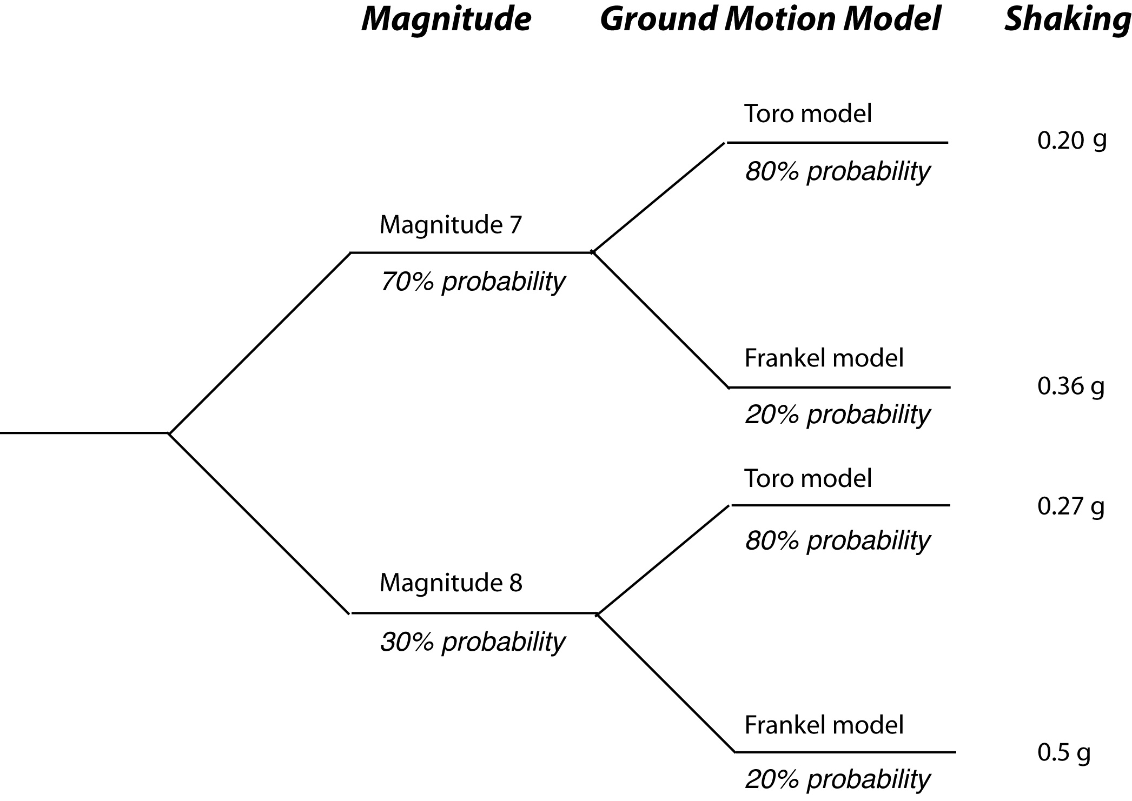
Result:
0.26 g
PAN 10.15: Logic tree combining the four models in Figure 10.13 to predict shaking at St. Louis. These weights give a value of 0.26 g, or 26% of the acceleration of gravity (Stein, 2010).

Slide 38
Result:
0.26 g
CQ: How would you change the weights on the magnitude and ground motion model branches if you wanted to raise the hazard from 0.26 to 0.4 g? How could you lower it to 0.22 g?

