Slide 1
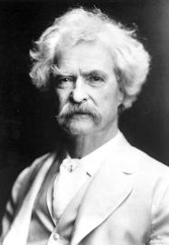
5:Communicating what we know and don't
"When in doubt tell the truth. It will confound your enemies and astound your friends."
Mark Twain

Slide 2
What do we mean by
Precision
Accuracy

Slide 3
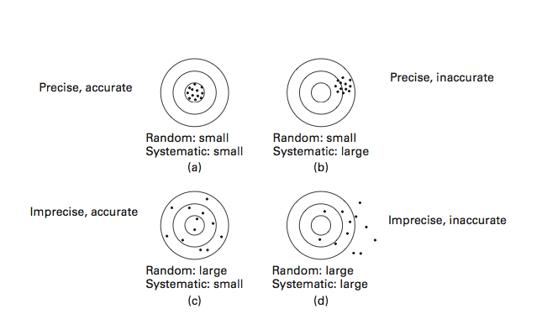
PAN 5.4

Slide 4
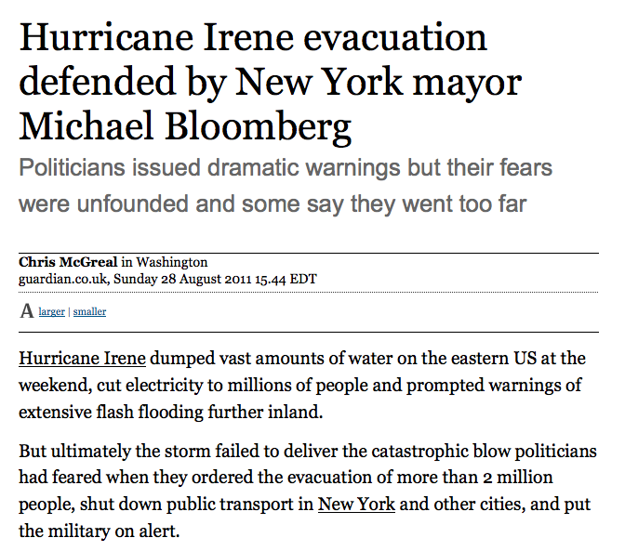
If it had been a weekday,
Major cost

Slide 5
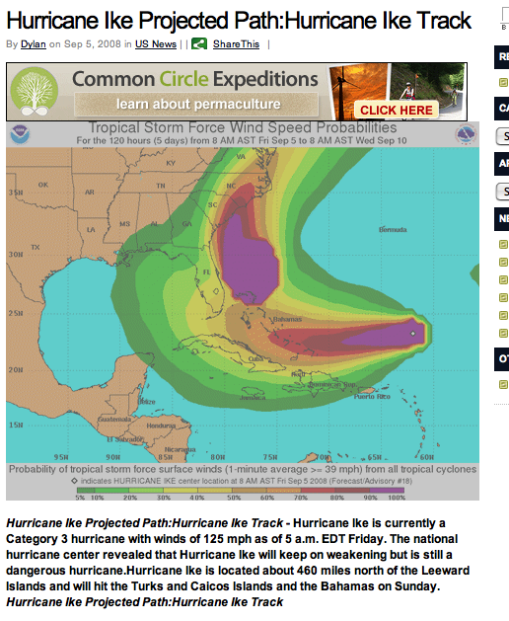
2008: Hurricane Ike predicted to hit Miami
PAN 5.1

Slide 6
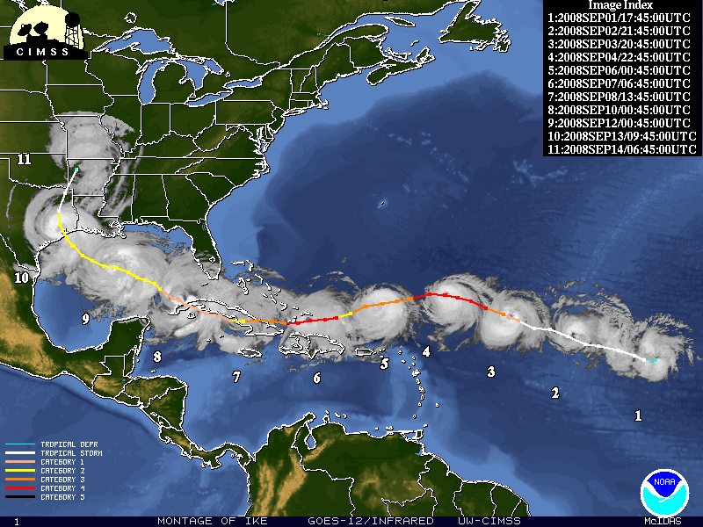
Ike’s actual track
PAN 5.1

Slide 7
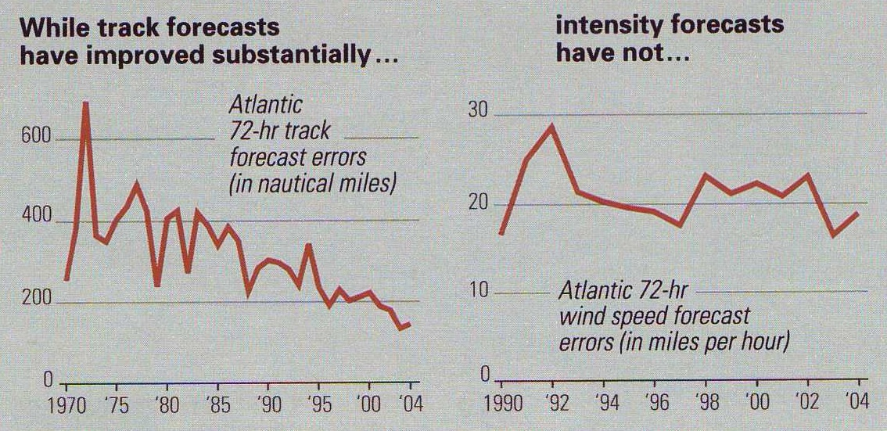
K. Emanuel CNN 8/26/11
National Geographic 8/06

Slide 8
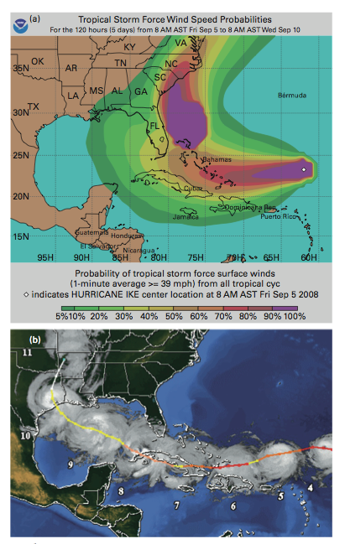
CQ: How would you assess whether the fact that Hurricane Ike moved outside its forecast track represented a problem with the forecast or just chance?
PAN 5.1

Slide 9
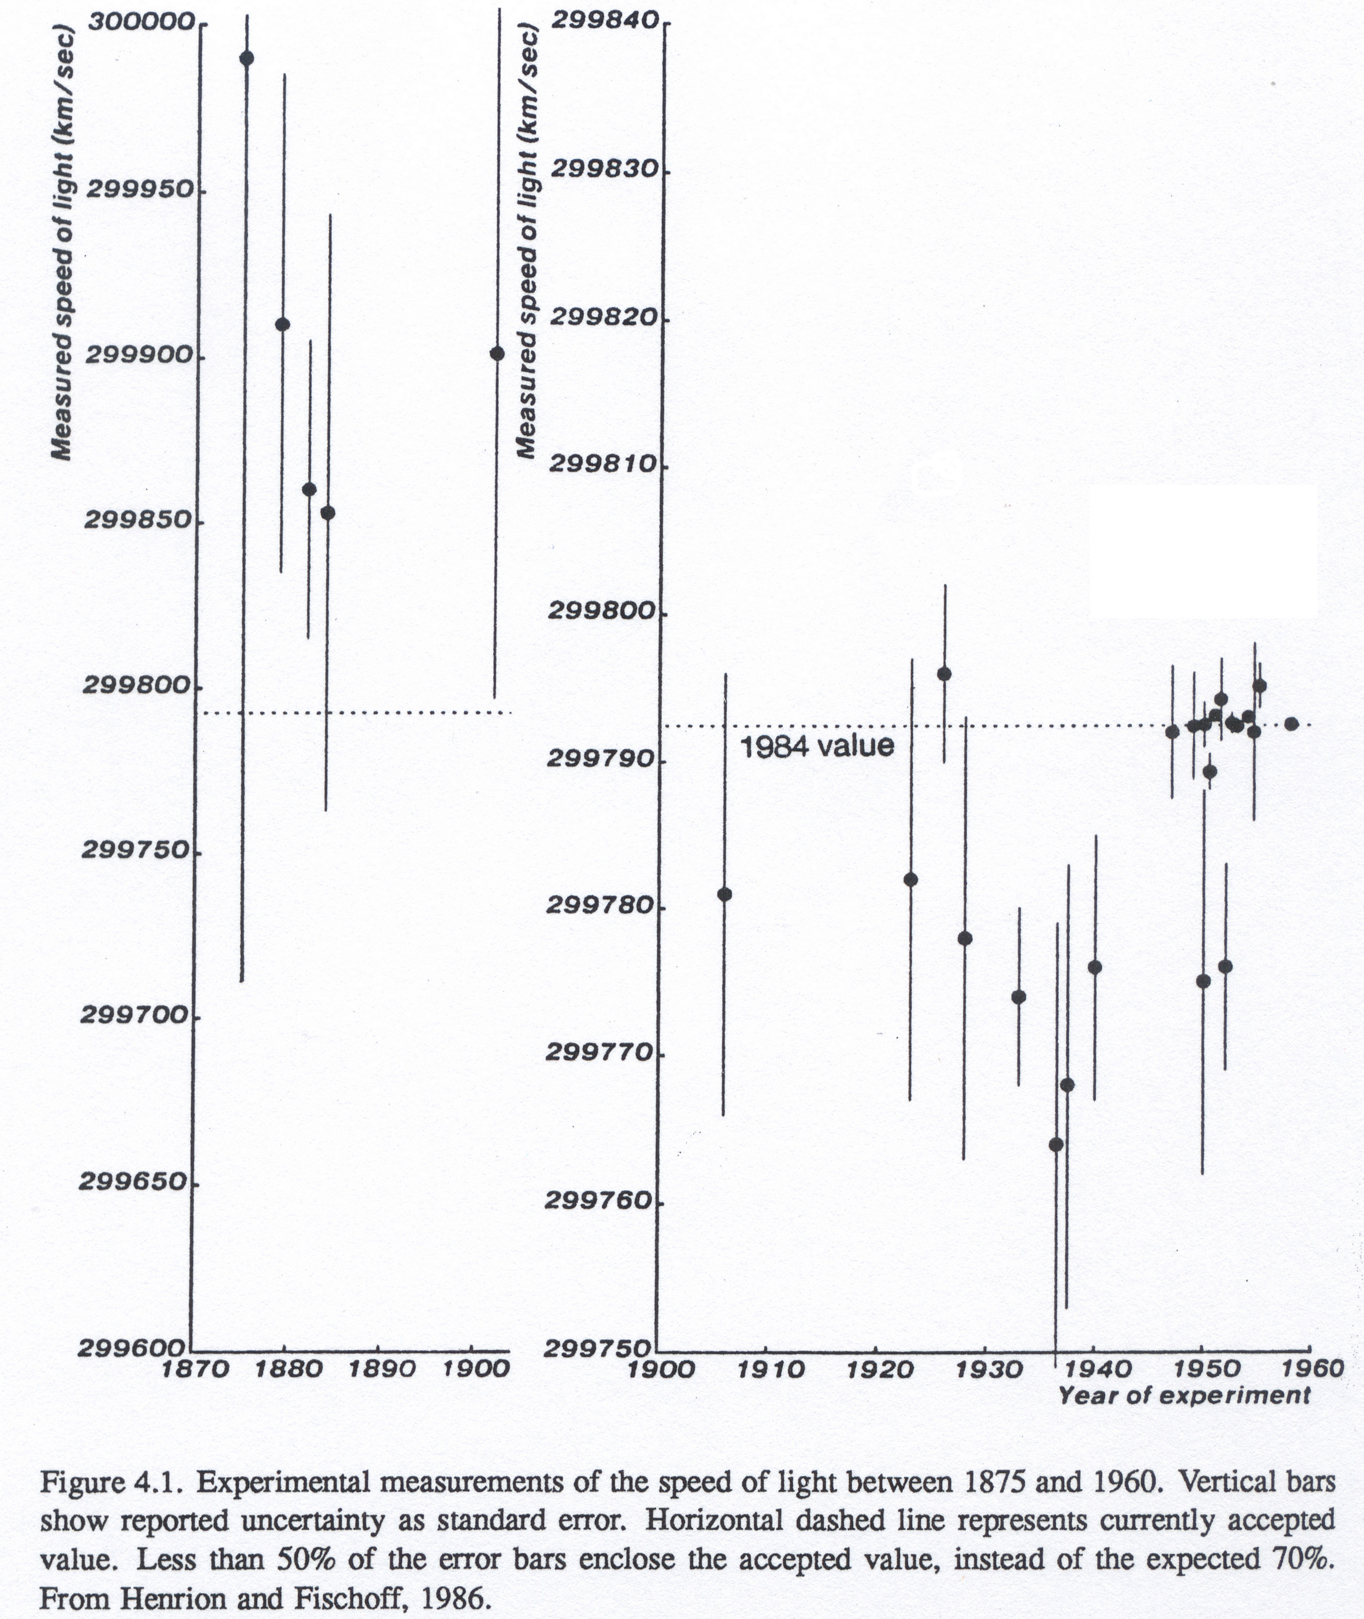
Systematic errors often exceed measurement errors PAN 5.3
Underestimated uncertainty and bias (bandwagon effect) in measured speed of light
Uncertainties are hard to assess and generally underestimated
1875-1960

Slide 10
CQ: Describe one of your experiences with the “bandwagon effect.”

Slide 11
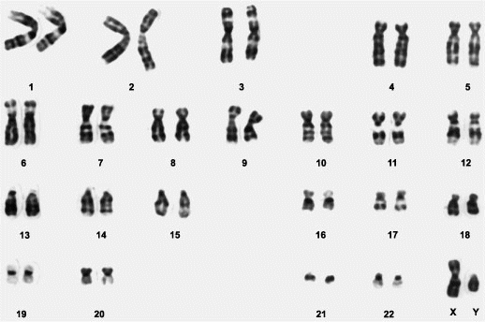
Systematic uncertainty is larger than we think: number of human chromosome pairs
1921-1955: 24 Now: 23

Slide 12
Confirmation Bias
We see what we expect to see, or accept data that fit our view and ignore data that do not
“Human understanding, once it has adopted an opinion, collects any instances that confirm it, and though the contrary instances may be more numerous and more weighty, it either does not notice them or else rejects them, in order that this opinion will remain unshaken.” (Francis Bacon , AD 1620)
It’s fooling ourselves, but hard to avoid.
“It’s not what you don’t know that hurts you – it’s what you know that isn’t so.”

Slide 13
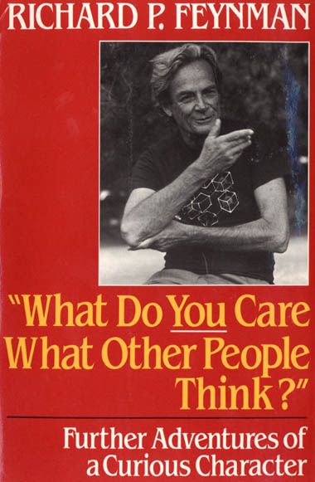
Richard Feynman (1986) explained that scientists have learned that
“whether they like a theory or they do not like a theory is not the essential question. Rather, it is whether or not the theory gives predictions that agree with the experiment. It is not a question of whether a theory is philosophically delightful, or easy to understand, or perfectly reasonable from the point of view of common sense."

Slide 14
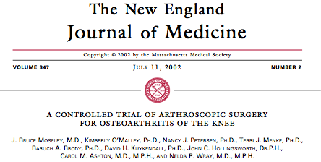
Testing analogy: evidence-based medicine objectively evaluates widely used treatments, often with embarrassing results
Although more than 650,000 arthroscopic knee surgeries at a cost of roughly $5,000 each were being performed each year

Slide 15
Testing analogy: evidence-based medicine objectively evaluates widely used treatments, often with embarrassing results
Although more than 650,000 arthroscopic knee surgeries at a cost of roughly $5,000 each were being performed each year, a controlled experiment showed that "the outcomes were no better than a placebo procedure."

Slide 16
Insights from weather forecasting
Adopt specific criteria for "good" and "bad" forecasts
"it is difficult to establish well-defined goals for any project designed to enhance forecasting performance without an unambiguous definition of what constitutes a good forecast.” (Murphy, 1993)

Slide 17
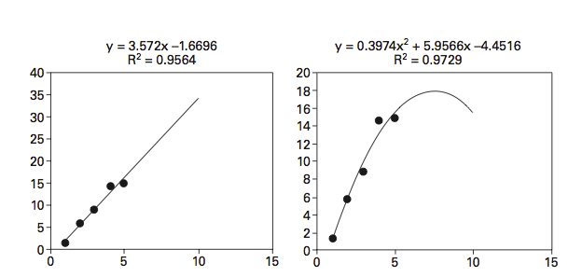
Overparameterized model (overfit data): Given a trend with scatter, fitting a higher order polynomial can give a better fit to the past data but a worse fit to future data
Linear fit
Quadratic fit
PAN 5.5

Slide 18
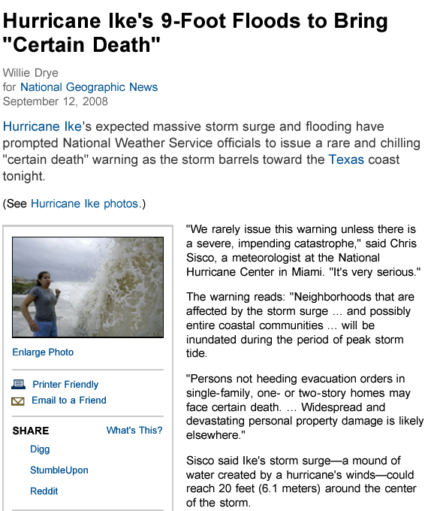
Ike predicted to bring certain death P(death)=1

Slide 19
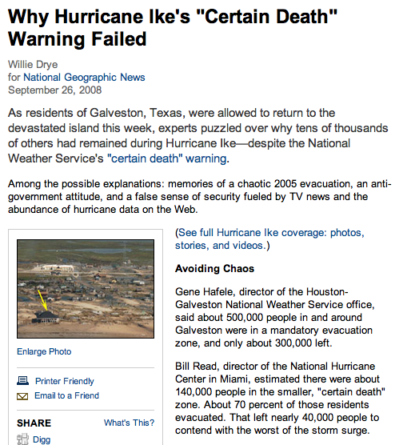
Actual deaths: < 50 of 40,000 Error 800x

Slide 20
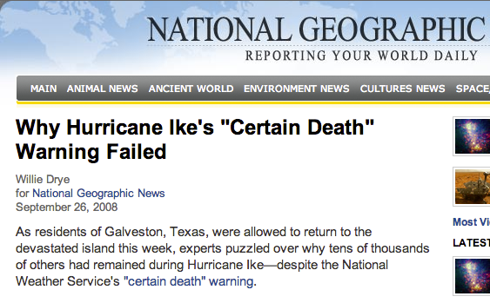
CQ: Why did about 40% of the people ordered to leave ignore the order and warning? What lesson do you think they drew?
http://news.nationalgeographic.com/news/2008/09/080926-hurricane-ike-evacuation.html

Slide 21
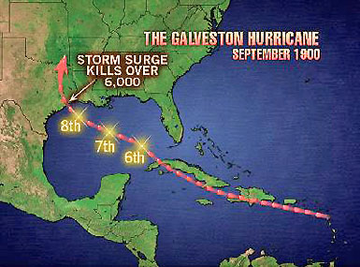
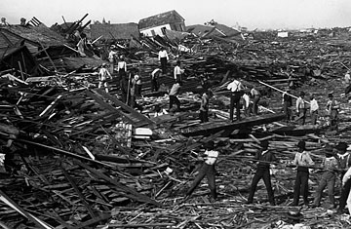
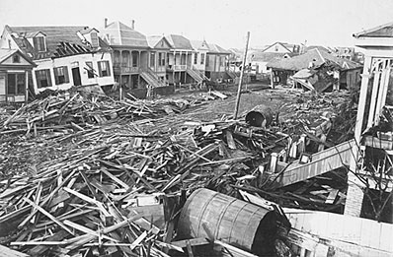

Slide 22
A good hazard communication approach:
Say what you know
Say what you don’t know
Say what you think
Say which is which and why

Slide 23
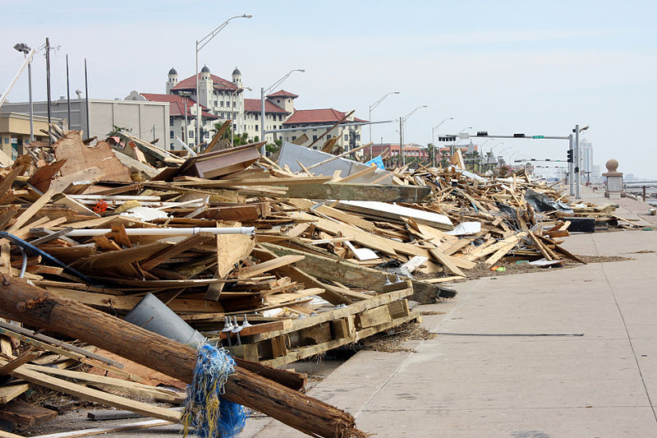
CQ: Write a short public statement - less than 200 words - that you would have given to the public if you had been working for the National Weather Service as Hurricane Ike approached Galveston Island. Your goal is to realistically describe the situation and make sensible recommendations.
September 17, 2008 - Piles of debris are lined up along the seawall on Galveston Island where Hurricane Ike made landfall

Slide 26
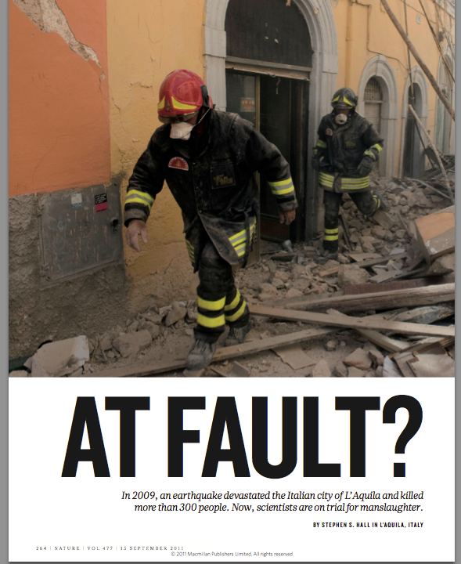

Slide 27
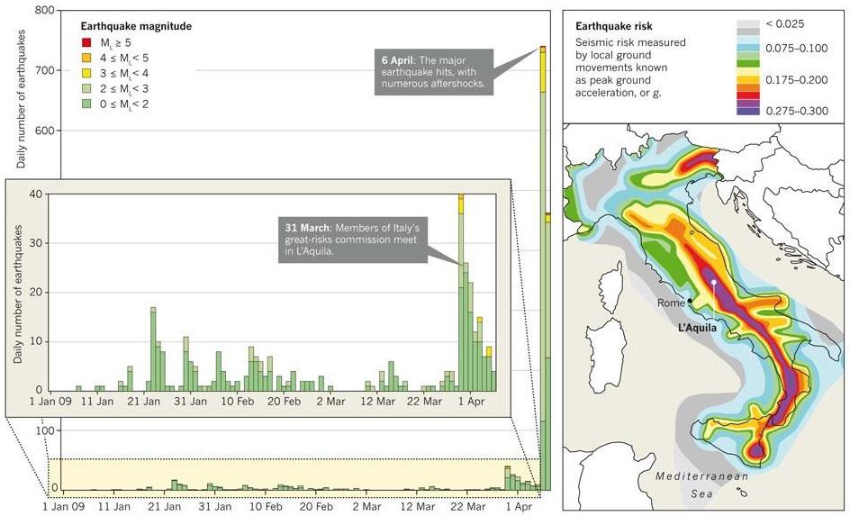
PAN 5.6: Left: Number of earthquakes and their magnitudes in the L'Aquila area, during period leading up to the large April 6, 2009 earthquake. Right: earthquake hazard map of Italy. (Hall, 2011)
PAN 5.6

Slide 28
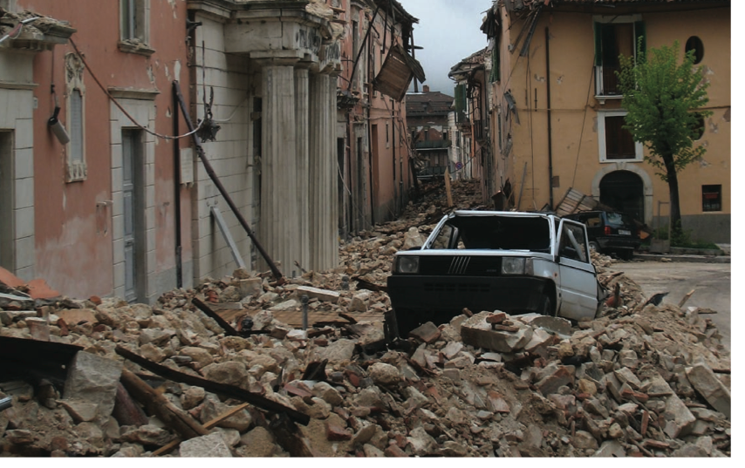
CQ: Write a short public statement - less than 200 words - that you would have given to the public if you had been working for the Italian civil protection authorities during the L'Aquila earthquake swarm. Given the public concern that a large earthquake may occur soon, your goal is to realistically describe the situation. What would you say when people ask what they should do?

Slide 29
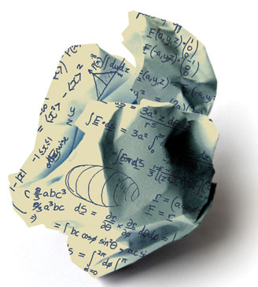
"The reliance on mathematical models has done tangible damage to our society in many ways. Bureaucrats who do not understand the limitations of modeled predictions often use them... Agencies that depend on project approvals for their very survival (such as the U.S. Army Corps of Engineers) can and frequently do find ways to adjust the model to come up with correct answers that will ensure project funding. Most damaging of all is the unquestioning acceptance of the models by the public because they are assured that the modeled predictions are the way to go."
Nature 447, 35-37 (3 May 2007)
Useless Arithmetic: Why Environmental Scientists Can't Predict the Future by Orrin Pilkey & Linda Pilkey-Jarvis
Columbia University Press: 2007.

Slide 30
"Above all, users of predictions, along with other stakeholders in the prediction process, must question predictions. For this questioning to be effective, predictions must be as transparent as possible to the user. In particular, assumptions, model limitations, and weaknesses in input data should be forthrightly discussed. Institutional motives must be questioned and revealed... The prediction process must be open to external scrutiny.
Openness is important for many reasons but perhaps the most interesting and least obvious is that the technical products of predictions are likely to be "better" - both more robust scientifically and more effectively integrated into the democratic process - when predictive research is subjected to the tough love of democratic discourse...
Uncertainties must be clearly understood and articulated by scientists, so users understand their implications. If scientists do not understand the uncertainties - which is often the case - they must say so. Failure to understand and articulate uncertainties contributes to poor decisions that undermine relations among scientists and policy makers.”
Sarewitz et al. (2000)

Slide 31
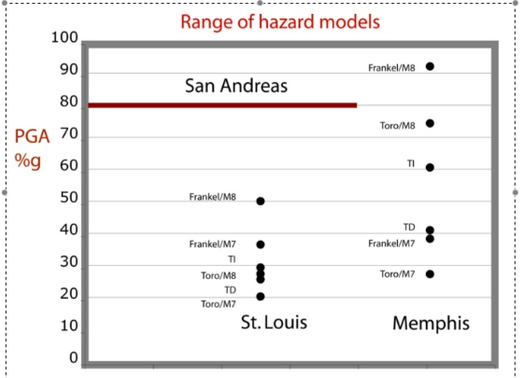
PAN 5.7: Comparison of earthquake hazard, described as peak ground acceleration as a percentage of the acceleration of gravity expected with 2% risk in 50 years, predicted by various assumptions. (Stein et al., 2012)

Slide 32
50% 30% 20%
PAN 5.8

Slide 33
Challenge: Users want predictions even if they’re poor
Future Nobel Prize winner Kenneth Arrow served as a military weather forecaster. As he described,
“my colleagues had the responsibility of preparing long-range weather forecasts, i.e., for the following month. The statisticians among us subjected these forecasts to verification and found they differed in no way from chance. The forecasters themselves were convinced and requested that the forecasts be discontinued.

Slide 34
Challenge: Users want predictions even if they’re poor
Future Nobel Prize winner Kenneth Arrow served as a military weather forecaster. As he described,
“my colleagues had the responsibility of preparing long-range weather forecasts, i.e., for the following month. The statisticians among us subjected these forecasts to verification and found they differed in no way from chance. The forecasters themselves were convinced and requested that the forecasts be discontinued.
The reply read approximately: "The commanding general is well aware that the forecasts are no good. However, he needs them for planning purposes."
Gardner, D., Future Babble: Why Expert Predictions Fail - and Why We Believe Them Anyway, 2010

Slide 35
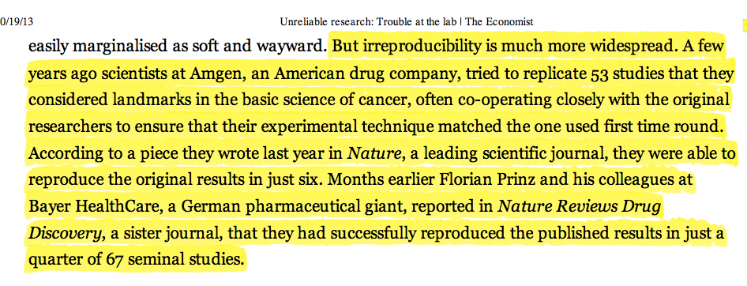
CQ: Drug company biologists who examined the results of important scientific studies about cancer have found that less than a quarter of the results can be replicated. What might be the causes of these problems?

Slide 37
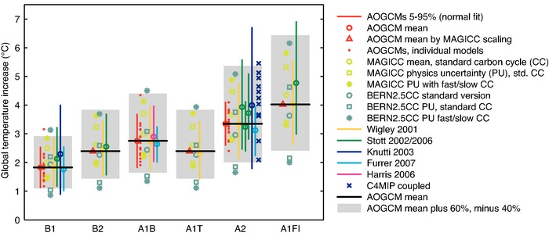
PAN 5.2: Comparison of the rise in global temperature by the year 2009 predicted by various climate models. For various scenarios of carbon emissions - B1, B2, , etc. - the vertical band shows the different predicted warming. (IPCC, 2007)

