Slide 1
User and Account Management in NUcore
Linda Lewandosky, Aaron Rosen, Todd Shamaly
nucore@northwestern.edu

Slide 2
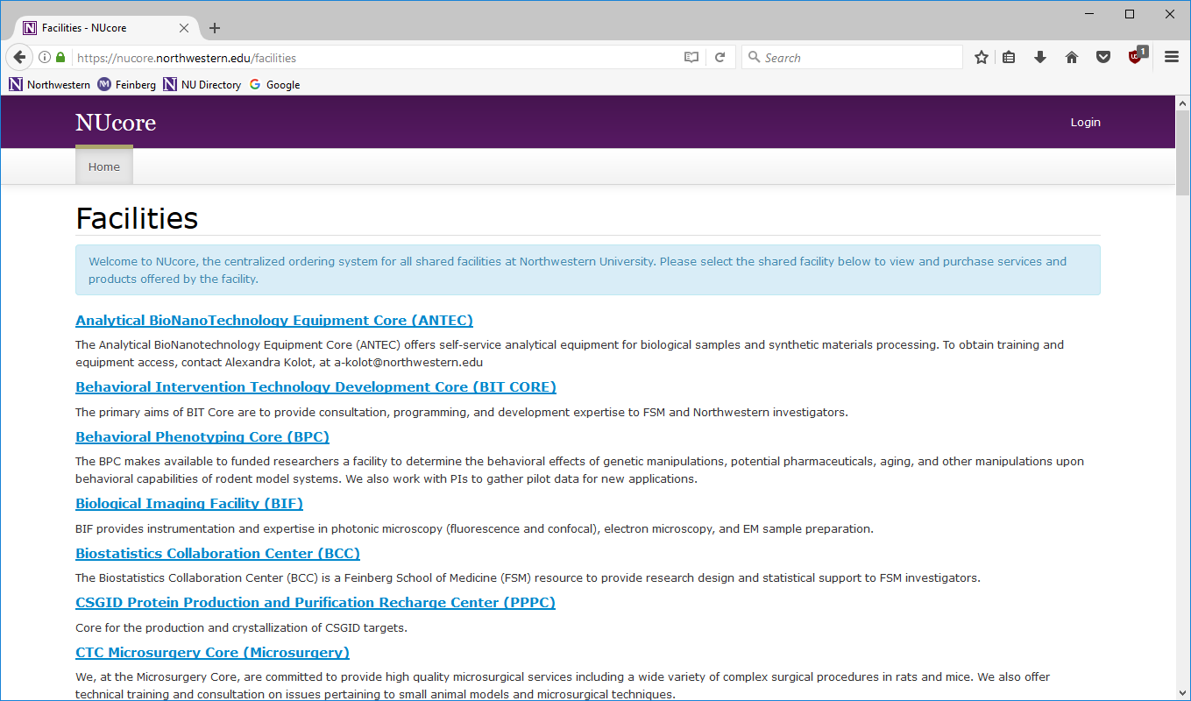
NUcore
A transaction processing system for core facilities at Northwestern

Slide 3
Key Components
Products
People (Roles)
Payment Sources

Slide 4
People
Core Directors
Payment Source Owners (PIs)
Users/students & staff
Administrators

Slide 5
People
Core Directors
Payment Source Owners (PIs)
Users/students & staff
Administrators

Slide 6
Payment Sources
Chartstrings
Purchase Orders
Credit Cards

Slide 7
Original Roles
Core Director
In addition to managing the core’s products, activity and finances
Manage Payment Source access
Create user accounts
Create all payment sources types
Payment Source Owner
Review and Dispute charges
Manage Payment Source access
Receive ”billing notifications”
Run reports on individual payment source activity
Suspend Payment Sources
User
Purchase, review their own activity on individual payment sources

Slide 8
Additional Role
Business Administrator
Attached to specific payment sources
Review and Dispute charges
Manage Payment Source access
Receive ”billing notifications”
Run reports on individual payment source activity
Suspend Payment Sources

Slide 9
Newest Role
Account Manager
Independent of payment sources or specific cores
Create new user accounts
Create chartstrings
Manage Payment Source access

Slide 10
Advantages of Centralized User & Account Management
Receive billing notifications
Prevent unauthorized usage
Manage access during onboarding/exiting of staff
Run usage reports
Avoid cost transfers

Slide 11
What you still can’t do and why
Things global admins can do for you
Update user information (name, email address)
Anything a Core Administrator or Owner can do
Things that are locked centrally
Chartstring Expiration which is governed by NU Financials
Can not add an user to an expired chartstring
Removing an user account
Pre-Spend accounts*

Slide 12
Contacts
nucore@northwestern.edu
Linda Lewandosky
Aaron Rosen
Todd Shamaly
Jeff Weiss

Slide 13
Thank You

