Slide 1
Radiation Pressure Confinement and its Implications for the Coupling of a Quasar with the Host Galaxy ISM
Jonathan Stern (MPIA)
March 2015
University of California, Irvine
Based on:
4 published papers:
Stern+14a,b; Baskin+14a,b
with Ari Laor, Ehud Behar, Alexei Baskin, Tomer Holczer (Technion, Israel)
1 paper in prep.: with Claude-André Faucher-Giguère (Northwestern) and Nadia Zakamska (John-Hopkins)
Notes:
My name is Jonathan Stern, and I finished my PhD last year at the Technion, and happily joined Joe’s group.
I want to talk to you today about models of photo-ionized gas
I want to show you that the standards models used consistenlty fail to explain a certain aspect of the observations, over a wide range of astrophysical systems.
Now most studies disregard this failure, or shove it under the carpet, but when we take a closer look at this failure there are some interesting things to be learned about the nature of systems where the photo-ionized gas resides
This talk is based on 5 papers, 4 of them were prepared with my group at the Technion,
And another paper I’m working on now, together with Joe, and NZ from JHU and CAFG from NWU.
NGC 7469
Review stability analysis
Read Proga+14
Rozanska mentioning
Send figure to Joe
Hidden slides – fix
Explain absorption
The question I wish to address is what sets the gas density in AGN hosts?
this talk is based on two published papers and another paper which will be submitted hopefully next week.
I did my Ph.D in the technion, in Haifa in Israel. And this work was done with my Ph.D advisor, Ari Laor, and with Ehud Behar and also with Alex Baskin, which is a Ph.D. student of Ari and also with Ehud Behar.

Slide 2
Outline
Intro: photo-ionized gas systems and why we model them
How do we model photo-ionized gas
A puzzle: why does the gas density depend on the flux?
The proposed solution – Radiation Pressure Confinement
Implications for Quasar feedback models
Notes:
A quick outline of my talk:
I’ll start with a quick introduction to the ionized gas systems that I will address in this talk, and give motivation for modelling them
Then I’ll give a quick overview on the standard models used to model photo-ionized gas
Next I’ll present the aspect in the observations that the models fail to reproduce
I’ll then suggest a solution
And finally I’ll discuss the implications of this solution

Slide 3
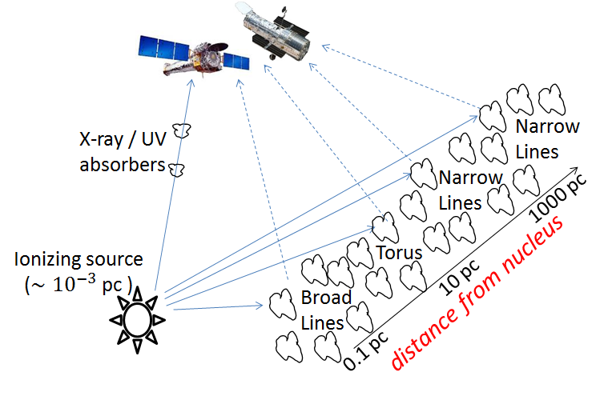
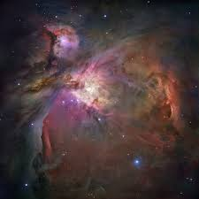
Photoionized Gas Systems
Active Galactic Nuclei
Star-Forming regions
Henney+07
Notes:
This is a picture of a Star-Forming region
And this is a skectch of a quasar because,in quasars we don’t have pictures, only sketches
This is my sketch of the PI systems in quasars.
It is not the standard sketch people usually use in quasar talks, but I think this sketch is more accurate, sorry I think it is less, less accurate than the standard sketch, so I’ll use this one.
We have a very small central source which emits ionizing photons
The ionizing photons travel freely until they reach a cloud of gas.
The clouds absorb the photons and reprocess the energy to emission lines and IR emission from the dust grains, and we see the reprocessed emission.
Now what’s special about quasars is that the absorbing clouds span a very large dynamical range in scales.
From clouds at sub-pc scales which emit broad lines, through 10pc scale clouds which emit mainly in the IR known as torus clouds, up to clouds at kpc scales which emit the narrow lines.
Note that I assume a continuous distribution of clouds vs distance, and I’m not making any strong claims on the 3D geometry of these clouds.
Now, the clouds which dominate the emission line spectrum of quasars are mostly optically thick
But some sightlines are relatively clear, and there are only optically thin clouds along them
We view these optically thin clouds through their absorption features on the central source spectrum, that’s why there usually called X-ray or UV absorbers.
So I’m going to address all these systems in my talk
What I want to emphasize (click) is that these systems have very diverse properties
The gas densities span roughly 9 orders of magnitude, from 100 cm^3 in the narrow lines and SF-regions to 10^11 particle per cm^3 in the broad lines
The photon fluxes incident on these clouds span a similar dynamical range
We have both optically thick and optically thin clouds
The absorbers and broad line clouds are dust-less, the torus NLR and SF clouds are likely dusty
The quasar clouds are ionized by a hard spectrum, while the SF clouds are ionize by a soft spectrum
So by talking about all these systems together, I’m covering almost the entire parameter space of systems of photo-ionzized gas.
Note title with continuous dust distribution.
So this is an illustration of the reflecting clouds
Forgive me for my lousy drawing capabilities
As I said before, we have a central source, some of the emission reaches us directly
Some of the emission is reprocessed by clouds from a large range of scales and then reaches us.
Usually AGN-ists divide these clouds into different groups – broad line region, torus, narrow line region. I’m going to disregard this division, and treat the gas distribution as continuous in r.
Also, I’m not going to say anything about the geometry of the clouds, I’m focusing on their distance from the central source.

Slide 4
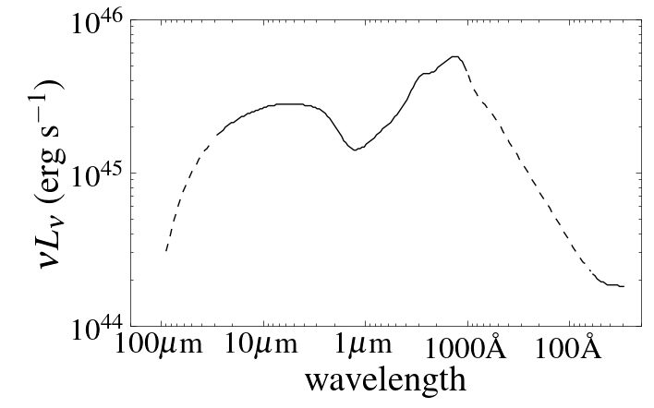
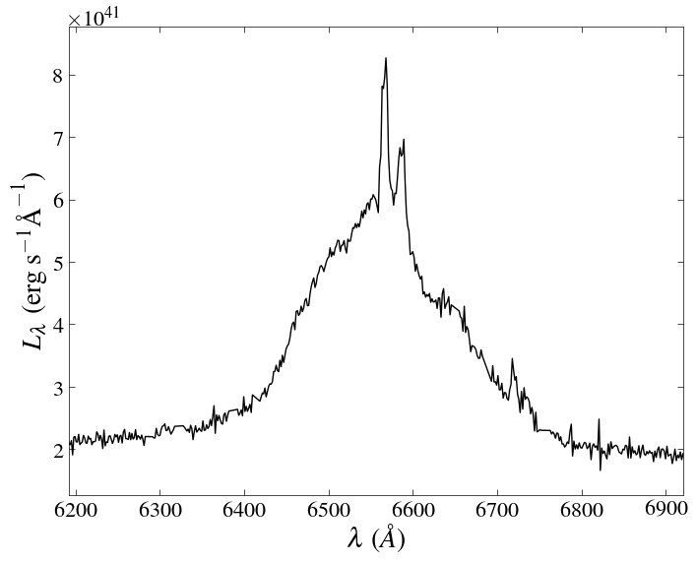
A Short Intro to AGN
Spectral Energy Distribution
Richards+06
Optical-UV spectrum
Vanden Berk+01
Hα spectrum
Narrow Hα
Broad Hα
Narrow [NII]
10,000 km/s
Notes:
This is my sketch of a quasar.
It is not the standard sketch people usually use in quasar talks, but I think this sketch is more accurate, sorry I think it is less, less accurate than the standard sketch, so I’ll use this one.
We have a very small central source which emits ionizing photons
The ionizing photons travel freely until they reach a cloud of gas.
The clouds absorb the photons and reprocess the energy to emission lines and IR emission from the dust grains, and we see the reprocessed emission.
Now what’s special about quasars is that the absorbing clouds span a very large dynamical range in scales.
From clouds at sub-pc scales which emit broad lines, through 10pc scale clouds which emit mainly in the IR known as torus clouds, up to clouds at kpc scales which emit the narrow lines.
Note that I assume a continuous distribution of clouds vs distance, and I’m not making any strong claims on the 3D geometry of these clouds.
So the emission we see in quasars is a sum of direct emission from the central source and reflected emission from the clouds.
Let’s see how this looks like
<click> this is the SED of a RQQ, the bump at 1000A is the direct emission from the central source, and the IR bump is due to reprocessing by dust in the torus clouds and the NLR clouds
<click> If we zoom in on the optical-UV spectrum, we see that on top of continuum from the central source there are broad emission lines.
<if we zoom in on an emission line, say Ha, we see the lines is made of (at least) two distinct kinematical components, the strong BL, with width of 10,000 kms, and on top of it a narrow Ha, with width of 500 km/s
So the BL comes from the BLR
While the NL comes from the much more distant NLR,
What is the quasar broad line region?
This is a SED of a radio quiet quasar
This is an optical spectrum of an AGN, and you see that on top of the continuum emission these strong and wide emission lines.
So this is a zoom in on a broad H-a of a local quasar, you can see the Ha line is very broad, and on top of it some narrow lines with widths of 300 km/s.
The broad lines suggest the BLR is very close to the BH.

Slide 5
Photoionized Gas Systems
Active Galactic Nuclei
Star-Forming regions
Henney+07
Diverse Properties
Gas densities: $n_{H}∼{10}^{2} −{10}^{11} {cm}^{−3}$
Photon fluxes: $φ_{i}∼{10}^{9}−{10}^{20} {cm}^{−2}s^{−1}$
Columns: optically thick / optically thin
Composition: dusty / dust-less
Spectrum: hard / soft
Notes:
This is a picture of a Star-Forming region
And this is a skectch of a quasar because,in quasars we don’t have pictures, only sketches
This is my sketch of the PI systems in quasars.
It is not the standard sketch people usually use in quasar talks, but I think this sketch is more accurate, sorry I think it is less, less accurate than the standard sketch, so I’ll use this one.
We have a very small central source which emits ionizing photons
The ionizing photons travel freely until they reach a cloud of gas.
The clouds absorb the photons and reprocess the energy to emission lines and IR emission from the dust grains, and we see the reprocessed emission.
Now what’s special about quasars is that the absorbing clouds span a very large dynamical range in scales.
From clouds at sub-pc scales which emit broad lines, through 10pc scale clouds which emit mainly in the IR known as torus clouds, up to clouds at kpc scales which emit the narrow lines.
Note that I assume a continuous distribution of clouds vs distance, and I’m not making any strong claims on the 3D geometry of these clouds.
Now, the clouds which dominate the emission line spectrum of quasars are mostly optically thick
But some sightlines are relatively clear, and there are only optically thin clouds along them
We view these optically thin clouds through their absorption features on the central source spectrum, that’s why there usually called X-ray or UV absorbers.
So I’m going to address all these systems in my talk
What I want to emphasize (click) is that these systems have very diverse properties
The gas densities span roughly 9 orders of magnitude, from 100 cm^3 in the narrow lines and SF-regions to 10^11 particle per cm^3 in the broad lines
The photon fluxes incident on these clouds span a similar dynamical range
We have both optically thick and optically thin clouds
The absorbers and broad line clouds are dust-less, the torus NLR and SF clouds are likely dusty
The quasar clouds are ionized by a hard spectrum, while the SF clouds are ionize by a soft spectrum
So by talking about all these systems together, I’m covering almost the entire parameter space of systems of photo-ionzized gas.
Note title with continuous dust distribution.
So this is an illustration of the reflecting clouds
Forgive me for my lousy drawing capabilities
As I said before, we have a central source, some of the emission reaches us directly
Some of the emission is reprocessed by clouds from a large range of scales and then reaches us.
Usually AGN-ists divide these clouds into different groups – broad line region, torus, narrow line region. I’m going to disregard this division, and treat the gas distribution as continuous in r.
Also, I’m not going to say anything about the geometry of the clouds, I’m focusing on their distance from the central source.

Slide 6
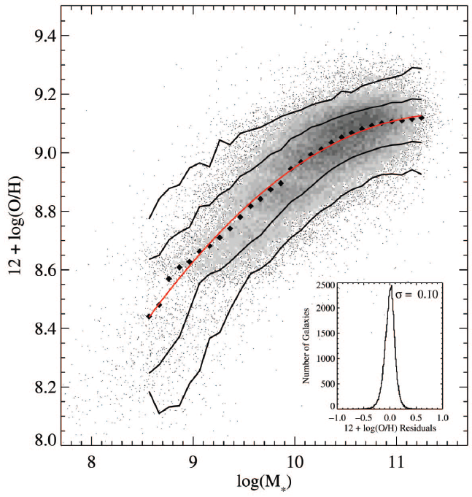
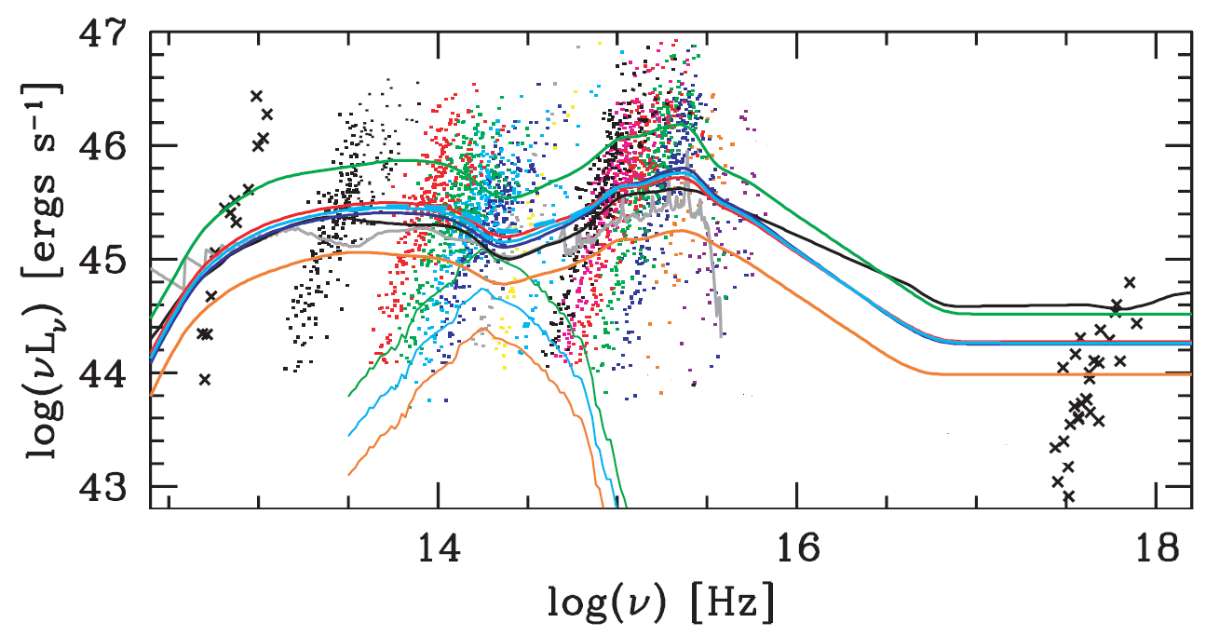
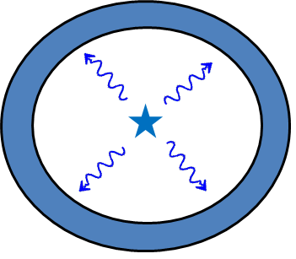
Why model photo-ionized gas?
Constrain gas properties: ${Z, n}_{H}$
Constrain unobservable $1−15 Ryd$ emission
Accretion disks
Hot stars
Constrain stellar feedback models
Ionization state reflects ratio of radiation pressure $(P_{rad})$ to pressure of expanding hot gas ($P_{hot})$ (Yeh & Matzner 2012)
Gas Metallicity
?
HII
Stellar Mass
Hot gas
$${(P}_{hot})$$
Tremonti+04
Richards+06
$$P_{rad}$$
1. Intro: photo-ionized gas systems and why we model them
Notes:
So we saw which kinds of photo-ionized gas systems exist,, but why should we want to model them?
So one reason is to constrain the gas properties such as Z and n.
You can then derive relations like this relation between the galaxy mass and the host metallicity.
This is a standard SDSS paper with 1400 citations which shows the increase of gas metallicity with host mass
The metallicity here is based on modelling the photo-ionized gas from star forming regions in the host galaxy
Another reason is to model photo-ionized gas is to constrain the ionizing emission at 1-15 ryd, which is not directly observerable due to HI in the host galaxy.
We can use the modelling of the photo-ionized gas to derive constraints on models of hot stares and models of quasar accretion disks
And a third reason which only recently has been appreciated, is that emission lines from photo-ionized gas can be used to constrain radiation pressure feedback of stars on the moclecular cloud which they formed in.
Feedback models basically say that the star formation is regulated due to some coupling between the newborn stars and the surrounding cloud of gas
So the argument made by Christopher Matzner and his student Sherry Yeh in 2012 was that the ionization state of the surrounding gas is sensitive to whether the coupling mechanism is radiation pressure or something else.
So I’ll return to to this point when I discuss the implications of my result

Slide 7
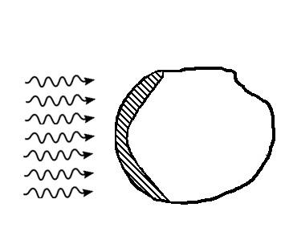
How do we Model Photoionized Gas?
Parameters
Spectral shape $(α_{ion})$
Ionizing photon flux $φ_{i}$
Gas density $n_{H}$
Metallicity Z
Column density $N_{H}$
(or $𝓤≡\frac{φ_{i}}{n_{H}c}$)
$$φ_{i}, α_{ion}$$
$${Z,n}_{H},N_{H}$$
Equations
Local Ionization Equilibrium
Local Temperature Equilibrium
Radiation Transfer
Result:
emission line / absorption line spectrum
Codes: CLOUDY, MAPPINGS, TITAN, XSTAR, ION, …
Notes:
So I want to give a quick overview on how we model systems of photo-ionized gas
We have a radiation field which is incident on a cloud of gas
In this picture the radiation source is far away so the incident radiation is plane parallel
And we characterize the incident radiation with the spectral shape and the flux of the ionizing photons.
By far the most important characterisic of the spectral shape is the slope of the ionizing spectrum called alpha_ion, so I’ll treat the spectral shape here on as a single parameter.
We characterize the cloud with its metallicity and gas density, and if the gas is optically thin we also need to state its column density.
We use these five free parameters as input to the equations which are LIE, LTE and RT, and the results is emission line or absorption line spectrum which we compare with the observations.
There are several codes to do this, by far the most popular is Cloudy, but there are also MAPPINGs, and if you model X-ray lines you also have Xstar and TITAN.
The different codes differ in the atomic physics and the solving scheme, but essentially they all use these five parameters and these three equations
I’ll also add that instead of characterizing the radiation by its absolute photon flux, its more useful to use the ionization parameter, which is the unit-less ratio of the photon flux to the gas density.
This is what we do for the constant gas pressure or constant density models.
We solve the local ionization and temperature equilibrium and radiation transfer models equations.
<click> The parameters for these equations are the gas composition, the spectrum of the incident radiation, the AGN luminosity
Also, we have to know the distance of the slab from the source, or sum up an ensemble of slabs with a distribution of radii
Similarly, in the constant pressure or constant density models we have to assume the gas density or gas pressure, which can have a distribution at each distance
<click> we have reasonable estimates for some of these parameters
The composition, at least in the NLR, seems to be similar to the ISM composition of inactive galaxies. This is part of a previous work I did.
The incident spectrum and luminosity can be constrained from observations
And the distance can be resolved, or in gas near the nucleus we can know it from reverberation mapping
The gas pressure or density distribution is a free parameter.
<click> In the radiation pressure confined models, we add the hydrostatic equation, and the gas pressure is no longer a free parameter.
The gas pressure now has a fixed profile, which ends at a gas pressure equal to the initial radiation pressure.
<click> So if we have an estimate of the radius, the RPC models have essentially no free parameters.

Slide 8
A Puzzle: Small Dispersion in Line Ratios
System: AGN Narrow Line Region
$$𝒰$$
Small dispersion suggests a small range in $𝓤≡\frac{φ_{i}}{n_{H}c}$
$$α_{ion}$$
$$𝒰$$
AGN observations
Why is there a universal $𝒰$?
or How does $n_{H}$ know about $φ_{i}$?
SF
$$(Z=2)$$
Data (type 1 AGN) from Stern+13
Notes:
Ok, so we are armed with our photo-ionized models, let’s compared them to the observations.
Let’s start with the narrow line region in AGN, I remind you the NLR is the most distant clouds which absorb the quasar radiation.
This plot is called the first BPT plot, its a comparison of two line ratios, [NII]/Ha vs. [OIII]/Hb.
The dots are observations of AGN and the lines are the models
Ionization parameter increases from here to here, while the spectral slope becomes harder from here to here.
First you can see that the models don’t cover all the observations, but that is not considered a problem, since SF galaxies with the same metallicity as AGN appear here, and therefore this sequence is assumed to be a super-position of the contribution from the AGN and the SF galaxy.
But something else is very clear in the plot – the line ratios permitted by the models span a much larger range than seen in the observations.
You can see that all objects have a similar value of U, the different objects span roughly a factor of 3 in U.
For some reason there is a preferred U in the system.
Now remember that one of our assumptions in the model was that the gas density and photon flux are independent free parameters.
This plot suggest that they are somehow linked, i.e. somehow the gas density knows about the photon flux.
We expect
This is a plot of AGN optical narrow line ratios by Brent Groves.
You can see that all AGN cluster here,
while the models give a large range of possible narrow line ratios
<click> So why are AGN emission line ratios so constant?
There must be some basic physical mechanism which is from our models.

Slide 9
A Puzzle
System: AGN
Broad Line Region
$$\frac{n_{CIV}}{n_{CIII}}\sim \frac{𝒰}{0.1}$$
$→𝓤\sim 0.1$ independent of $L_{AGN}$
a range
of 10⁶
in L_{AGN}
Why is there a universal $𝒰$?
or How does $n_{H}$ know about $φ_{i}$?
Dietrich+02

Slide 10
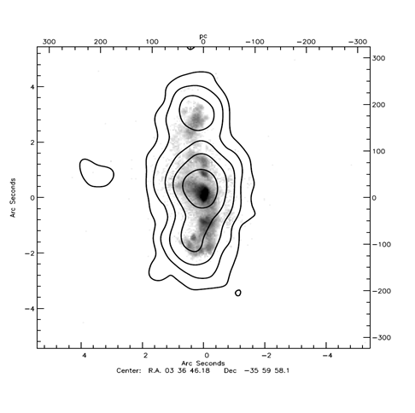
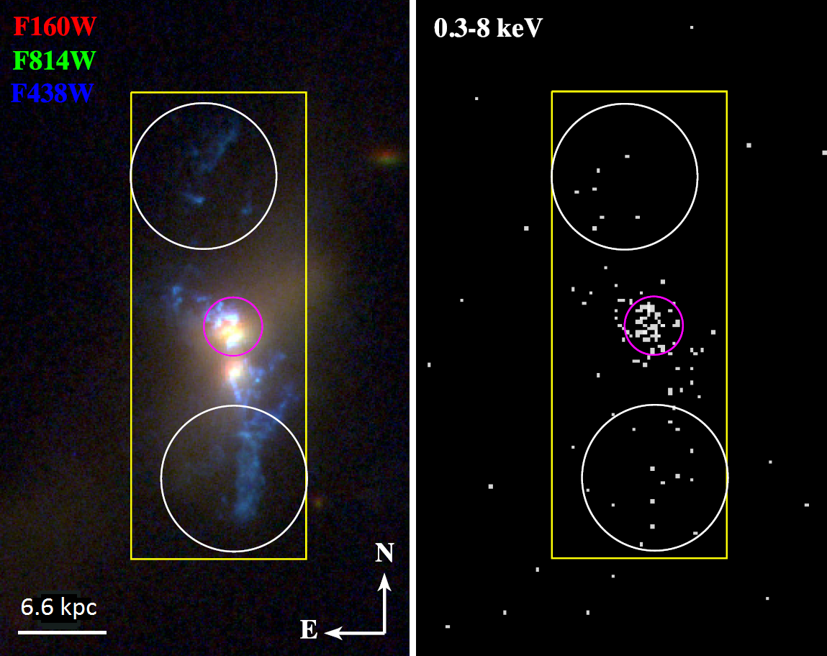
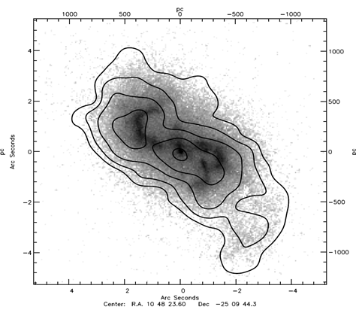
A Bigger Puzzle: Co-spatial X-ray Lines
System: AGN
Narrow Line Region
Narrow Line Region in AGN
NGC 1386
Image:
[OIII]
Contours:
X-ray lines
(OVII – FeXXI)
Greene et al. (2014)
100 pc
NGC 3393
Bianchi & Guainazzi (2007)
400 pc
Notes:
Here are the observations
You see here an HST image of [OIII], and on top of it contours of the soft x-ray emission.
In these objects the central source is obscured, so the direct soft X-ray emission is obscured.
From the X-ray spectra of these objects, we see that the X-ray emission is dominated by emission from photoionized gas with very high ionization – ionization potentials of keV.
You see a strong correlation between HST and Chandra, even in the small features, despite that [OIII] is 35eV while the X-ray lines are keV.
This is exactly what you expect from RPC
(read Guianazzi&Bianchi 374..1290)
Questions:
These are obscured AGN, so only extended X-ray emission is seen. How do we know extendedX-ray emission is lines – spectra.
X-ray spectra of photoionized gas has 2 distinction from T-I equilibrium gas:
It shows only recombination and resonance lines – the gas is too cold for X-ray collision lines.
The recombination lines from free electrons are narrow, because KT<<I (relevant to AGN, which has v widths? Kinkhabwala say they manage to measure the T)

Slide 11
A Bigger Puzzle: Co-spatial X-ray Lines
integrated data from Bianchi+07, Greene+14
$$𝒰 =10$$
$$𝒰 =1$$
$$𝒰$$
$$𝒰 =0.01$$
$$𝒰 ={10}^{−3}$$
Inconsistent with a single-$𝒰$ model $→$ requires high-$𝒰$and low-$𝒰$`phases’
2-phase models are consistent with the whole screen
So why is there a constant ratio of high-$𝓤 to$ low-$𝓤$ gas?

Slide 12
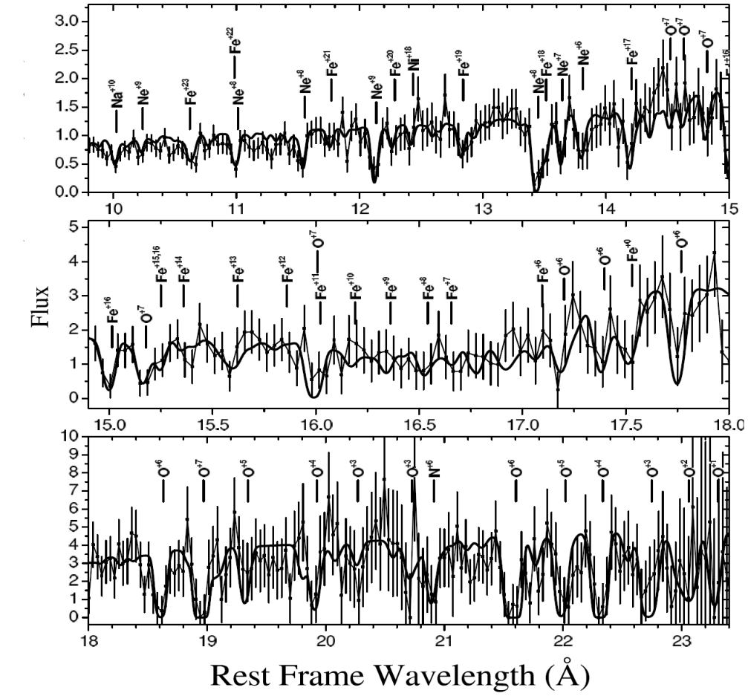
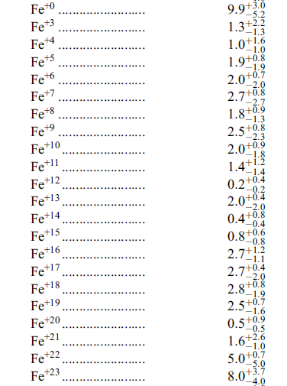
A Bigger Puzzle: X-ray Lines
System: AGN X-ray absorbers
X-ray Spectrum:
Column densities $({Fe}^{+0}−{Fe}^{+23})$:
Ion
$N_{ion}/{10}^{16}$ ${cm}^{−2}$
Holczer+2007, IRAS 13349+2438, 300ks HETGS
Notes:
* Note all ionization states are observable

Slide 13
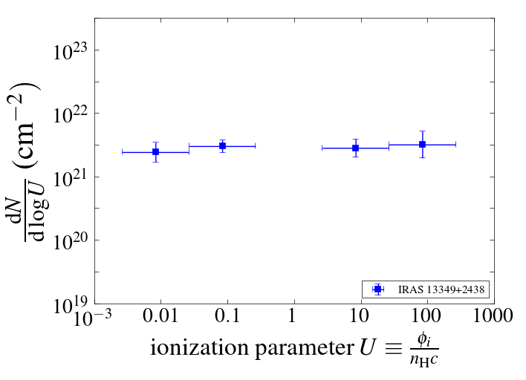
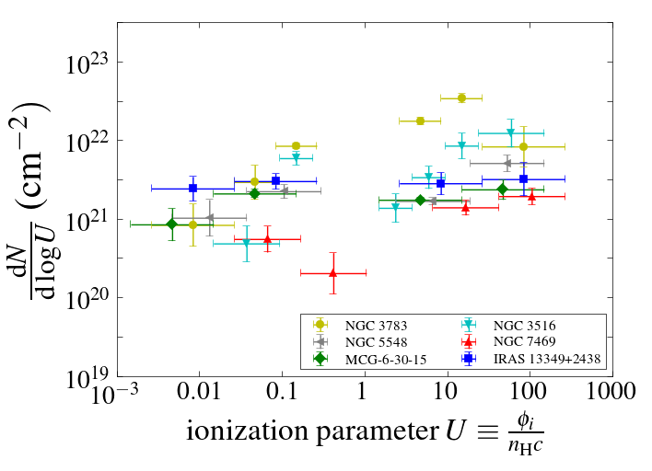
A Bigger Puzzle: X-ray Lines
System: AGN X-ray absorbers
Column densities $({Fe}^{+0}−{Fe}^{+23})$:
Ion
$N_{ion}/{10}^{16}$ ${cm}^{−2}$
Behar+09
8-10(!) free parameters with const-$n_{H}$models
So why do all objects have
$\frac{dN}{dlog 𝒰}≈{{10}^{21.5}𝒰}^{0−0.4}$?

Slide 14
Mid-Summary: The Puzzle
Photoionized Gas Models:
Independent free parameters - ${n_{H}, φ}_{i}$
The Puzzle (BLR, NLR):
Optical line ratios: a dominant $𝒰≡\frac{φ_{i}}{n_{H}c}$
$→ n_{H}$ not independent of $φ_{i}$
Including X-ray lines: a universal $𝒰$-distribution
$\frac{dN}{dlog 𝒰}≈{{10}^{21.5}𝒰}^{0−0.4}$

Slide 15
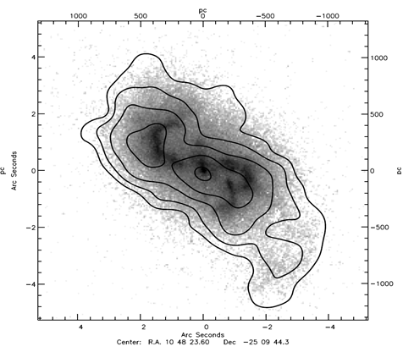
Possible Solution #1: LOC (Locally Optimal emitting Clouds) (Baldwin+95, Ferguson+97)
The model:
Numerous clouds with different $n_{H}$ (and $𝒰$)
Each line is emitted from the cloud which maximizes the line emission
Explains:
Preferred $𝒰$, as a selection effect
Can’t Explain:
$L_{U∼0.01}≫L_{U≫0.01}$ $→$ The system has a dominant $𝒰$
Constant ratio of low-𝒰 to high-𝒰 clouds
Notes:
So actually the problem of the preferred U and the small dispersion is often considered a solved problem.
And the proposed solution, which was suggested in the 90’s go as follows.
In each object we observed the sum of emission of clouds with a large range of n, and therefore also a large range of ionization parameters.
Each line is preferrably emitted from the clouds which maximizes the line emission
Therefore when we look at a specific line – we will derive the U which maximizes the line emission.
So essentially the observation of a preferred U is a selection effect according to the lines we are observing.
It’s a very intuitive solution, and that’s why most people accept it as the solution.
But it has two main failures

Slide 16
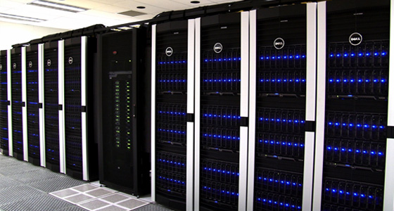
Possible Solution #2: Radiative Transfer + Hydrodynamics (e.g. Krumholz+13, Proga+14, Namekata+14)
Highly dynamic systems → hydro sims are apparently required
Problems:
CPU intensive → radiation transfer is approximate
Hydrodynamics → more free parameters in contrast with gas uniformity
Notes:
How do we study such systems where radiation is incident on gas
There are two approaches
One is using constant density radiation transfer simulations.
The most popular code to do this is Cloudy.
<click> these codes assume temperature and ionization equlibirium,
And treat the gas density or the gas pressure as a free parameter.
The advantages of these codes is that they can predict very accurately the expected emission spectrum, which can then be compared with observations
However, these calculations can’t tell you about the system evolution or about the confinement of the gas, because they assume some density or density distribution.
The second approach is doing hydrodynamical simulations
<click> however, due to computational issues, we currently can’t do hydrodynamics together with full radiative transfer, so the radiative transfer currently implemented in these codes is very approximate.
Therefore, while these codes can follow the evolution of systems, its hard to compare predictions with observations

Slide 17
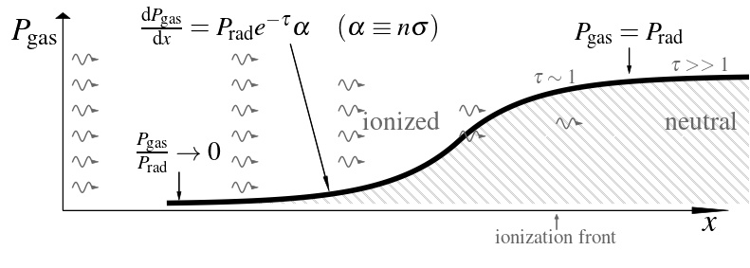
The Proposed Solution: Radiation Pressure Confinement (RPC) SF: Mathews 67; Pellegrini+07,09; Draine 11; Yeh&Matzner 12 AGN: Pier&Voit 95; Dopita+02; Różańska+06; Stern+14a,b; Baskin+14a,b
${\frac{F_{rad}}{c}≡P}_{rad}≫P_{gas,0}$
Self-gravity is negligible
Quasi-hydrostatic
Radiation is dominant force
Radiation compresses the gas.
Something absorbs the momentum
Notes:
Note on what absorbs P_rad – inertia, or ram pressure on the shielded side
So about a decade ago, Mike Dopita and Brent Groves came with an idea.
Let’s assume that radiation is the dominant force acting on the gas in the cloud’s rest frame,
and that the ambient pressure is much lower than radiation pressure.
In this case, the Radiation Pressure confines the gas, that is the gas is radiation pressure confined or RPC for short.
This is the implied pressure profile
The radiation comes from far away, so it is plane parallel
The gas pressure starts at some very small value.
The radiation is absorbed in the surface layer of the gas, both ionizing it and compressing it.
As the radiation is absorbed, it compresses the gas, increasing its pressure
At tau near one, the gas pressure roughly equals the radiation pressure
At tau of several, all the radiation is absorbed, and there is a transition to neutral gas. This layer where tau is of order 1 1 is called the ‘ionization front’.
What Dopita and Groves shows was that at the ionization front, where tau is about 1 and most of the absorption occurs, the equality of gas pressure and radiation pressure implies that the ionization parameter is 0.03.
<click> So if radiation pressure is the source of confinement, we expect the dominant ionization parameter to be 0.03, as observed.

Slide 18
RPC Properties: Ionization Front
$P_{gas}=P_{rad}=\frac{F_{rad}}{c} →$
$2n_{H}kT=φ_{i}\frac{{\left\langle hν\right\rangle }_{i}}{c}(1+β)$
additional pressure
from optical photons
$$→𝒰≡\frac{φ_{i}}{n_{H}c}=\frac{2kT}{{\left\langle hν\right\rangle }_{i}\left(1+β\right)}≈0.03\left(\frac{T}{{10}^{4}K}\right){\left(\frac{β}{2}\right)}^{−1}{\left(\frac{{\left\langle hν\right\rangle }_{i}}{36eV}\right)}^{−1}$$
Most of the energy absorbed (and released) a$t 𝓤≈0.03$
Notes:
So about a decade ago, Mike Dopita and Brent Groves came with an idea.
Let’s assume that radiation is the dominant force acting on the gas in the cloud’s rest frame,
and that the ambient pressure is much lower than radiation pressure.
In this case, the Radiation Pressure confines the gas, that is the gas is radiation pressure confined or RPC for short.
This is the implied pressure profile
The radiation comes from far away, so it is plane parallel
The gas pressure starts at some very small value.
The radiation is absorbed in the surface layer of the gas, both ionizing it and compressing it.
As the radiation is absorbed, it compresses the gas, increasing its pressure
At tau near one, the gas pressure roughly equals the radiation pressure
At tau of several, all the radiation is absorbed, and there is a transition to neutral gas. This layer where tau is of order 1 1 is called the ‘ionization front’.
What Dopita and Groves shows was that at the ionization front, where tau is about 1 and most of the absorption occurs, the equality of gas pressure and radiation pressure implies that the ionization parameter is 0.03.
<click> So if radiation pressure is the source of confinement, we expect the dominant ionization parameter to be 0.03, as observed.

Slide 19
RPC Properties: The Surface Layer
$$P_{gas}↑,T↓ ⇒ n_{H}↑↑, 𝒰↓↓$$
a large range of $n_{H}$ and $𝒰$ in a single slab
Analytic solution:
(Stern+14b)
Emission Measure Distribution: $\frac{dL}{d\log{𝒰}}∝𝒰^{−0.9}$ (for $𝒰>0.03)$
Absorption Measure Distribution: $\frac{dN}{d\log{𝒰}}≈{10}^{22}𝒰^{0.1} cm^{−2}$
Notes:
So about a decade ago, Mike Dopita and Brent Groves came with an idea.
Let’s assume that radiation is the dominant force acting on the gas in the cloud’s rest frame,
and that the ambient pressure is much lower than radiation pressure.
In this case, the Radiation Pressure confines the gas, that is the gas is radiation pressure confined or RPC for short.
This is the implied pressure profile
The radiation comes from far away, so it is plane parallel
The gas pressure starts at some very small value.
The radiation is absorbed in the surface layer of the gas, both ionizing it and compressing it.
As the radiation is absorbed, it compresses the gas, increasing its pressure
At tau near one, the gas pressure roughly equals the radiation pressure
At tau of several, all the radiation is absorbed, and there is a transition to neutral gas. This layer where tau is of order 1 1 is called the ‘ionization front’.
What Dopita and Groves shows was that at the ionization front, where tau is about 1 and most of the absorption occurs, the equality of gas pressure and radiation pressure implies that the ionization parameter is 0.03.
<click> So if radiation pressure is the source of confinement, we expect the dominant ionization parameter to be 0.03, as observed.

Slide 20
RPC Models of Photo-ionized Gas
Codes: CLOUDY, MAPPINGS, TITAN , XSTAR, ION, …
Parameters
Ionizing photon flux $φ_{i}$
Spectral shape
Metallicity Z
Gas density $n_{H}$
Column density $N_{H}$
$$φ_{i},$$
$$spectrum$$
$${Z,n}_{H},N_{H}$$
set by $φ_{i}$ ; range of $n_{H}$ per slab
Result:
specific emission line / absorption line spectrum
Equations
Local Ionization Equilibrium
Local Temperature Equilibrium
Radiation Transfer
Hydrostatic equilibrium
Notes:
Now let’s see what exactly we do in our numerical calculation
To calculate the ionized slab structure, we need to solve the differential equations.
This is what we do for the constant gas pressure or constant density models.
We solve the local ionization and temperature equilibrium and radiation transfer models equations.
<click> The parameters for these equations are the gas composition, the spectrum of the incident radiation, the AGN luminosity
Also, we have to know the distance of the slab from the source, or sum up an ensemble of slabs with a distribution of radii
Similarly, in the constant pressure or constant density models we have to assume the gas density or gas pressure, which can have a distribution at each distance
<click> we have reasonable estimates for some of these parameters
The composition, at least in the NLR, seems to be similar to the ISM composition of inactive galaxies. This is part of a previous work I did.
The incident spectrum and luminosity can be constrained from observations
And the distance can be resolved, or in gas near the nucleus we can know it from reverberation mapping
The gas pressure or density distribution is a free parameter.
<click> In the radiation pressure confined models, we add the hydrostatic equation, and the gas pressure is no longer a free parameter.
The gas pressure now has a fixed profile, which ends at a gas pressure equal to the initial radiation pressure.
<click> So if we have an estimate of the radius, the RPC models have essentially no free parameters.

Slide 21
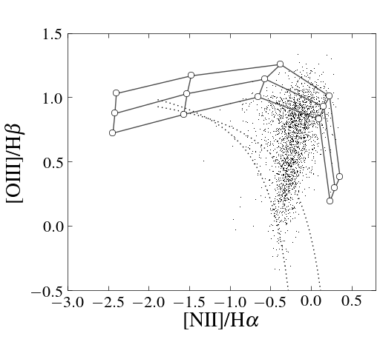
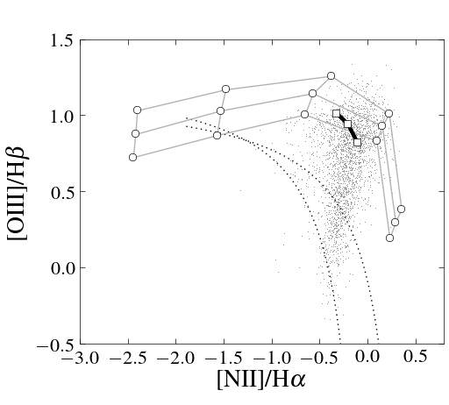
RPC: Comparison with Observations
System: AGN Narrow Line Region
$$0.01$$
RPC
Models
$$Z=2,η=0$$
$$0.1$$
$$𝒰 =1$$
$${10}^{−3}$$
$${10}^{−3.5}$$
Contribution from SF?
constant-$n_{H}$ models
$$Z=2,n_{H}=1000$$
constant-$n_{H}$ models
$$Z=2,n_{H}=1000$$
SF
$$(Z=2)$$
Data (type 1 AGN) from Stern+13 RPC models from Stern+14a (see also Groves+04)

Slide 22
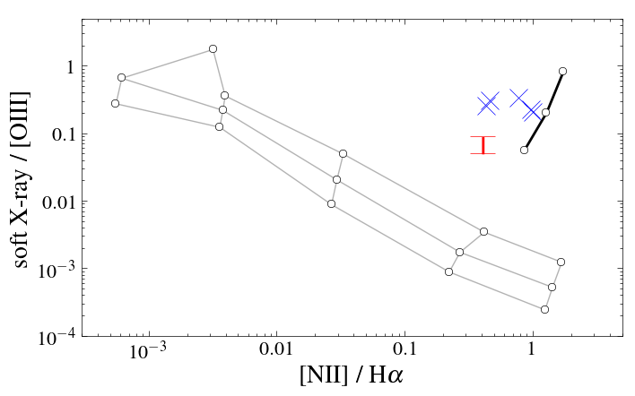
RPC: Comparison with Observations
System: AGN Narrow Line Region
RPC
Models
$$𝒰 =10$$
$$𝒰 =1$$
$$𝒰 =0.1$$
constant-$n_{H}$
models
constant-$n_{H}$
models
$$𝒰 =0.01$$
$$𝒰 ={10}^{−3}$$
Stern et al., in prep.

Slide 23
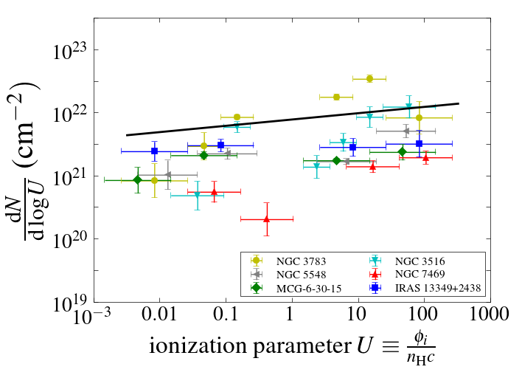
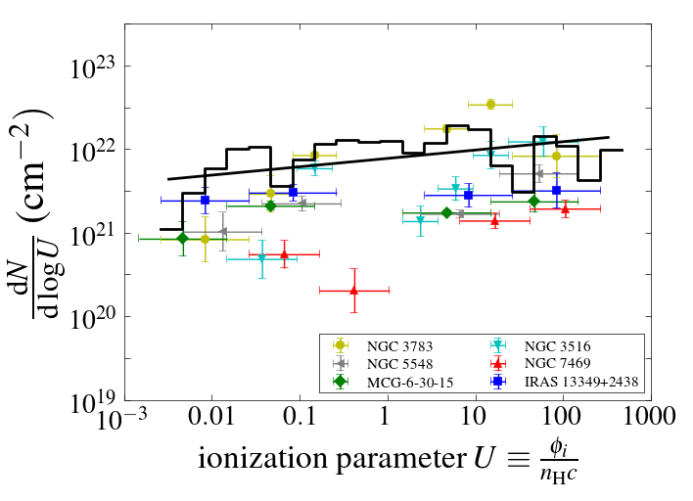
RPC: Comparison with Observations
Predicted Absorption Measure Distribution: $\frac{dN}{d\log{𝒰}}≈{8x10}^{21}𝒰^{0.1} cm^{−2}$
System: AGN X-ray absorbers
RPC(CLOUDY)
Column densities $({Fe}^{+0}−{Fe}^{+23})$:
Ion
$N_{ion}/{10}^{16}$ ${cm}^{−2}$
Stern+14b
8-10(!) free parameters with const-$n_{H}$models
0 free parameters with RPC

Slide 24
RPC: Comparison with Observations
NGC 3783
Direct fit to ion column densities
(using TITAN)
cold RPC solution
hot RPC solution
data
Goosmann+ in prep.

Slide 25
RPC: Comparison with Observations
NGC 1068
RPC predicts
$$\frac{dL}{d\log{𝒰}}∝𝒰^{−0.9}$$
as observed!
$$\frac{dL}{d\log{𝒰}}∝𝒰^{−1}$$
Ogle et al. (2003)

Slide 26
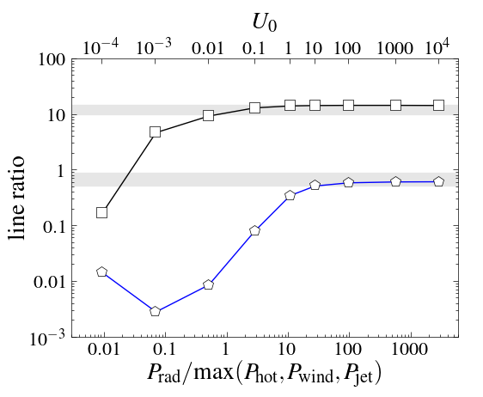
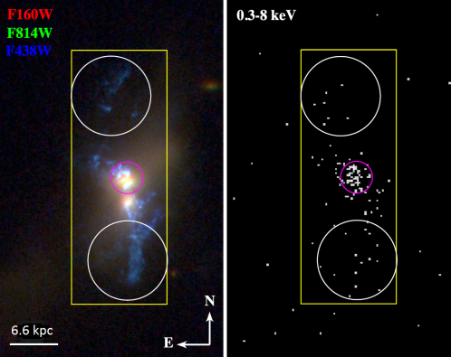
RPC Implications: Quasar Feedback
1$1 z\sim 0.5$quasars $(<10kpc)$
(Liu, Zakamska, et al. 2013)
[OIII]/Hβ
Soft X-ray / [OIII] (x10)
Greene+14
$\frac{\left[OIII\right]}{Hβ}$ suggests $\frac{P_{rad}}{P_{other}}>0.4$
$\frac{X−ray}{[OIII]}$ suggests $\frac{P_{rad}}{P_{other}}>10$
RPC limit
Line ratios suggest
radiation dominates
quasar-ISM coupling
Stern, Faucher-Giguère,
Zakamska, in prep.
e.g. pressure of expanding
hot gas bubble
Notes:
So what are the implications of RPC to quasar feedback models?
So quasar feedback is similar to stellar feedback in the sense that the quasar somehow couples to the ISM of the host galaxy and therefore regulates SF.
the x-axis here is the ratio of the radiation pressure to the pressure of the ambient gas
<click> and for example in feedback models that the quasar is surrounded by an expanding bubble of hot gas which clears out the ISM, the pressure of the bubble will equal the pressure of the ambient gas.
The RPC solution is in the limit that this ratio goes to infinity
What are the observations?
<click> the top grey stripe are resolved observations of [OIII]/Hb in 11 quasars on kpc scales from Zakamska’s group
You see that these [OIII]/Hb observations suggest radiation pressure is at least comparable to other sources of pressure
The bottom grey strip is the Jenny Greene observation of the X-ray/[OIII] ratio that I showed you in the beginning. It is still an open question whether the X-ray emission here is from photo-ionized gas, but if it is, its suggest that radiation pressure dominates other coupling mechanisms by a factor of at least 10.
<line ratios suggest that radiation dominates quasar-ISM coupling.

Slide 27
RPC: More Implications
Constraining $α_{ion}, Z$:
One less free parameter $→$ stronger constraints (see Dopita et al. 2014)
Molecular gas:
Also in pressure equilibrium with the radiation? $→G/n$ is not a free parameter
$$HII$$
$${HI, H}_{2}$$
$$P_{gas}=P_{rad}$$
$$?$$

Slide 28
Summary – Radiation Pressure Confinement
Constant-$n_{H}$ models raise a puzzle:
Why do photoionized gas systems have a dominant $𝒰≡\frac{φ_{i}}{n_{H}c}$ ?
Why is the $𝒰$–distribution universal?
A possible solution:
Radiation Pressure Confinement: pressure equilibrium with incident radiation
Implications:
Radiation pressure dominates coupling of quasar to host ISM

Slide 29
Implications: Star-Forming Regions
SF: no sensitivity to high-$𝒰$ states
data
Small dispersion suggests a small range
in $𝓤≡\frac{φ_{i}}{n_{H}c}$ at each Z
open problem since Dopita & Evans (1986)
const’-$n_{H}$ models
Levesque+10
Notes:
This is the same plot for SF galaxies.
This is the spread in the models, while these are the observations.
Again, the implied small dispersion suggests that at each Z, there is a small range of U.
Why should objects with the same Z have the same U?
5. How does n know about phi?
This is a plot of AGN optical narrow line ratios by Brent Groves.
You can see that all AGN cluster here,
while the models give a large range of possible narrow line ratios
<click> So why are AGN emission line ratios so constant?
There must be some basic physical mechanism which is from our models.

Slide 30
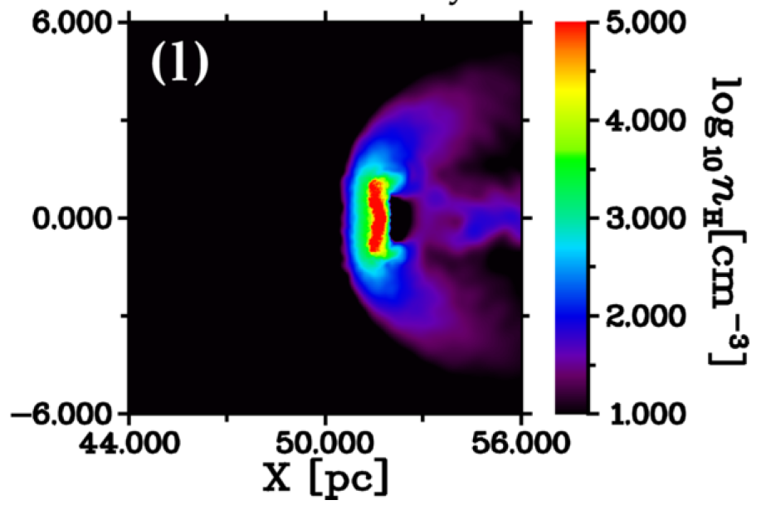
RPC: Hydrodynamical stability
Rayleigh-Taylor
Illuminated side: stable. (tenuous gas ‘above’ dense gas)
A cloud pushed against a low density medium: unstable. (but possibly $τ_{RT }>τ_{sound}$)
Hydro-simulation: (Namekata+14)
Much more work to do
Notes:
One question that always arise when people think about radiation pressure is whether the solution is stable.

Slide 31
(Chandra HETGS, 300ks, 6-23Å, FWHM=23mÅ)
Notes:
1. Here I plotted the Fe ionization state vs. the ionization parameter
2. You can see that if you see you see a specific ionization state of Fe, you can estimate the ionization parameter
3. Now this is the measurement of a specific object
4. You can see there is no way you can model the absorbing gas as a slab with a single ionization parameter

Slide 33
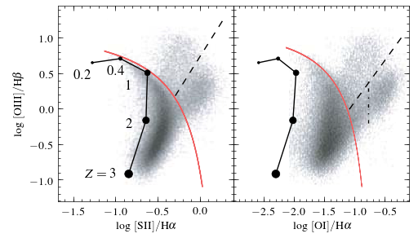
RPC in SF Galaxies (Very Preliminary)
1st BPT plot:
Other BPT plots:
Caveat: assumed spectral shape

Slide 34
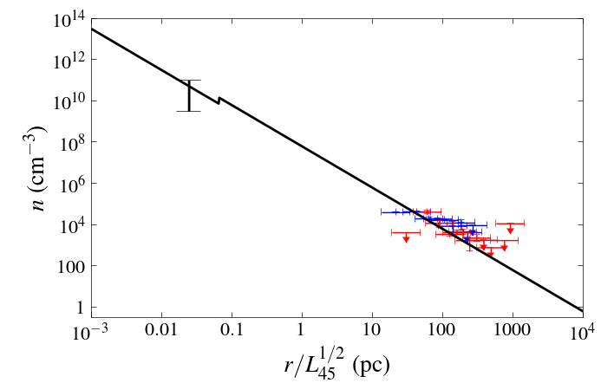
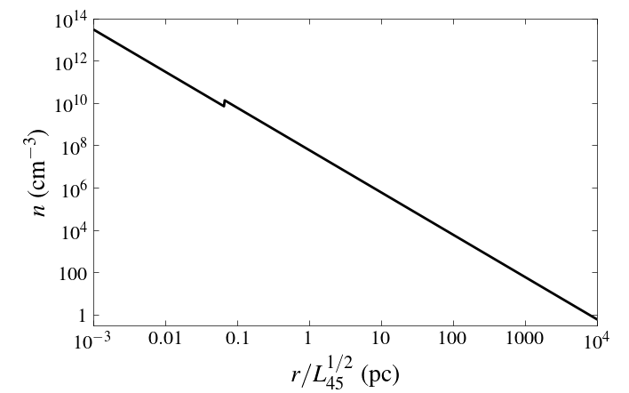
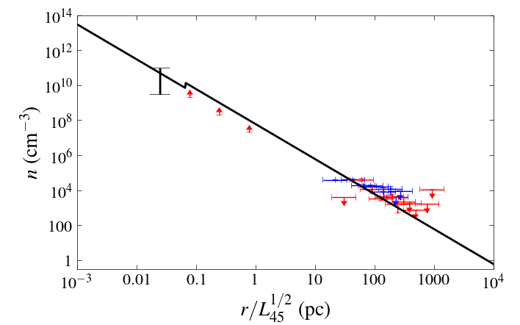
RPC: Quasar Feedback
$$n\left(τ\sim 1\right)=6{⋅10}^{7}L_{45}r_{pc}^{−2}{cm}^{−3}$$
BLR
Torus
NLR
extended NLR
reverberation
$$(L={10}^{40}−{10}^{47})$$
thermalization
?
?
resolved
Dust suppression (Pier&Voit95)
$P_{gas}$ set by $P_{rad}$
Gas density is set by radiation pressure at 0.01 pc - kpc
Notes:
1. So lets compare P_gas and P_rad in the observations
2. So what we can measure from the emission lines is the gas density
3. If gas pressure equals the radiation pressure, we get that the density equals the radiation pressure divided by 2kT.
4. Now, near the ionization front, the temperature is about 10^4K,
5. so, I put in the expression for the radiation pressure and 10^4 for the temperature, and we get a specific expression for the density, which scales with the luminosity and the radius to the power of -2.
6. So the dotted line is the analytical expression, while the solid line is what you get from a full radiative transfer calculation.
7. Now lets see the observations
8. The hard part in the observations is getting the distance of the gas, so there are several methods to do this
9. <click> these data points are based on resolved observations of the NLR in nearby Seyferts using HST. There are two objects here, each color is a different object.
10. <click> This is the average result from reverberation mapping of the BLR.
11. the BLR has the property that r scales as the luminosity to the power of a half, so in this plot it always appears here, independent of the AGN luminosity
12. And the error bar spans the range of densities roughly allowed by the models
13. <click> Another way to get the distance is to assume that gas within the sphere of influence of the black hole is in virial motion, so you can derive the distance from the M_BH and width of the emission lines.
14. These observations depend on the M_BH estimate, so the error-bars are very large.
15. But in general you see that the observations match the predictions quite well, over 4 orders of magnitude in distance from nucleus.
16. I’d say that this is very strong evidence that density of the host gas is determined by the AGN radiation pressure.

Slide 35
RPC: AGN Narrow Line Region
Constant $𝒰\left(τ\sim 1\right) → n_{H}\left(τ_{i}\sim 1\right)=6{⋅10}^{7}L_{45}r_{pc}^{−2}{cm}^{−3}$
a measure of gas density
NGC 4151
NGC 3227
[O I] / [SII]
[O I] / [SII]
1 10 100
1 10 100
r (pc)
r (pc)
[SII] 6716/6731
Stern+14a
HST data from Kraemer+00, Walsh+08
[SII] 6716/6731
1 10 100
r (pc)
no free parameters!
HST data from Kraemer+00, Walsh+08
1 10 100
r (pc)
Notes:
Q: How does a a different density profile look like – normalization is well constrain, power law less (-1 – 3) are ok
Q: both objects are Seyfert 1.5? yes
Walsh08 on central point: geometric rectification issues during the data reduction
Lets also compare the predicted density with resolved observations of the NLR.
The best way to measure the density of the lines is to compare the strength of forbidden lines with different critical density.
This is distance vs. [OI]/[SII] ratio, which differ by a factor of 1000 in critical density.
The data here is from HST, NGC 4151 is from Kraemer et al. 2000 and NGC 3227 is from Walsh et al. 2008.
The solid line is the RPC calculation using Cloudy, in which we plugged the observed luminosity.
The range in the fit is due to the uncertainty in the intrinsic luminosity.
You see that except the central measurement, the fit is good.
I stress that there is no free parameters in this fit, the only parameter is the luminosity, which we know.

Slide 36
How can the ionization state inform us on feedback (Yeh&Matzer12)?
Ionization state is set by: $𝒰≡\frac{φ_{i}}{nc}$
Which is related to:
$Ξ≡\frac{P_{rad}}{P_{gas}}=\frac{φ_{i}{\left\langle hν\right\rangle }_{i}/c}{2nkT}$=$𝒰⋅\frac{{\left\langle hν\right\rangle }_{i}}{2kT}$
Assuming $P_{gas}$ is set by confinement mechanism, then $Ξ$ measures the ratio of radiation pressure to other confining mechanisms. confiniP_gas isTwo models of feedback:
Expanding wind
Radiation pressure driven

Slide 37
RPC: Numerical Solution
not RPC P_{gas}(0)>P_{rad}
U₀
ionization front (x_{f})
illuminated
surface
0.01
0.1
1
10
RPC solution is independent of n₀ or U₀
100
1000
1000
100
10
1
0.1
0.01
Notes:
I want to stress the fact that the initial density or initial ionization parameter are not free in RPC models.
These are Cloudy solutions of models with different initial density.
The photon density is the same, so these models also differ in their initial ionization parameter, which is stated here
The models include ionization parameters from 10^-2 to 10^3
We see here the calculated density and T vs. distance from the illuminated surface of the slab.
You see the different models have similar behavior, at some point the density starts to increase.
The line ends at the ionization front
You see that regardless of what was the initial density, the density at the ionization fronts is the same, except in the U_0=0.01 model, which I’ll return to in a second.
You can also see that the final T is always 10^4.
But now, let’s look at these models vs. the distance from the ionization front <click>
So now the x-axis is the distance from the ionization front
The vertical bars mark the start of the different models.
All the models except the top model line on the same density and temperature profile.
The models differ only in their starting point.
Since as you go to lower initial densities, you are adding only optically thin layers at the surface, they do not affect the rest of the solution.
<click> The model with U_0=0.01 has initial gas pressure which is larger that the radiation pressure, implying that it is not RPC, something else is doing the confinement
<click> RPC models with different n_0 or U_0 have the same solution, implying U0 or n0 are not a free parameter.

Slide 38
Type 2 quasars (Liu+13)
[OIII] / Hβ
1 3 10
r (kpc)
Notes:
Since the radiation pressure decreases as r^-2, at some distance we expect other pressure sources to be larger than the radiation pressure.
Here we have observations by a group at John Hopkins and Princeton, which measured the ratio of [OIII]/H-beta of very luminous type 2 quasars at redshift of 0.5.
They found that the [OIII]/Hbeta ratio is constant up to a radius of about 10 kpc, and beyond that radius [OIII]/Hbeta starts to drop.
Now,[OIII]/Hb is a measure of the ionization state of the gas
<click> In RPC we have a constant U_f, so we expect [OIII]/Hb to be constant, exactly as seen up to the break radius.
When radiation pressure drops below the gas pressure, we expect a lower ionization parameter, therefore a lower [OIII]/Hbeta, as seen beyond the break radius.
<click> so in quasars we see evidence that P_rad equals P_gas up to about 10 kpc.
At larger radii, the lower [OIII]/Hbeta indicate that P_gas is larger than P_rad, which means there is another source of pressure on the gas which is stronger than the radiation pressure.

Slide 39
RPC: The Surface Layer
$\frac{dN}{d\log{U}}=\overline{σ}{\left(U\right)}^{−1}∙\frac{T\left(U\right)}{{10}^{4}K}∙{\left(\frac{U}{0.03}\right)}^{−1}∙\left(1−\frac{d\log{T}}{d\log{U}}\right)$
What are $\overline{σ}(U)$ and $T(U)$?
At $U=1000$, the gas is fully ionized, so $\overline{σ}=σ_{Thompson}={10}^{−24.2}cm^{2}, T=T_{Compton}={10}^{6.5}K$
At $U=0.03$ $\overline{σ}={10}^{−22}cm^{2}, T={10}^{4}K$
Power-law interpolation (justified numerically): $\overline{σ}\left(U\right)\sim {10}^{−22}{\left(\frac{U}{0.03}\right)}^{−0.49}{cm}^{2}, T\left(U\right)\sim {10}^{4}{\left(\frac{U}{0.03}\right)}^{0.56}K$
Therefore, $\frac{dN}{d\log{U}}\sim {{4x10}^{21}\left(\frac{U}{0.03}\right)}^{0.05}$
Notes:
So this is the equation
<click> And the question is how do the opacity and temperature depend on the ionization?
So we can get the dependence of the opacity and temperature from a numerical solution, but I want to do an analytical approximation so you understand what is going on.
At very high U, the gas is fully ionized, so the opacity is dominated by electro scattering and the cooling is dominated by Compton cooling so the gas is at the Compton temperature.
At U=0.03, the opacity is roughly 50% from HI absorption and 50% from metals, so the opacity is about 10^-22 or a force multiplier of about 150.
The cooling by lines ensures that the temperature is 10^4.
So if we approximate the dependence of the opacity and the temperature as power laws, we get the following power law.
And then putting these power laws in the original equation we get that the dependence of the column density at each U on U is also a power law.
So now all we have to do is compare this power law with the observations.

Slide 40
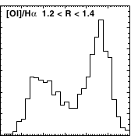
Implications: the Seyfert/LINER bi-modality
Kewley et al. (2006)
Seyferts: U_{f ~} 10⁻² also have L/L_{Edd}>10⁻³
?
LINERs: U_{f ~} 10⁻³ also have L/L_{Edd}<10⁻³
change in incident spectrum at L/L_{Edd}=10⁻³?
Notes:
Add fig from AGN3
Another possible implication of RPC is on the Syefert/LINER bi-modality
This emission line ratio diagram is called a BPT diagram
It shows narrow line ratios of emission line galaxies from the SDSS.
It was originally used to separate AGN from star forming galaxies, according to the red line.
But it was found, that the objects on the AGN side are clearly separated into two classes of objects,
<click>as can be seen from the bi-modal distribution across this line.
The top objects are called Seyferts and from modelling the ionization parameter of these objects is roughly 0.01, as expected for a typical AGN SED with RPC.
It was also found that all these objects have luminosity in Eddington units which is larger than 10^-3
The bottom objects are called LINERs, and photo-ionization modeling shows that the emission line clouds are irradiated by a lower ionization parameter, roughly 10^-3. These objects are also distinct from the Seyferts, in that they have Eddington ratios below 10^-3
<click> So we found that in RPC, the ionization parameter near the front is inverse proportional to the mean energy per ionizing photon
if LINERs are also radiation pressure confined, this means that their mean energy per ionizing photon is 10 times larger than in Seyferts
So RPC gives a quantitative relation between the incident spectrum and the ionization parameter.
Read Quataert 2001, Ferland&Netzer83
Notes:
Other classification schemes also point to harder and lower ionization
Inaccuracies:
Harder ionization is only region where T1 LINERs are.
LINER related papers - Heckman80, Ferland&Netzer83, Halpern&Steiner83, Fillipenko&Halpern84
Most BPT analyses were done on type 2s
BPT analyses of Type 1s were done only on medium-size x-ray selected samples
So this is a BPT check of a BLR-selected sample
We see here the distribution of type 2s, SF galaxies and LINERs.
These are the position of the Type 1’s
Most are consistent with the classification of Seyferts. But 9% are composites, and about 3 % are LINERs and about 1% are classified as SF.
Strong absorption cases included. Note that if increasing nHa and nHb by 0.1 dec: SF are 4%, Liners are 2.5,2.3% and composities are 15%. Liners in both are 1.6% (1.3% with 0.1 dec change).
Ho97 – 50% Seyferts, 50%LINERs; T1/Emission line galaxies 34/211 (15%-20%)
(check whether viewable in projector. Check definitions of Kewley and Kauffmann lines)
The black dashed line was calculated by Guinivere Kauffmann at 2003 so 95% of the SF galaxies at each y-axis-bin fall below it. As can be seen, it effectively excludes T1 AGNs.
The red lines are the extreme starburst lines, which purely star forming galaxies should never pass. About 15% of the T1 AGN fall below it. These are assumed to be ‘composites’ both AGNs and SF galaxies.

Slide 41
Constrain radiation pressure feedback
Only <10% of the mass of giant molecular clouds is converted into stars. Why?
Krumholz & Matzner (2009): The first stars’ radiation pressure clears the remaining gas out
Can we find signatures of this feedback mechanism?
Notes:
Elaborate according to Krumholtz&Matzner, CAFG models

Slide 42
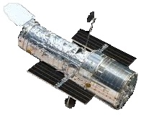
Narrow Lines
X-ray / UV
absorbers
Narrow Lines
1000 pc
Torus
Accreting
BH
10 pc
Broad Lines
distance from nucleus
0.1 pc
Notes:
Add NLR, BLR,torus designations
Denote X-ray absorbers
Add picture for HII region
Note title with continuous dust distribution.
So this is an illustration of the reflecting clouds
Forgive me for my lousy drawing capabilities
As I said before, we have a central source, some of the emission reaches us directly
Some of the emission is reprocessed by clouds from a large range of scales and then reaches us.
Usually AGN-ists divide these clouds into different groups – broad line region, torus, narrow line region. I’m going to disregard this division, and treat the gas distribution as continuous in r.
Also, I’m not going to say anything about the geometry of the clouds, I’m focusing on their distance from the central source.

